Slide 1
2024 VTCAP
Teacher & Proctor Training

Slide 2
Agenda
VTCAP Assessment Overview and Key Dates
Roles and Responsibilities
Test Security
Accommodations and Designated Supports
Before, During, and After Computer-Based Testing
TestNav & Student Testing Experience
Before, During, and After Print-Based Testing
Resources and Support

Slide 3
VTCAP Overview

Slide 4
VTCAP Assessments
Grades and Contents
English language arts, grades 3–9
Mathematics, grades 3–9
Science, grades 5, 8, and 11
Format
Adaptive, computer-based test (CBT) – primary mode of administration
Fixed, accommodated CBT
  ASL
  Translations (Math & Science only)
Fixed, accommodated paper-based test (PBT)
  Standard print
  Large print
  Braille (as Braille Ready Files)

Slide 5
Key Dates
Rostering window for ordering paper materials in ADAM | January 22–February 2, 2024
Rostering window for all testers | January 22–March 8, 2024
Initial order of paper-based materials arrives in schools | March 4, 2024
Additional materials ordering window | March 4–April 26, 2024
Test administration window | March 11–April 26, 2024
Make-up test administration window | April 29–May 3, 2024

Slide 6
Roles and Responsibilities
District Administrator (DA)
District Test Coordinator (DC)
School Test Coordinator (SC)
Teacher
Proctor

Slide 7
Roles and Responsibilities
The District Test Administrator (DA):
Assumes overall responsibility for implementing VTCAP assessments in their organization
Serves as the local point of contact for questions and information
Disseminates information about assessments with the district and schools
Organizes training for SCs
Creates accounts for other users within their organization
Uploads students for their organization
*Note: The DA can assign District Test Coordinators (DC) as needed to assist with their responsibilities or may also serve as the DC.

Slide 8
Roles and Responsibilities
The District Test Coordinator (DC):
Reviews schedule and testing requirements with SCs, teachers, and proctors
Works with SCs and technology staff to ensure all systems are properly installed and functioning
Creates accounts for other users within their organization
Uploads students for their organization
Schedules and administers training sessions
Ensures all personnel are trained on how to properly administer the VTCAP assessments
Monitors secure administration
Investigates and reports all testing irregularities and breaches reported by the SC, teacher, or proctor
Ensures all testing materials remain secure

Slide 9
Roles and Responsibilities
The School Test Coordinator (SC):
Coordinates the administration of VTCAP assessments within their school
Ensures testing within their school is conducted properly and securely
Establishes testing schedules
Works with technology staff to ensure all systems are properly installed and functioning
Ensures student information in ADAM is accurate
Ensures appropriate accommodations or designated supports are assigned in ADAM
Attends all district training and reviews the manuals
Ensures teachers and proctors attend training or review training modules
Monitors secure administration of the test
Monitors student test progress
Investigates and reports any test security incidents

Slide 10
Roles and Responsibilities
The Teacher and/or Proctor:
Completes all district and/or school training
Reviews the Test Administrator’s Manual (TAM)
Reviews student information prior to testing to ensure each student receives the proper test with appropriate supports.
Administers the VTCAP assessments
Reports any test security incidents to the SC or DC
Note: Proctors should be licensed school personnel
If a paraprofessional or substitute teacher must serve as a proctor, the individual must be fully trained in test administration and test security procedures. They should be monitored by a licensed teacher, principal, or other building administrator.

Slide 11
Test Security and Procedures

Slide 12
Test Security
The security of assessment instruments and the confidentiality of student information are vital to maintaining the validity, reliability, and fairness of the results. Security of test materials must be maintained before, during, and after administration.
Secure CBT test materials
Student print cards
Periodic tables written on by students
Scratch paper written on by students
Secure PBT test materials
Test booklets
Periodic tables written on by students
Scratch paper written on by students
All secure test materials must be securely destroyed by the school/district.

Slide 13
Test Security Incidents
Any breaches in test security must be immediately reported to the SC or DC. Test security incidents are categorized below:
Student access to unapproved device/material
Cheating
Sharing, posting, or copying of secure test materials (student)
Sharing, posting, or copying of secure test materials (adult)
Student engaged with incorrect assessment
  Wrong student test, incorrect grade level
Technology issue interrupting test session (unable to restart session)
All test security incidents must be reported to AOE using the Test Security Incident Form available on the Documentation and Training page of the Vermont Help and Support website.

Slide 14

Test Security Incidents
In some cases, a test security incident has a low impact on the individual or group of students who are testing and has a low risk of potentially affecting student performance on the test, test security, or test validity.
These circumstances can be corrected and contained at the local level. Such incidents do not need to be reported to the AOE.
Examples include a fire drill occurring during a test session or minor connectivity issues interrupting testing.

Slide 15
Test Security Incidents
An unusual circumstance that impacts an individual or group of students who are testing and may potentially affect student performance on the test, test security, or test validity must be reported to the AOE.
These circumstances can be corrected and contained at the local level. An irregularity must be reported to the SC and DA immediately.
Examples include more significant technology issues, students talking to each other during testing, or inappropriate assignment/use of an accommodation.

Slide 16
Test Security Incidents
In rare cases, a test security incident may pose a threat to the validity of the test. Examples may include such situations as a release of secure materials or a security/system risk.
These circumstances have implications for anyone using the test items (perhaps outside of Vermont) and may result in a decision to remove the test item(s) from the available secure bank.
Such an incident must be reported to the DC and SC immediately and must be reported to the AOE promptly.

Slide 17
Accommodations & Designated Supports

Slide 18
Universal Tools
Embedded Universal Tools
Desmos calculator
Notepad
Pop-up glossary
Highlight
Line reader mask
Answer eliminator
Writing tools
Magnifier
Zoom
Non-Embedded Universal Tools
Breaks
English dictionary (Math and Science)
Scratch paper
Thesaurus (Math and Science)

Slide 19
Designated Supports
Embedded Designated Supports
Text-to-speech (Math and Science)
Translations (Math and Science)
  Arabic (Standard MENA)
  Chinese (Simplified Mandarin)
  French
  Spanish (Nicaraguan)
  Swahili
Non-Embedded Designated Supports
Amplification
Bilingual dictionary (Math, Science, and Writing)
Color overlays
Magnification
Medical device
Noise buffers
Separate setting

Slide 20
Accommodations
Embedded Accommodations
American Sign Language (ASL)
Closed captioning
Color contrast
Speech-to-text (ELA & Science)
Text-to-speech (ELA)
Non-Embedded Accommodations
100s number table
Abacus
Alternate response options
Multiplication table
Scribe
Speech-to-text (Math)
Print-Based Accommodations
Standard print
Large print
Braille

Slide 21

Assessment Delivery and Management
(ADAM)
Image by Photographer’s Name (Credit in black type) or
Image by Photographer’s Name (Credit in white type)
Presentation Title Arial Bold 7 pt
21

Slide 22

Logging in to ADAM
Image by Photographer's Name (Credit in black type) or
Image by Photographer's Name (Credit in white type)
Presentation Title Arial Bold 7 pt
22

Slide 23

Assessment Delivery and Management
ADAM is the platform used to manage users, assessment assignments, accommodations, teacher proctoring, and view reports
Users
District Administrators
District Test Coordinators
School Test Coordinators
Teacher

Slide 24
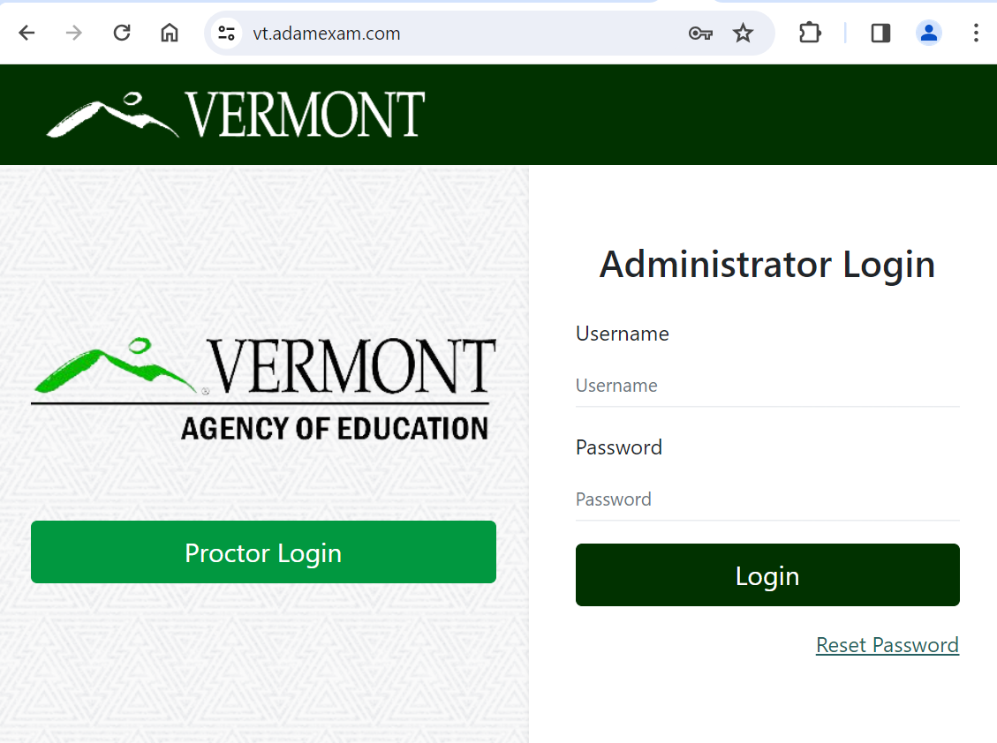
Teachers
Logging in to ADAM
1. Go to: https://vt.adamexam.com/
2. Enter username and password (received via email)
3. Click Login
4. To reset your password click “Reset Password”.

Slide 25
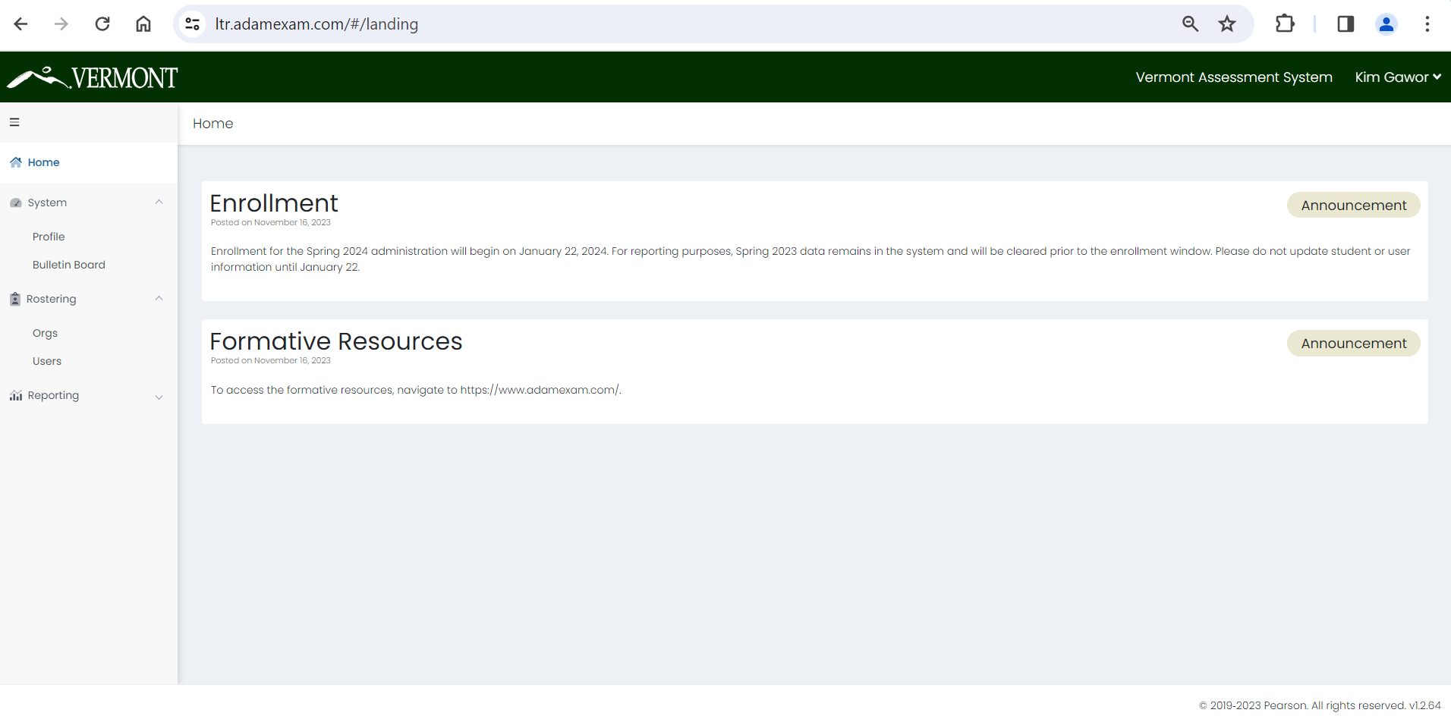
Logging in to ADAM
Once logged in to ADAM you will see the main dashboard screen.
From here you can navigate to System > Profile to view your role, and to Rostering to upload and view your students.

Slide 26
Roster Validation
Image by Photographer's Name (Credit in black type) or
Image by Photographer's Name (Credit in white type)
Presentation Title Arial Bold 7 pt
26

Slide 27
View Roster Data
To search for a user including students:
Go to Rostering > Users.
On the left side of the page, enter or select the appropriate filters. The search is dynamic, so you change the filter fields at any time to alter the search.
  Name – Filter by keyword on the following fields:
    First name
    Last name
    Combination of first name + last name (e.g. John Smith)
    Identifier (SSID)
    User email
  Org – Filter by a specific District or School. For a school, you can also select a specific Class (if a class has been created).
  Role – Filter by role (e.g. School Testing Coordinator)
  Accommodation – Filter by a specific accommodation (e.g. Paper or Text to Speech).
  Unrostered - Select the checkbox to include unrostered users in the search.

Slide 28
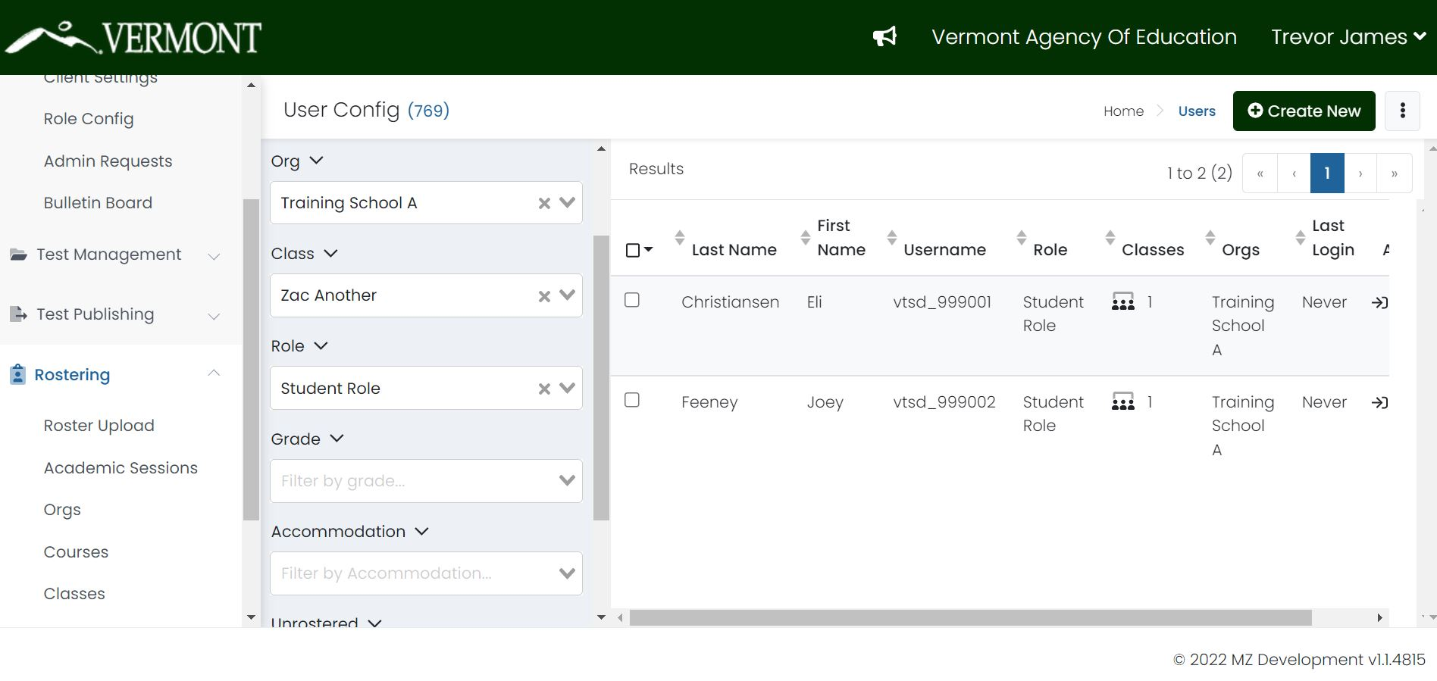
View Roster Data

Slide 29
Before, During, and After Computer-Based Testing (CBT)

Slide 30
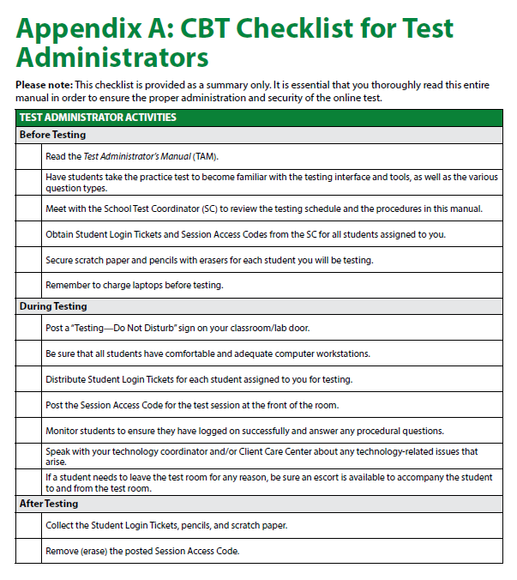
CBT Checklist for Test Administrators
Refer to Appendix A of the TAM for the CBT Checklist for Test Administrators
It may be helpful to print this checklist out to ensure proper administration

Slide 31
Before CBT Testing
Teachers and Proctors
Review the Test Administrator’s Manual (TAM)
Complete training facilitated by the DC/SC
Provide students the opportunity to take the practice test
Validate the student roster and notify the DC/SC of any errors
  Are all students in ADAM?
  Are all students assigned to the correct grade?
  Is the identifier the correct, 7-digit, state assigned student ID?
  Do all students have the appropriate accommodations and supports assigned?
Review your school’s testing schedule
Adhere to all school, district, and state test security policies and procedures

Slide 32
Before CBT Testing
Teachers and Proctors
Prepare the testing environment
  Ensure laptops are fully charged and workstations are set up to prevent student’s from seeing each other’s work
  Obtain scratch paper and pencils for each student
  Obtain Session Access Codes and Student Login Tickets
  Hang a “Testing—Do Not Disturb” sign on the door
  Ensure nothing is visible in the room that could clue any test answers
    Ex: rubrics, writing guides, word walls, hundreds charts, multiplication fact tables

Slide 33
During CBT Testing
Teachers and Proctors
Monitor students during testing
Use of cell phones and electronic devices is strictly prohibited
Adhere to security policies and procedures
Report any test security incidents to the SC
Follow the test administration script exactly
  Beginning on p. 26 of the TAM

Slide 34
After CBT Testing
Teachers and Proctors
Ensure all students click Submit once they complete a test session and are showing in the Proctor Dashboard as Submitted
Collect and securely destroy any testing materials
  Test booklets
  Student print cards
  Scratch paper
  Periodic tables written on by students

Slide 35
Test Proctoring

Slide 36

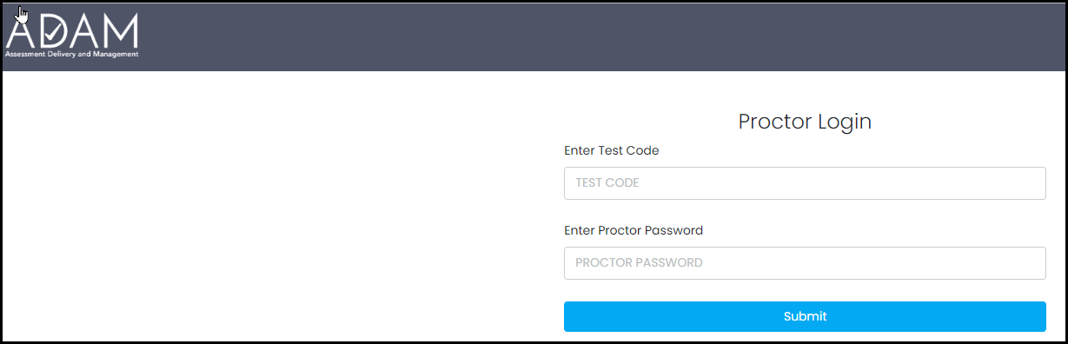
Proctor Login
Go to: https://vt.adamexam.com
Click on Proctor Login
Enter the Test Code and Proctor Password
Click Submit

Slide 37
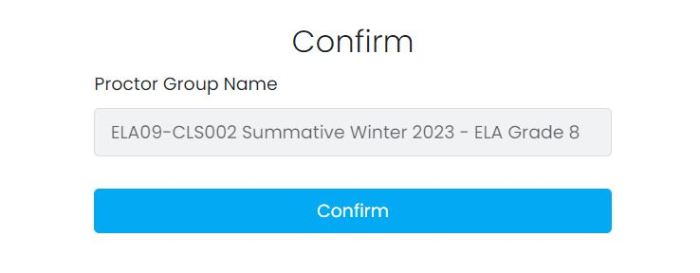
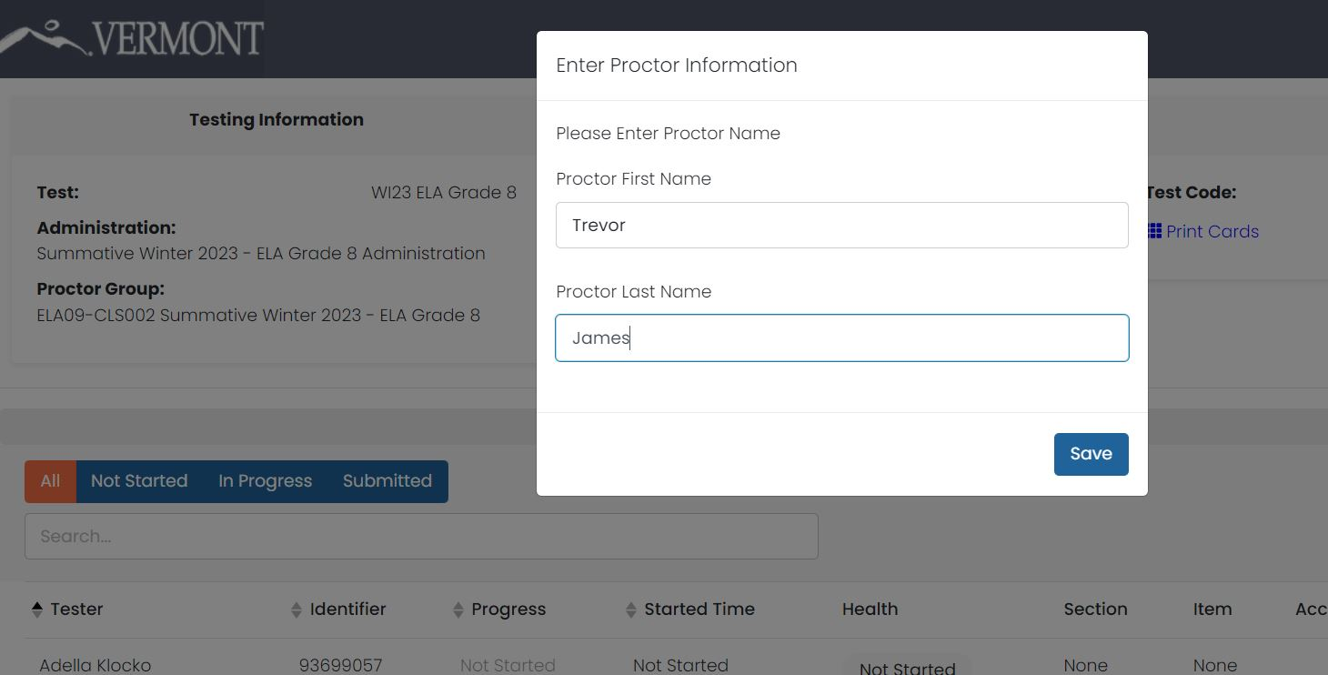
Proctor Group Confirmation
Click Confirm on next screen.
Type in your Proctor First Name and Last Name on next screen.
Click Save.
The Proctor dashboard screen will load.

Slide 38
Create a New Proctor Group
To create a new proctor group, enter the:
  Proctor group name
  District
  School
  Proctor first name
  Proctor last name
  Proctor email address
*Note: Make the Proctor Group Name unique, such as S.Hanlon Grade 6 Math First Period

Slide 39
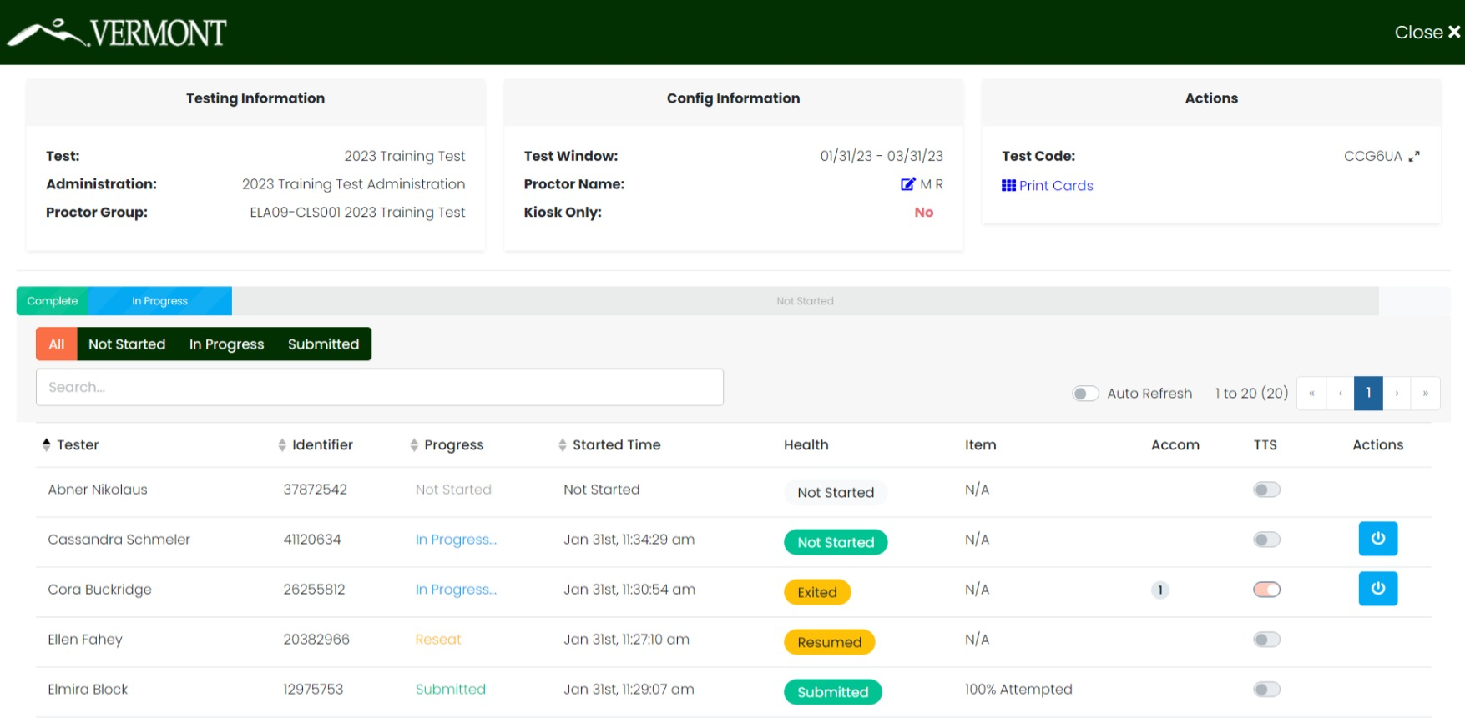
Proctor Dashboard

Slide 40
Proctor Dashboard
The following sections appear on the Proctor Dashboard:
Testing Information
This area includes the name of the Test/Assessment, the name of the administration, and the name of the Proctor Group.
Config Information
This area provides the test window for the overall Assessment, the Proctor’s name, and a field called Kiosk Only, which for the Vermont assessments will always be “No.”
Test Code
This is the test code used by all the students in this proctor group to log into the assessment.
Click the expand arrows found next to the code to maximizes the code to a full-screen view of the test code.
Click the minimize arrows (on the expanded test code window) to return to the normal Proctor Dashboard page.

Slide 41
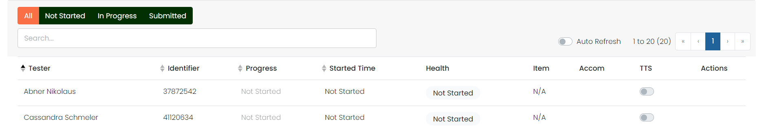
Proctor Dashboard
Print Cards
Proctors can:
print a Roster and the Assessment Cards (a.k.a, “test tickets”) for distribution to the students or
use the Print Cards function to open a second window displaying the student cards from this proctor group.
Session Management Area
In this area, you will be able to view, filter, and search for students in your proctor group and manage their sessions. Students who have access to the test are listed in the Tester column.

Slide 42
Proctor Dashboard
Tester
The name of the student.
Identifier
The student identifier used by the student to log into the test.
Progress
The progress of the students’ assessment will display one of the following. Note: The Proctor does not “start” the test from the Proctor Dashboard. Students (when instructed to do so by the Proctor) will start their tests by starting the TestNav application on their devices and entering their SSID and the test code.
  Not Started – The student has not logged into the assessment.
  In Progress – The student has logged into the assessment. No action is needed by the Proctor.
  Submitted – The student has completed the test and submitted the results.
  Reseat – The Proctor has reseated the student(s). The student has not yet logged back into the session. No action is needed by the Proctor.

Slide 43
Proctor Dashboard
Health
Health helps the Proctor know if the student is interacting with the assessment. Health can be one of the following values:
Not Started – The student has not logged into the assessment. No action is needed by the Proctor.
In Progress – The student has logged into the assessment. The student has recently interacted with the assessment.
Exited – The student has exited the TestNav app. The Proctor needs to reseat the student before they can log back into the assessment.
Resumed – The proctor has re-sat the student, and they can log back into the assessment
Submitted – The student has completed and submitted the test.
No Activity – The student has not interacted with the assessment for at least 90 seconds. This indicates the student is still in the assessment but has not interacted with the application. Proctor may choose to check on student if this status persists.

Slide 44
Proctor Dashboard
Section / Item
The Section and Item columns show the completion of a section or test. While a student is actively testing, this column will only show N/A. After student has submitted the assessment, the fields will be populated with the completion percentage.
Accom
The number of accommodations a student has appears in this column. Hover over the count to show the accommodations. Only accommodations relevant to the online assessment session administration will be displayed
TTS
When this toggle is on, the student has access to the Text To Speech player
Actions
Available actions will appear based on the testing status of the student:
  Reseat Session – Use if a student has an “interrupted” session (computer issue, session timeout, unexpected error). Reseating allows the student to re-enter their test code and SSID to resume their assessment session.

Slide 45
Student Test Experience

Slide 46

ADAM and TestNav
ADAM is the platform used to manage assessment assignments, teacher proctoring, and reporting
ADAM is used by:
District Administrators
District Test Coordinators
School Test Coordinators
Teachers
Proctors
TestNav is the testing engine used to deliver summative assessments.
TestNav is used by:
Students

Slide 47
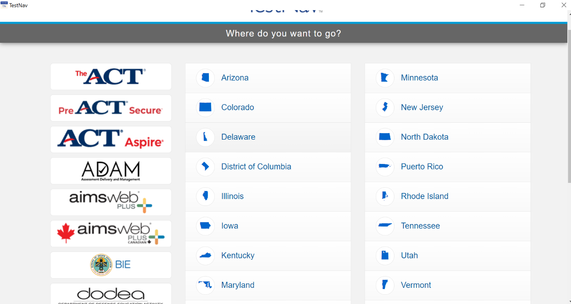
Student Experience
Log in
Before you begin, make sure TestNav is installed on your device and close all other apps.
1. Open the TestNav app.
2. Click the Vermont link on the “Where do you want to go?” screen.

Slide 48
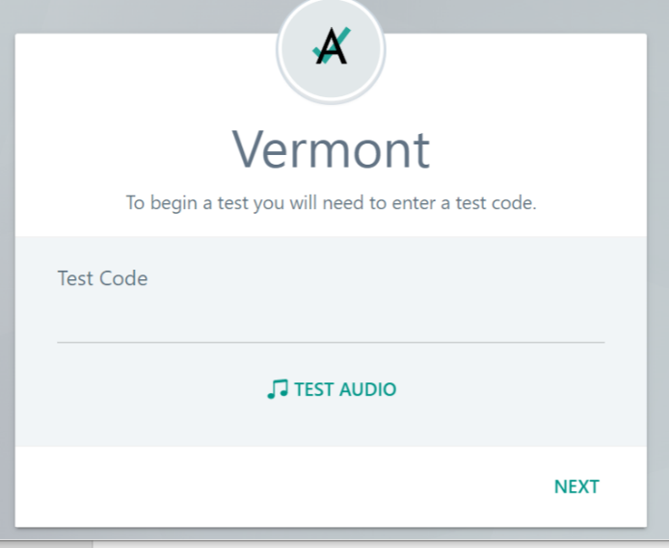
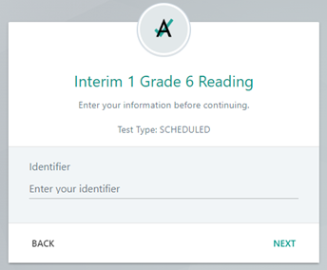
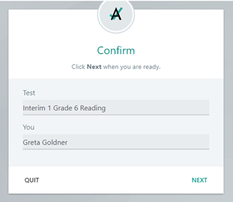
Student Experience
Log in
3. Enter your Test Code and click Next
4. Enter your Identifier and click Next
5. Verify your name and test and click Next; test will launch

Slide 49
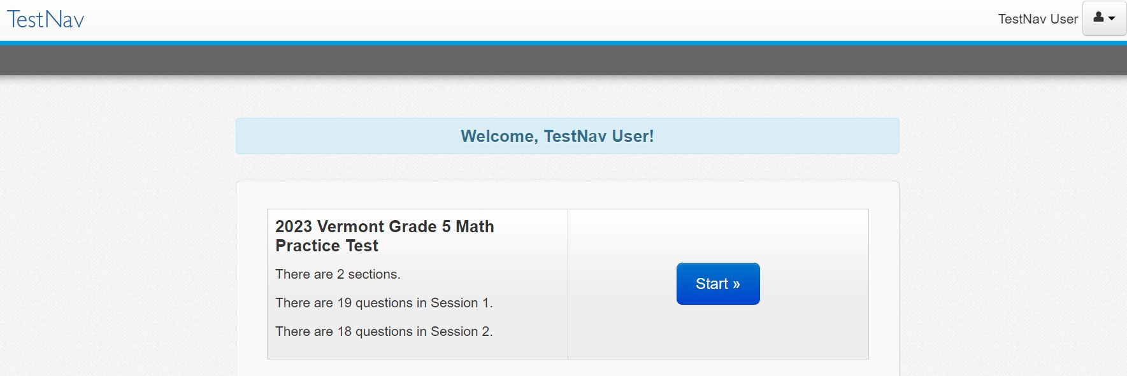
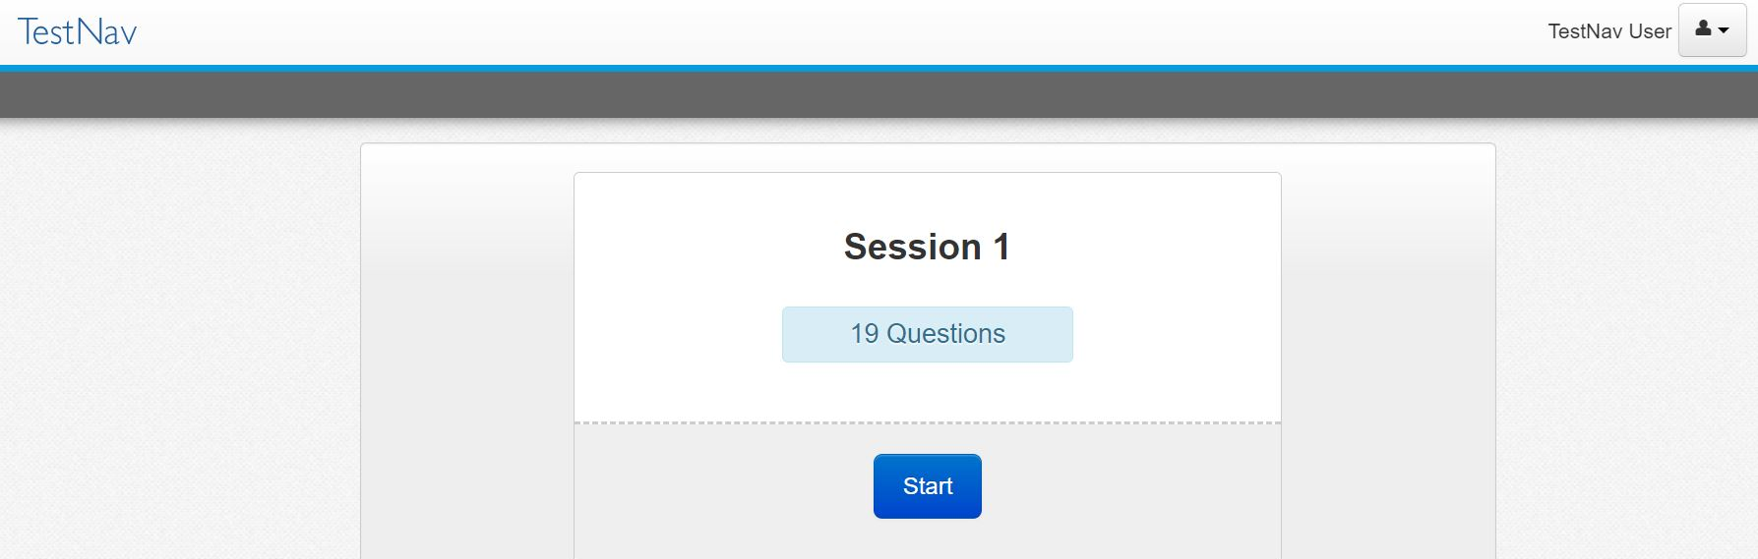
Student Experience
Press Start to begin the test.
Click Start on the first session.

Slide 50
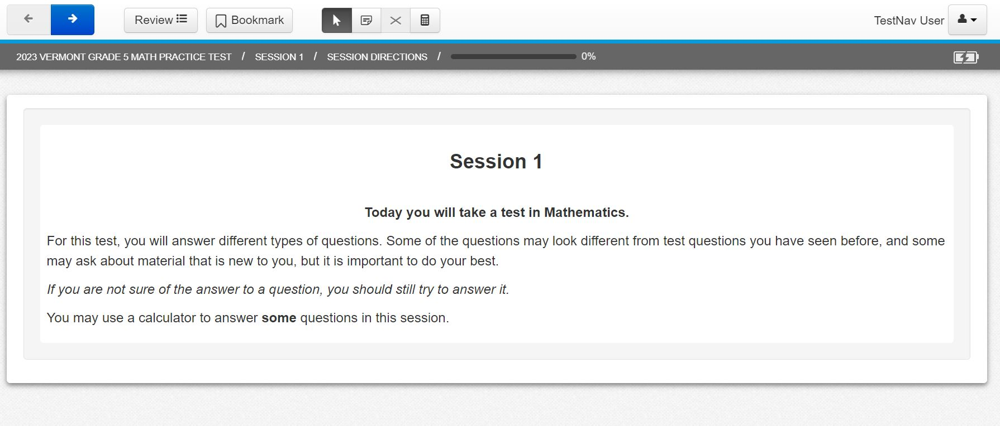
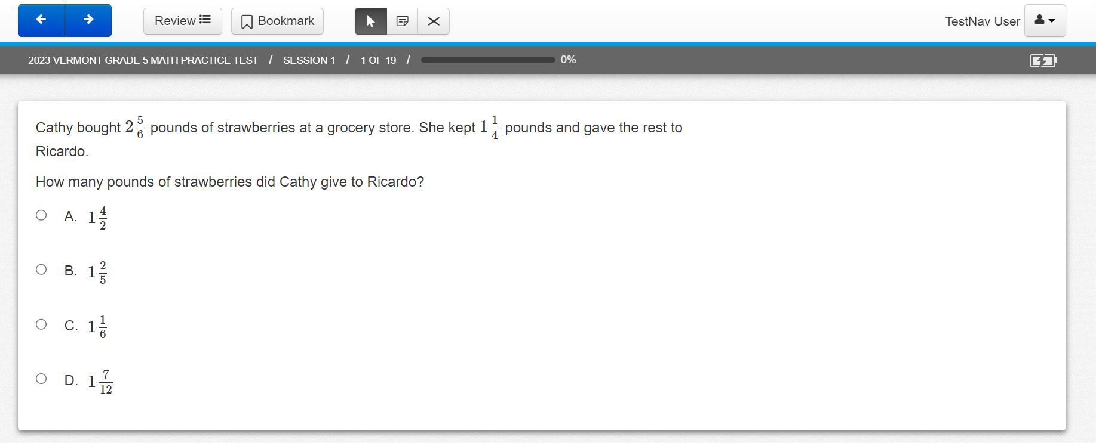
Student Experience
Read the session directions, and then navigate to the first item.
Answer the item question.

Slide 51
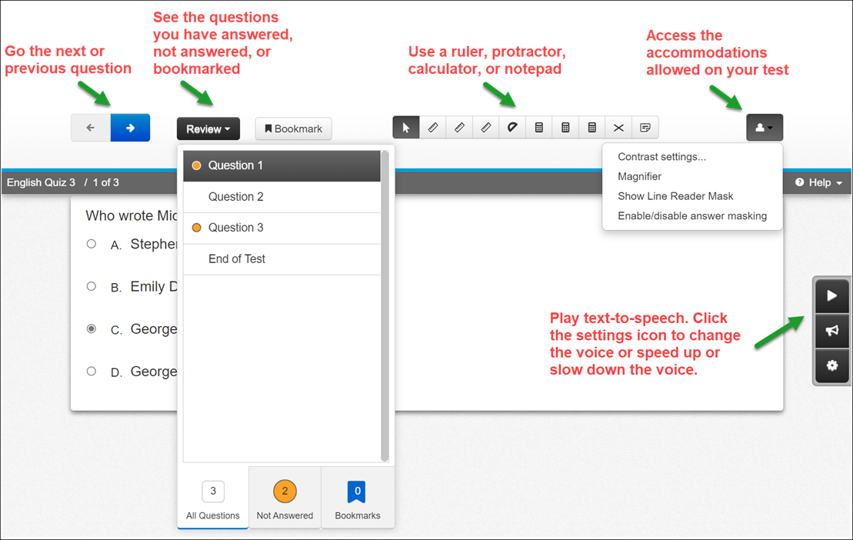
Student Experience
The student test will include the universal tools and any accommodations assigned to the student.

Slide 52
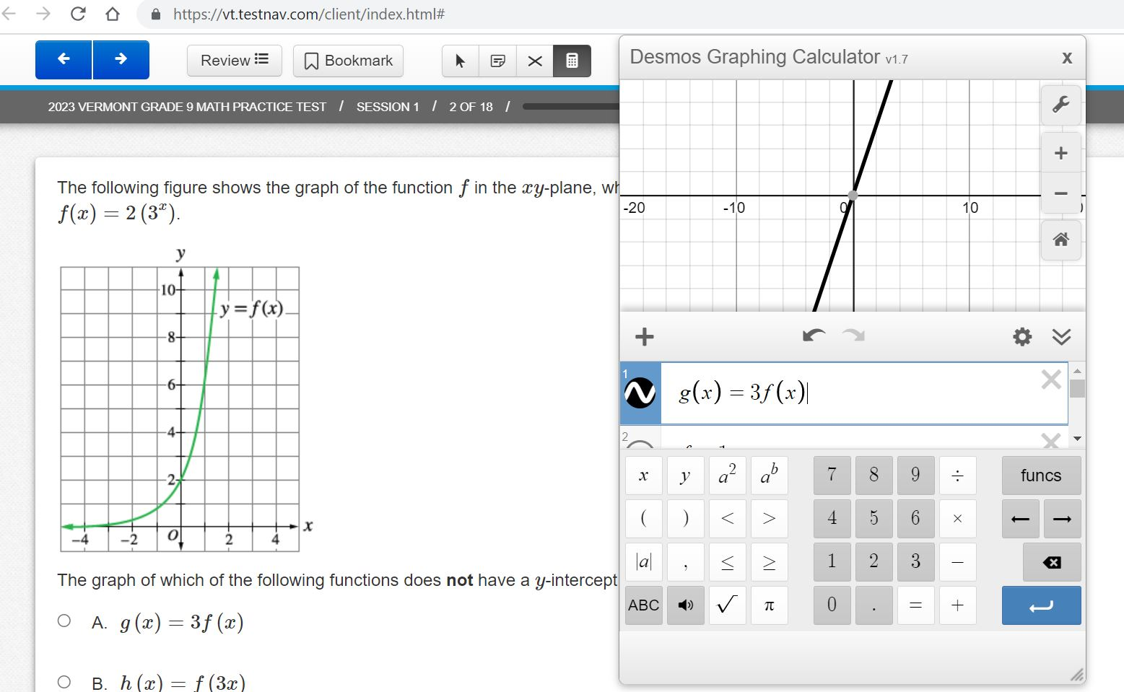
Desmos Calculator
Grades 3–5: Four function with square root and percentage functions
Grades 6–8: Scientific
Grade 9: Graphing

Slide 53
Before, During, and After
Paper-Based Testing (PBT)

Slide 54
Before PBT Testing
Teachers and Proctors
Review the Test Administrator’s Manual (TAM)
Complete training facilitated by the DC/SC
Provide students the opportunity to take the practice test
Review your school’s testing schedule
Adhere to all school, district, and state test security policies and procedures

Slide 55
Before PBT Testing
Teachers and Proctors
Prepare the testing environment
  Ensure there is sufficient lighting and space between desks
  Hang a “Testing—Do Not Disturb” sign on the door
  Ensure nothing is visible in the room that could clue any test answers
    Ex: rubrics, writing guides, word walls, hundreds charts, multiplication fact tables
Prepare student materials
  Test booklets
  Obtain scratch paper and pencils for each student
  Other support materials based on grade/content
    Calculators (Math only)
    Periodic table (Science, Grade 11)

Slide 56
During PBT Testing
Teachers and Proctors
Monitor students during testing
Use of cell phones and electronic devices is strictly prohibited
Adhere to security policies and procedures
Report any test security incidents to the SC
Follow the test administration script exactly
  Beginning on p. 53 of the TAM

Slide 57
During PBT Testing
Large Print
Read the directions and scripts exactly as you would for a standard administration
It is recommended that students work at tables to allow for the booklet’s size
Student responses are recorded directly into the test booklet
Braille
Read the directions and scripts exactly as you would for a standard administration
Students may record their responses:
  Using braille on a separate sheet of braille paper
  Directly in the braille version of the test booklet
  Using a word processor (without spelling and grammar check) for short-answer or open-ended response questions
  Using a scribe, if indicated in the student’s IEP

Slide 58
After PBT Testing
Teachers and Proctors
All student responses must be submitted by the teacher or proctor into TestNav for scoring
All student responses must be transcribed verbatim into TestNav
Collect and securely destroy any testing materials
  Test booklets
  Scratch paper
  Periodic tables written on by students

Slide 59
Resources
Vermont Help & Support site
  https://vermont.onlinehelp.cognia.org
Resources are posted throughout the year
  Key dates
  Announcements
  Documentation and Training
  Online Testing
  Practice Test
  Reporting
  Formative Resources

Slide 60
Vermont Service Center
Hours
  Monday–Friday 7:00 a.m.–5:00 p.m. Eastern
Contact Information
  Phone: 800-215-8975
  Email: VTServiceCenter@cognia.org

Slide 61
Thank you!

