Slide 1
2024 VTCAP
Administration Training

Slide 2
Agenda
Welcome and Introductions
VTCAP Assessment Overview and Key Dates
Assessment Delivery and Management (ADAM)
  Logging in
  Rostering
  Accommodations
  Classes
  Users
  Test administration and proctoring
TestNav
  Student testing experience
  Technology set up
  Resources and troubleshooting
Test Security
Before, During, and After Testing
Print Materials
Resources and Support

Slide 3
Welcome & Introductions
Vermont Agency of Education (AOE)
Danielle Dupuis, Director of Assessment and Accountability
Mabika Goma, VTCAP Assessment Coordinator
Glenn Bailey, Assessment and Accountability Data Administration Director
Cognia
Sara Hanlon, Program Manager
Pearson
Trevor James, Program Manager

Slide 4
VTCAP Overview

Slide 5
VTCAP Assessments
Grades and Contents
English language arts, grades 3–9
Mathematics, grades 3–9
Science, grades 5, 8, and 11
Format
Adaptive, computer-based test (CBT) – primary mode of administration
Fixed, accommodated CBT
  ASL
  Translations (Math & Science only)
Fixed, accommodated paper-based test (PBT)
  Standard print
  Large print
  Braille (as Braille Ready Files)

Slide 6
Key Dates
Rostering window for ordering paper materials in ADAM | January 22–February 2, 2024
Rostering window for all testers | January 22–March 8, 2024
Initial order of paper-based materials arrives in schools | March 4, 2024
Additional materials ordering window | March 4–April 26, 2024
Test administration window | March 11–April 26, 2024
Make-up test administration window | April 29–May 3, 2024

Slide 7
Roles and Responsibilities
District Administrator (DA)
District Test Coordinator (DC)
School Test Coordinator (SC)
Teacher
Proctor

Slide 8
Roles and Responsibilities
The District Test Administrator (DA):
Assumes overall responsibility for implementing VTCAP assessments in their organization
Serves as the local point of contact for questions and information
Disseminates information about assessments with the district and schools
Organizes training for SCs
Creates accounts for other users within their organization
Uploads students for their organization
*Note: The DA can assign District Test Coordinators (DC) as needed to assist with their responsibilities or may also serve as the DC.

Slide 9
Roles and Responsibilities
The District Test Coordinator (DC):
Reviews schedule and testing requirements with SCs, teachers, and proctors
Works with SCs and technology staff to ensure all systems are properly installed and functioning
Creates accounts for other users within their organization
Uploads students for their organization
Schedules and administers training sessions
Ensures all personnel are trained on how to properly administer the VTCAP assessments
Monitors secure administration
Investigates and reports all testing irregularities and breaches reported by the SC, teacher, or proctor
Ensures all testing materials remain secure

Slide 10
Roles and Responsibilities
The School Test Coordinator (SC):
Coordinates the administration of VTCAP assessments within their school
Ensures testing within their school is conducted properly and securely
Establishes testing schedules
Works with technology staff to ensure all systems are properly installed and functioning
Ensures student information in ADAM is accurate
Ensures appropriate accommodations or designated supports are assigned in ADAM
Attends all district training and reviews the manuals
Ensures teachers and proctors attend training or review training modules
Monitors secure administration of the test
Monitors student test progress
Investigates and reports any test security incidents

Slide 11
Roles and Responsibilities
The Teacher and/or Proctor:
Completes all district and/or school training
Reviews the Test Administrator’s Manual (TAM)
Reviews student information prior to testing to ensure each student receives the proper test with appropriate supports.
Administers the VTCAP assessments
Reports any test security incidents to the SC or DC
Note: Proctors should be licensed school personnel
If a paraprofessional or substitute teacher must serve as a proctor, the individual must be fully trained in test administration and test security procedures. They should be monitored by a licensed teacher, principal, or other building administrator.

Slide 12


ADAM and TestNav
ADAM is the platform used to manage assessment assignments, teacher proctoring, and reporting
ADAM is used by:
District Administrators
District Test Coordinators
School Test Coordinators
Teachers
Proctors
TestNav is the testing engine used to deliver summative assessments.
TestNav is used by:
Students

Slide 13

Assessment Delivery and Management
(ADAM)
Image by Photographer’s Name (Credit in black type) or
Image by Photographer’s Name (Credit in white type)
Presentation Title Arial Bold 7 pt
13

Slide 14

Logging in to ADAM
Image by Photographer's Name (Credit in black type) or
Image by Photographer's Name (Credit in white type)
Presentation Title Arial Bold 7 pt
14

Slide 15
Assessment Delivery and Management
ADAM is the platform used to manage users, assessment assignments, accommodations, teacher proctoring, and view reports
Users
District Administrators
District Test Coordinators
School Test Coordinators
Teacher

Slide 16
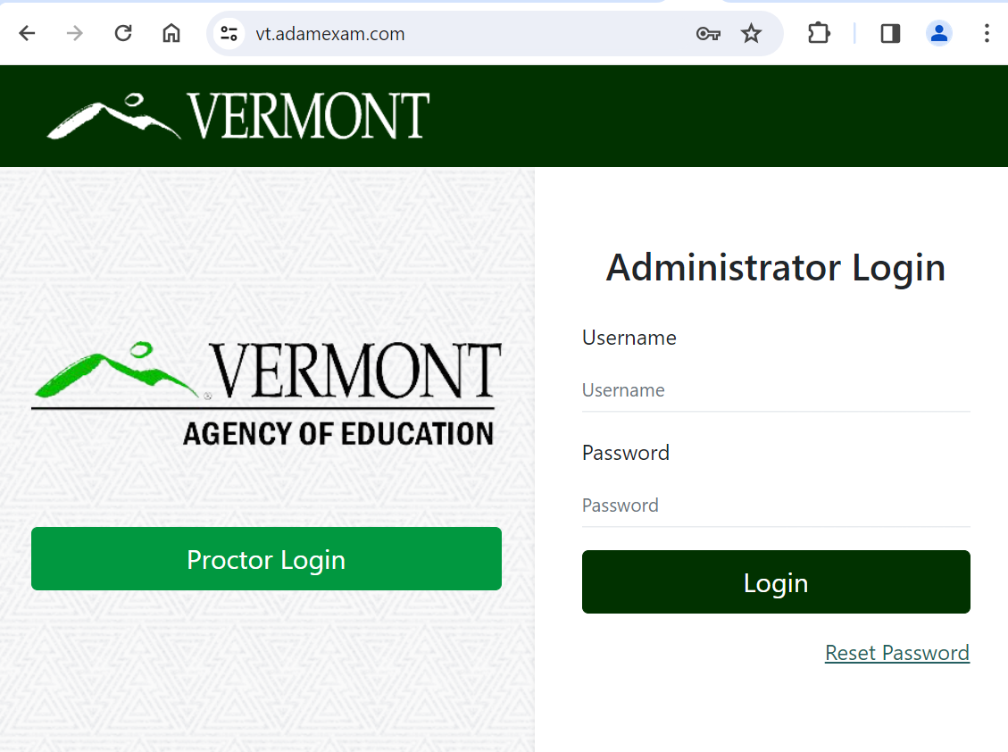
District Administrators, District Test Coordinators, and School Test Coordinators
Logging in to ADAM
Go to: https://vt.adamexam.com/
2. Enter username and password (received via email)
3. Click Login
4. To reset your password click “Reset Password”.

Slide 17
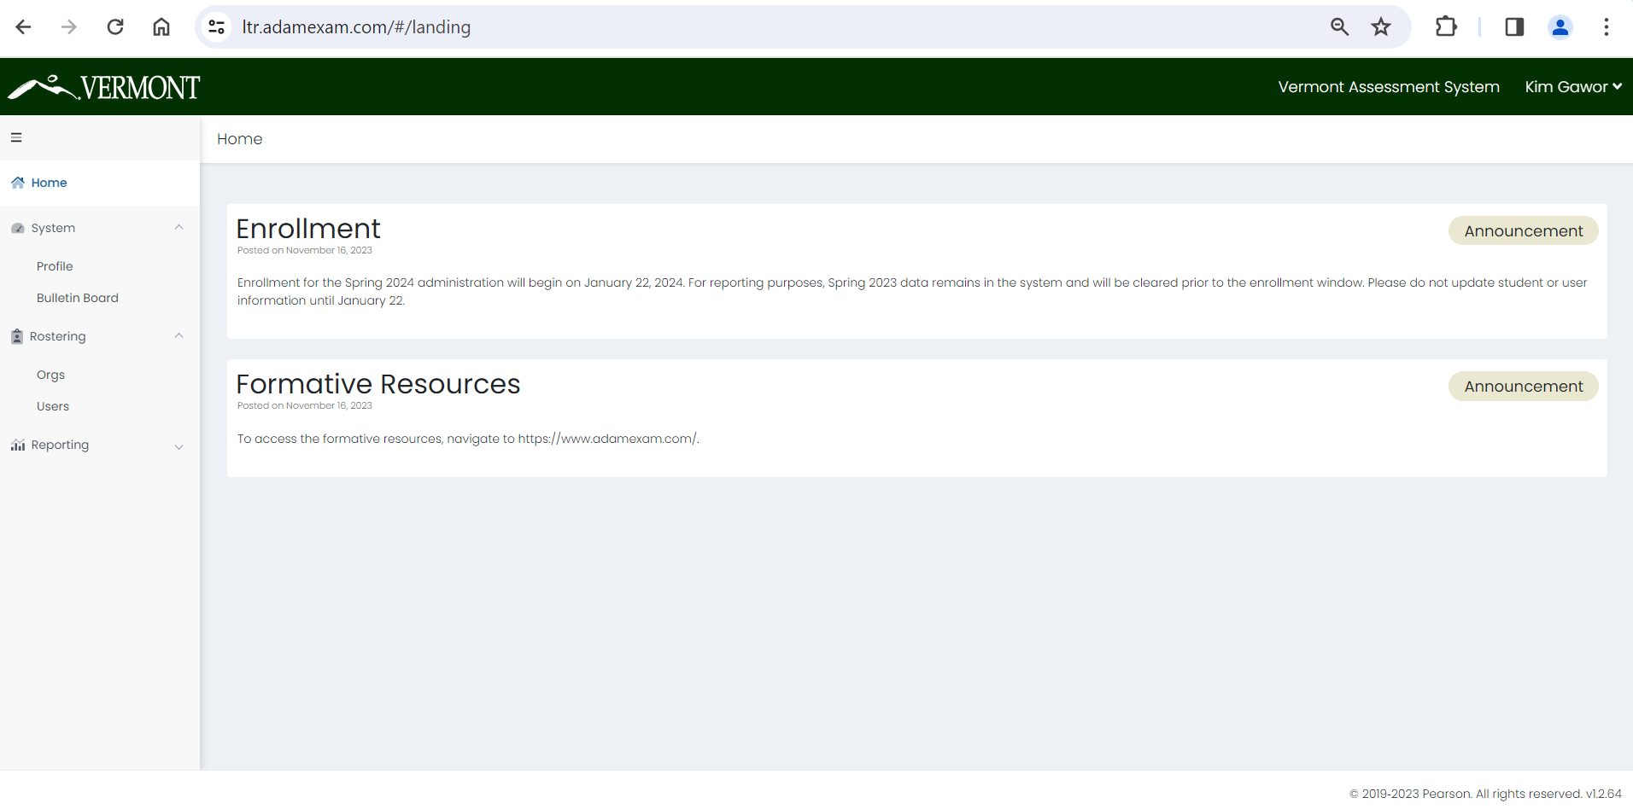
Logging in to ADAM
Once logged in to ADAM you will see the main dashboard screen.
From here you can navigate to System > Profile to view your role, and to Rostering to upload and view your students.

Slide 18
User Roles
Role | Edit/Add Student Accounts | Creating Educator Accounts | Quick Upload & Add Accommodations | Proctor Test
District Administrators | X | X | X | X
District Test Coordinators | X | X | X | X
School Test Coordinators | X |  | X | X
Teachers |  |  |  | X
Proctors |  |  |  | X

Slide 19
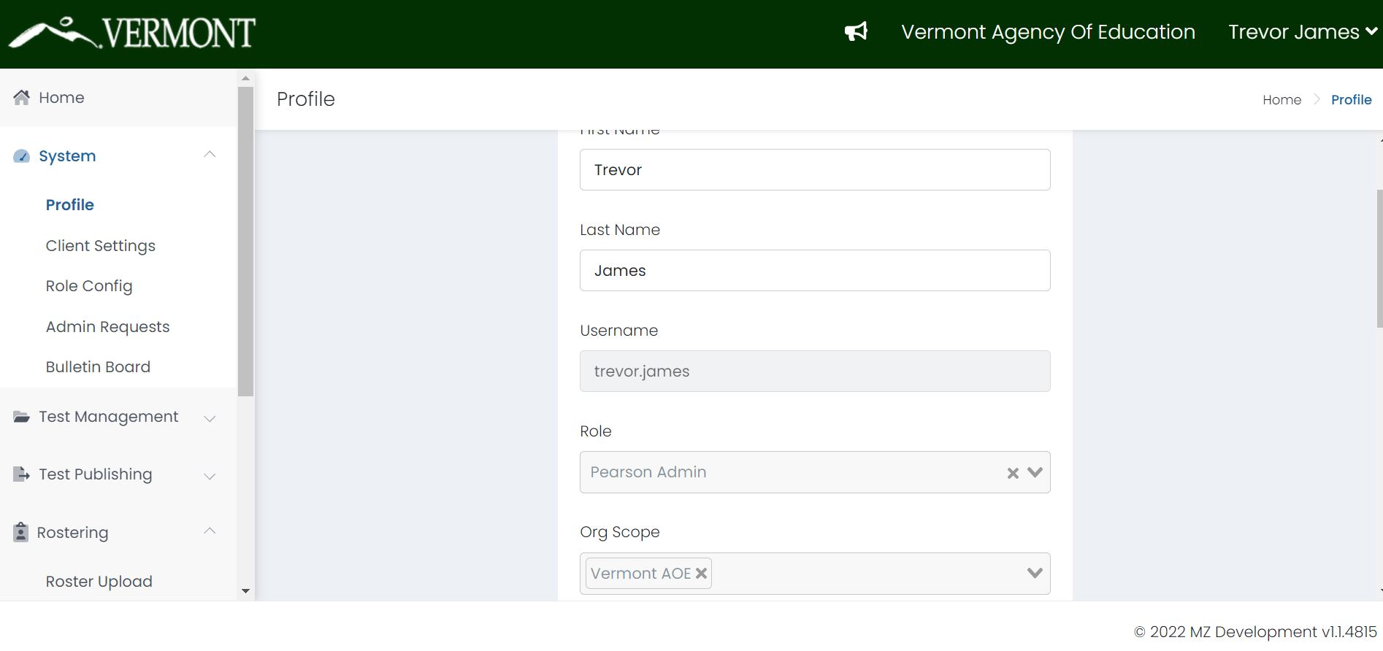
What is My Role?
You can view your profile and role by navigating to System > Profile. On this screen you can also change your password.

Slide 20
Roster Validation
Image by Photographer's Name (Credit in black type) or
Image by Photographer's Name (Credit in white type)
Presentation Title Arial Bold 7 pt
20

Slide 21
View Roster Data
To search for a user including students:
Go to Rostering > Users.
On the left side of the page, enter or select the appropriate filters. The search is dynamic, so you change the filter fields at any time to alter the search.
  Name – Filter by keyword on the following fields:
    First name
    Last name
    Combination of first name + last name (e.g. John Smith)
    Identifier (SSID)
    User email
  Org – Filter by a specific District or School. For a school, you can also select a specific Class (if a class has been created).
  Role – Filter by role (e.g. School Testing Coordinator)
  Accommodation – Filter by a specific accommodation (e.g. Paper or Text to Speech).
  Unrostered - Select the checkbox to include unrostered users in the search.

Slide 22
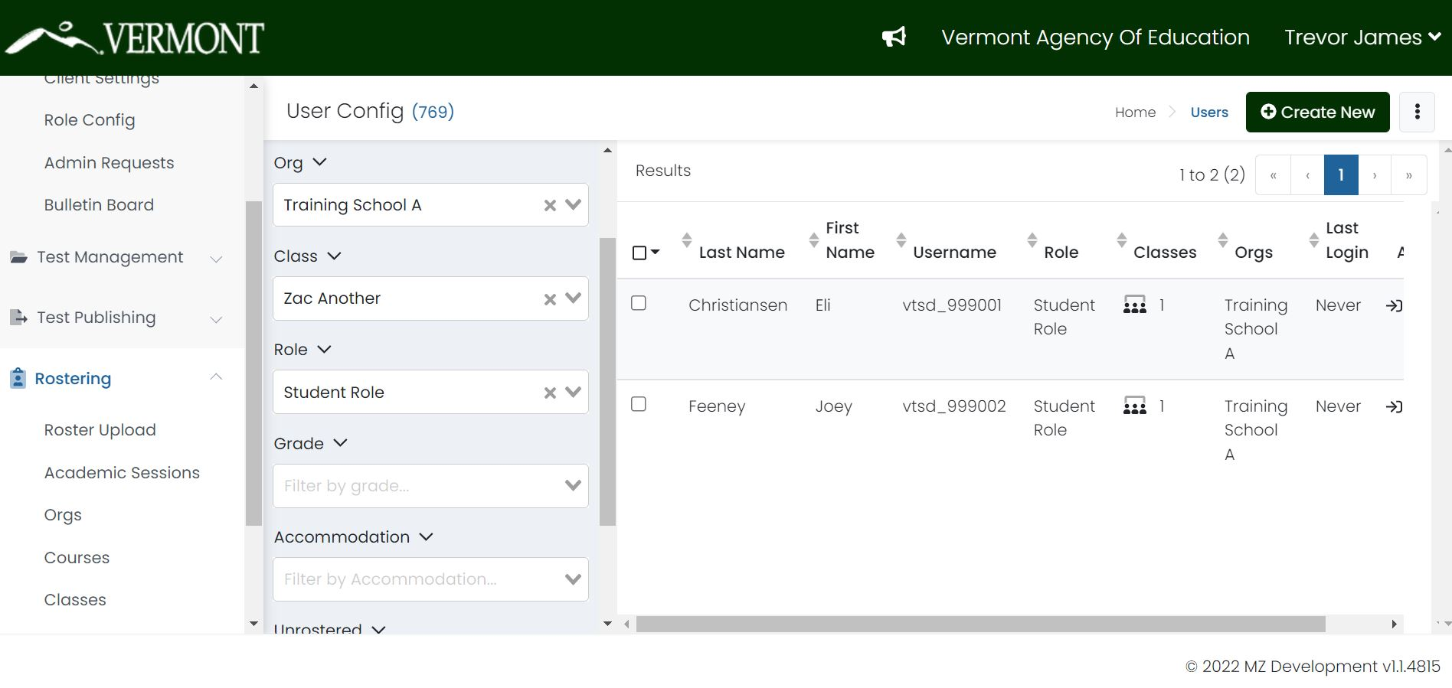
View Roster Data

Slide 23
Student Rosters
To edit a Student record in ADAM:
Go to Rostering > Users.
Search for the user you want to edit. Users are restricted by the organization you belong to. If you are a School Administrator, you will only be able to search for users in the same school.
Click the edit icon in the appropriate username row.
Click the tabs in the left navigation to access and edit the following information. Your role authority determines which tabs you have access to.
  Information – The basic information about the user: Name, Role, Identifier, Grade, Schools (Org Scope), Username, and User Email.
  Accommodations – Accommodation options, such as Text To Speech, Extended Time, and Paper.
  Classes – A list of the classes a student or teacher is enrolled in or teaching.
  Administrations – A list of historic and active administrations the student took.
  History – Audit history showing who made an update and when.

Slide 24
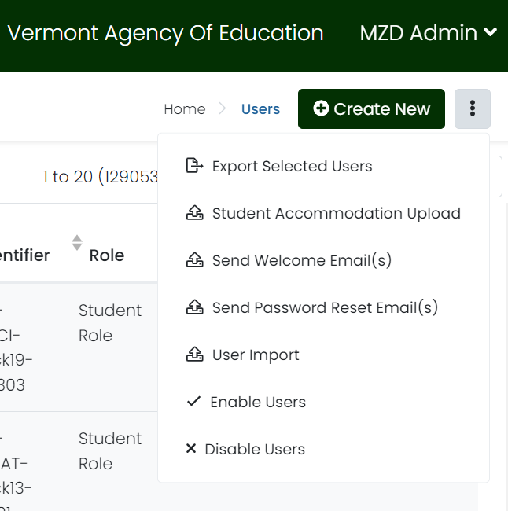
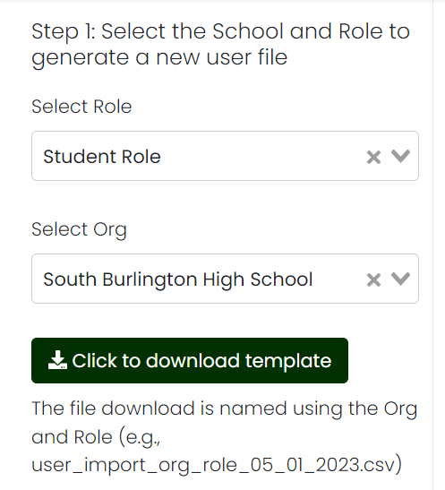
Upload Student Records
To upload students to the Vermont ADAM site, click on the ellipsis button, then click on “User Import”.
When the User Import screen loads,
follow the steps to import your users.
Step 1: Select the role you are importing to (for example, Students).
Select the school you are importing to.
Click the “Click to Download Template”
to download the CSV template file.

Slide 25
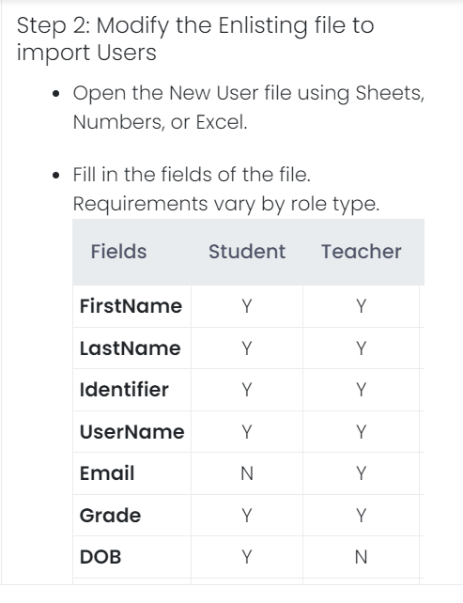
Upload Student Records
Step 2: Open the CSV file in Excel, Sheets, or Numbers, and add the following values to the fields: FirstName, LastName, Identifier, Username, Email, Grade, DOB, Gender.
Note: the Identifier is restricted to a
7-digit numeric ID for student users. You can use the same ID for the username of the student.

Slide 26
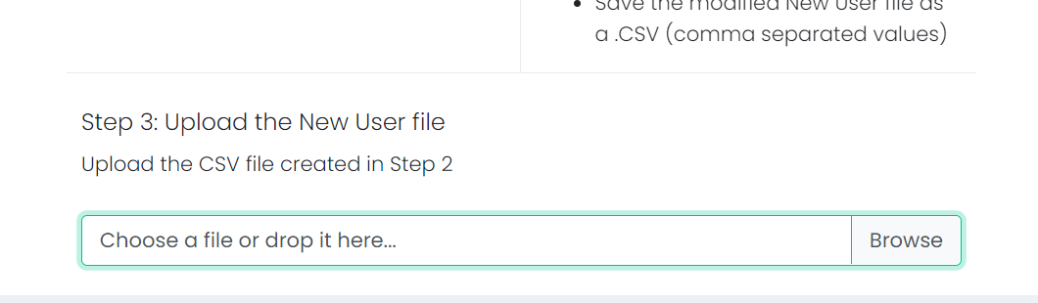
Upload Student Records
Step 3: Upload the CSV back into the platform by dropping the file into
the Step 3 location on the screen.

Slide 27
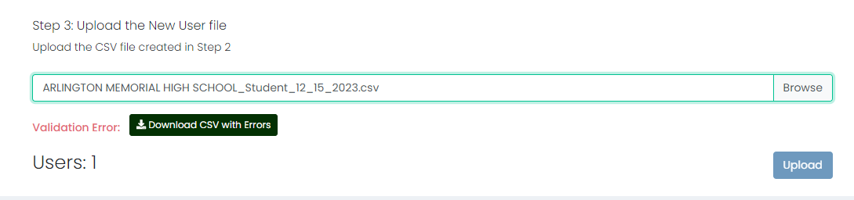
Upload Student Records
Possible Errors with User Upload
A common error you may encounter when uploading your CSV file back into the ADAM site occurs if you are trying to upload the same student again. The platform does not allow for duplicate user accounts, so if any of the CSV values, including username, identifier or email address are the same, you will get an error on upload.
When you receive a validation error upon upload you will see the error printout to the screen like this:

Slide 28
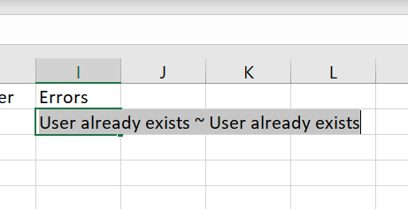
Upload Student Records
Possible Errors with User Upload
When this occurs, you can “Download the CSV with Errors” and you can then determine what the validation error is.
Click on the “Download CSV with Errors” button.
Open up the CSV file, and on the row that contains the validation error, you will see a message saying “User already exists ~ User already exists” under a new “Error” column.
You can now fix the issue in the CSV file, and
re-upload the file.
Be sure to delete the Errors column before
saving your updated file.

Slide 29
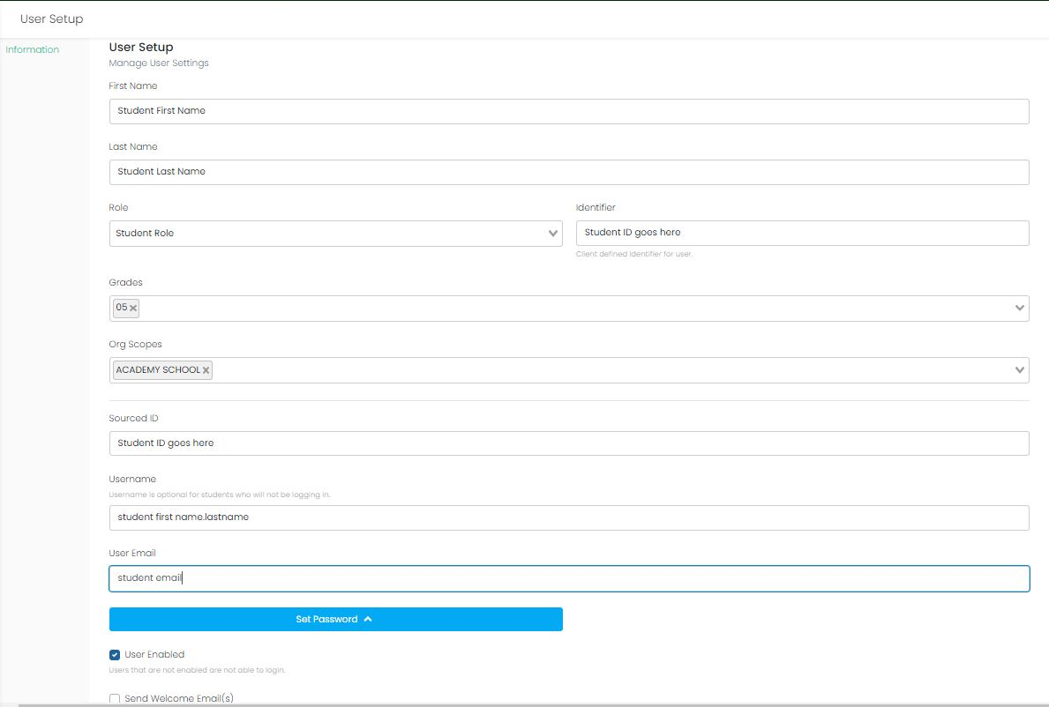
Add a New Student Manually
To add a student record, click the "Create New" button, then complete the form, and save the student record. You do not need to set a password for a student record.

Slide 30
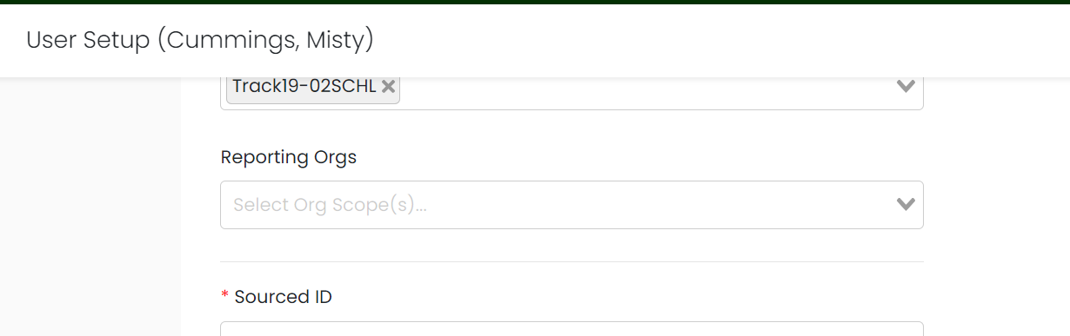
Reporting Orgs
For students attending independent schools, the student’s sending district must be identified in the Reporting Orgs field. This ensure that both their enrolled school and the sending district receive student reports.

Slide 31
Accommodations
Image by Photographer's Name (Credit in black type) or
Image by Photographer's Name (Credit in white type)
Presentation Title Arial Bold 7 pt
31

Slide 32
Universal Tools
Embedded Universal Tools
Desmos calculator
Notepad
Pop-up glossary
Highlight
Line reader mask
Answer eliminator
Writing tools
Magnifier
Zoom
Non-Embedded Universal Tools
Breaks
English dictionary (Math and Science)
Scratch paper
Thesaurus (Math and Science)

Slide 33
Designated Supports
Embedded Designated Supports
Text-to-speech (Math and Science)
Translations (Math and Science)
  Arabic (Standard MENA)
  Chinese (Simplified Mandarin)
  French
  Spanish (Nicaraguan)
  Swahili
Non-Embedded Designated Supports
Amplification
Bilingual dictionary (Math, Science, and Writing)
Color overlays
Magnification
Medical device
Noise buffers
Separate setting

Slide 34
Accommodations
Embedded Accommodations
American Sign Language (ASL)
Closed captioning
Color contrast
Speech-to-text (ELA & Science)
Text-to-speech (ELA)
Non-Embedded Accommodations
100s number table
Abacus
Alternate response options
Multiplication table
Scribe
Speech-to-text (Math)
Print-Based Accommodations
Standard print
Large print
Braille

Slide 35
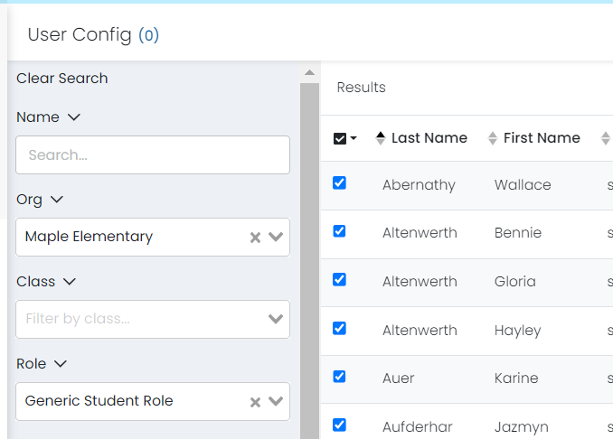
Upload Accommodations
Step 1: Go to Rostering > Users
Step 2: Filter on the desired students

Slide 36
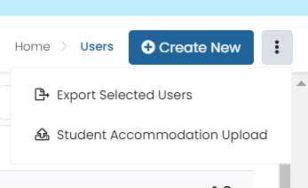
Upload Accommodations
Step 3: Click the ellipsis in the upper right and select Student Accommodation Upload
Step 4: This will load a window with instructions. Review the instructions in the new
window, and then download the sample file

Slide 37
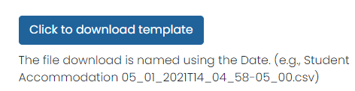
Update Accommodations
Update Student Accommodations via CSV
This is a three-step process to update accommodations for Students:
Follow the instructions in Step 1 - download the selected Students with accommodation template
Follow the instructions in Step 2 - to update the accommodation in the downloaded template, in the accommodation column type a 1 for update accommodation and leave empty/blank for no accommodation
Follow the instructions in Step 3 - Upload the file into ADAM
Walk through the below process to complete the necessary steps.
Step 1: Download the template file for accommodations

Slide 38
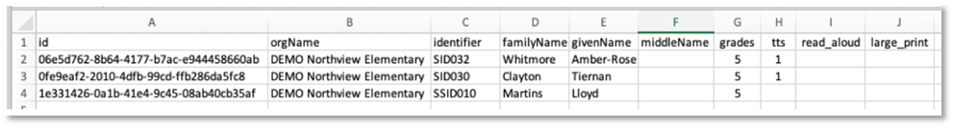
Upload Accommodations
Update Student Accommodations via CSV
Step 2:
Open the "Students Accommodation Upload file" using Sheets, Numbers, or Excel.
In Accommodation Columns enter 1 (number one) to assign accommodation to the students and leave empty/blank to unassign accommodation to students.
Save the modified "Students Accommodation Upload file" as a .CSV (comma separated values).

Slide 39
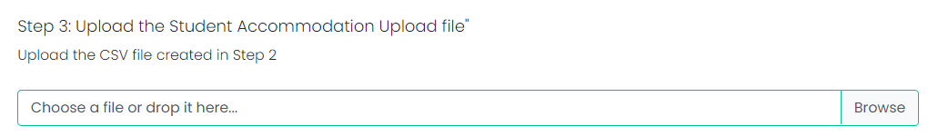
Upload Accommodations
Update Student Accommodations via CSV
Step 3: Save and upload the file back into ADAM.

Slide 40
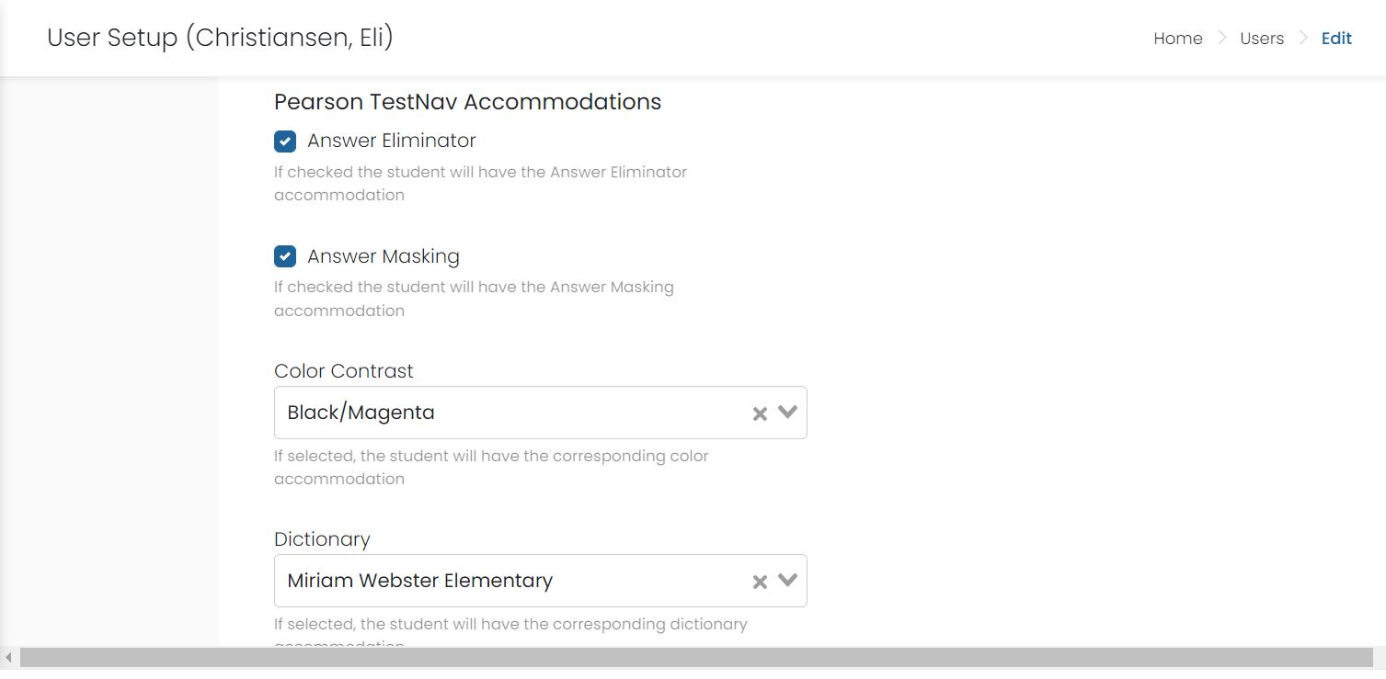
Update Accommodations
Update Student Accommodations Manually
For students added after the accommodations upload, users can edit per student. Edit the student account, then select "Accommodations" from left user set up navigation. Complete the form.

Slide 41
Quick Class Upload
Image by Photographer's Name (Credit in black type) or
Image by Photographer's Name (Credit in white type)
Presentation Title Arial Bold 7 pt
41

Slide 42
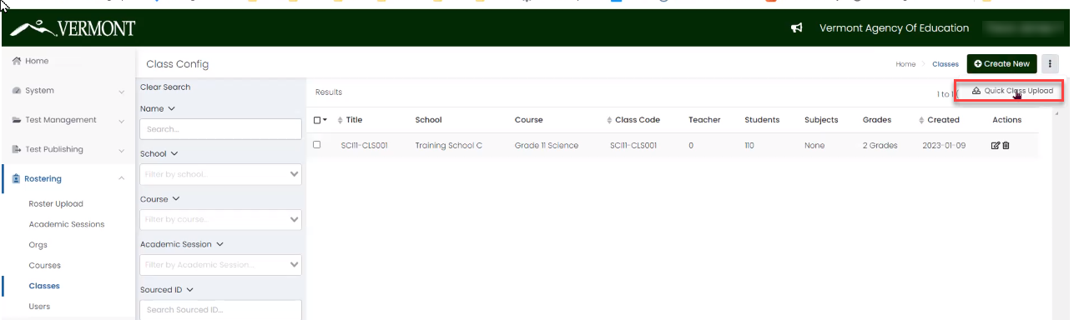
Quick Class Upload
Assign Students to Classes
Navigate to the Quick Class Upload page by clicking: Rostering> Classes
Click the ellipsis to the right of Create New and pick: Quick Class Upload

Slide 43
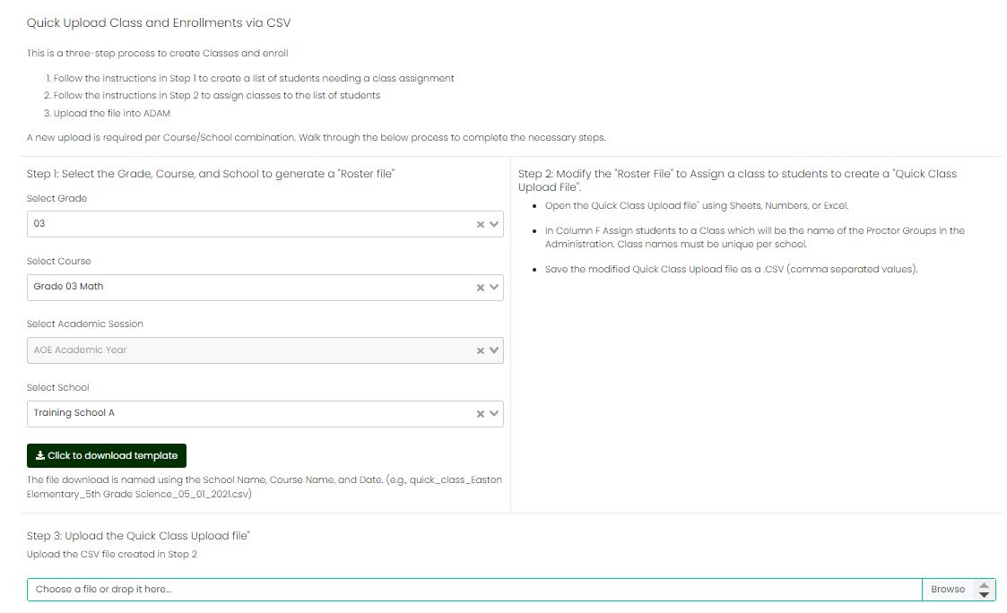
Quick Class Upload

Slide 44
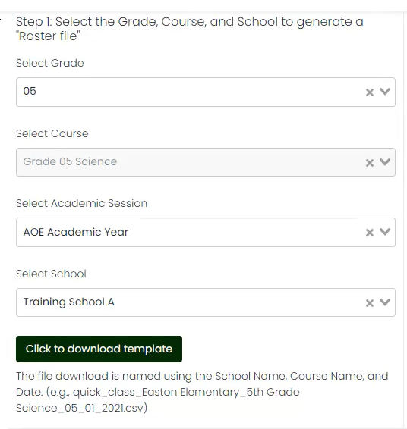
Quick Class Upload
Step 1: Create the Roster File CSV
Select the Grade to match the Class(es) you are creating.
Select the Course (it should match the grade).
Select the School to match the Class(es) you are creating.
Click the ‘Click to download template’ button to produce a roster file of students.

Slide 45
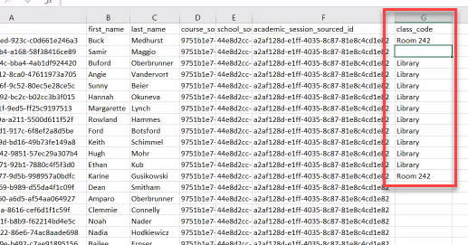
Quick Class Upload
Step 2: Populate the Roster File
Open the downloaded roster file (column A is the student SSID)
Add a class to each row of students (column G). The naming convention should help identify these students and classes
Save the roster file (as a .csv)

Slide 46
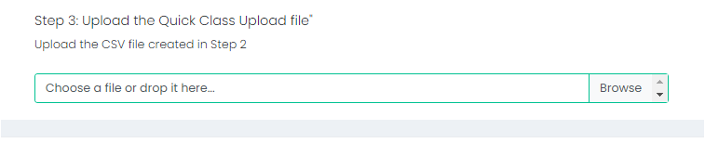
Quick Class Upload
Step 3: Upload the Roster File
Upload the modified roster file back into ADAM
Click the OK button to save the upload.

Slide 47
Class Naming Convention
This naming convention should help you identify these students and classes
Should be meaningful for the Proctor
Consider Subject, Grade, School, Teacher Name, Class Period, Time
Example: ELA Grade 3 Lyman James Period-2 10am

Slide 48
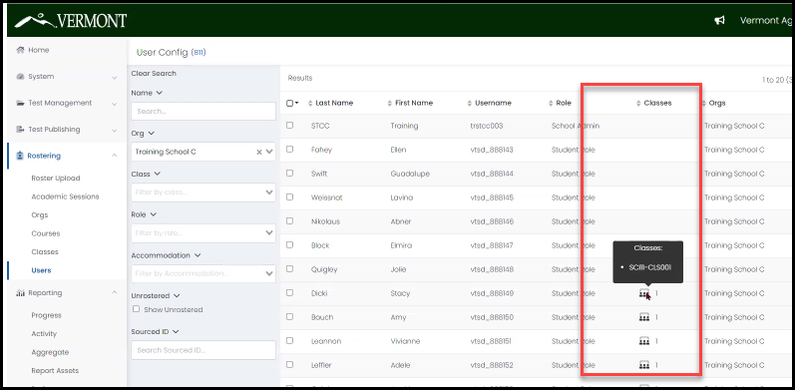
Class Upload Results

Slide 49
Creating Additional Educator Accounts
Image by Photographer's Name (Credit in black type) or
Image by Photographer's Name (Credit in white type)
Presentation Title Arial Bold 7 pt
49

Slide 50
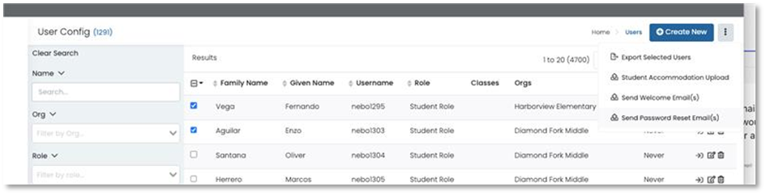
Create Users
Click Rostering > Users > Create New (from the top righthand corner).

Slide 51
Create Users
Enter the users First and Last Name.
Role – pick one only
Identifier – must be unique (example first initial, last initial, school initial)
Org Scopes – enter the highest organization only
Sourced ID – can make match Identifier
Username – this is what user will use to sign in (pick a schema for all accounts, district email is a common choice option)
User Email – enter the user’s district email address
Select ‘User Enabled’ – users without this checkbox will not be able to login.
Check Send Welcome email.
  Welcome email can be resent by clicking the box next to the user’s name and choosing Send Welcome Email from the top right drop-down.
Click Save.

Slide 52
Welcome Email
The welcome email will be sent from "ADAM Assessment System" with a no_reply@mzdevinc.com address.
Sample welcome email:
User's First Name,
Welcome to the ADAM Assessment Delivery and Management system. An account has been created for you with the username of: Username .
To complete the setup of your account and create your own password, follow these steps:
Follow this link to Set Your Password. This will allow you to create a password of your choice that you will use to login to ADAM. Follow the instructions on the webpage that opens from this link:
https://adamexam.com/#/?user=a2F0aGxlZW4ubXllcnM%3D&token=38a028e0-bd4b-440d-ac5a-13a034b68fdd
From the homepage, follow the prompts on the page to the Administrator Login area.
  Log into ADAM using Username as your username and the password you just created.
  Complete the reCAPTCHA puzzle.
  Click the Login button.
  To login to the assessment system again, go to https://adamexam.com and enter this username and password. You can change your password at any time from within ADAM, or by using the Forgot Password link on the ADAM homepage.
  If you have questions about this account, please contact the Vermont Service Center.
  Happy Testing!
  The ADAM Team

Slide 53
Test Administration
Image by Photographer's Name (Credit in black type) or
Image by Photographer's Name (Credit in white type)
Presentation Title Arial Bold 7 pt
53

Slide 54
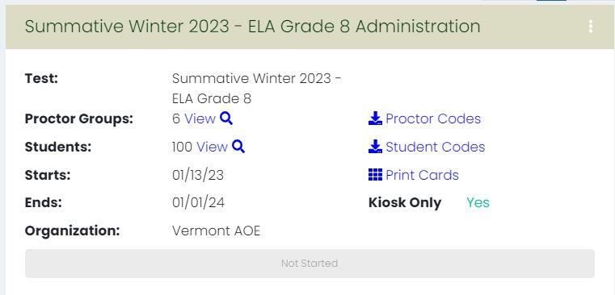
Test Administration
Test administrations will be set up by Cognia and Pearson. Vermont District Administrators, District Test Coordinators, and School Test Coordinators will be able to view the administrations in ADAM.
The Administration includes:
Proctor groups associated​
Number of students in the administration​
Proctor codes​
Student codes​
Print cards​
Start/End date of administration​
Whether administration has been started
Note: ”Kiosk Only” can be ignored.

Slide 55
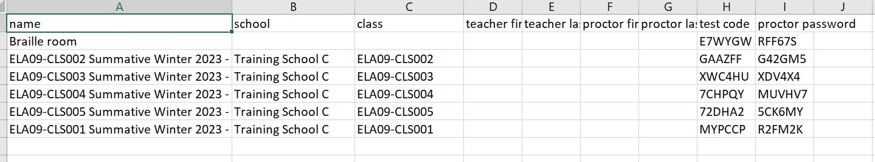
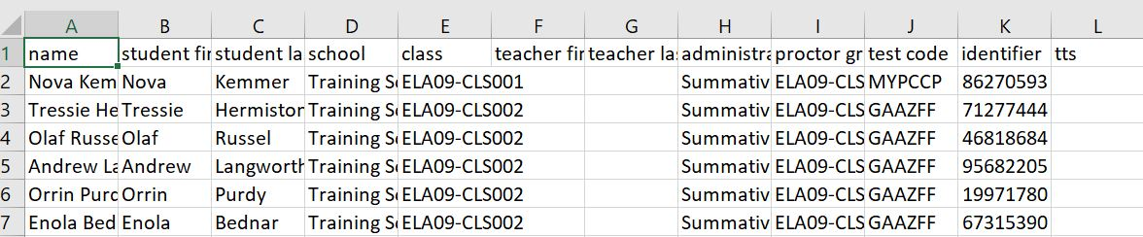
Proctor Codes and Student Codes
Click the Proctor Codes link in the Administration view to download your proctor test codes and proctor passwords. You will download a spreadsheet that contains the codes.
Click the Student Codes link in the Administration view to download your student test codes. You will download a spreadsheet that contains the codes.

Slide 56
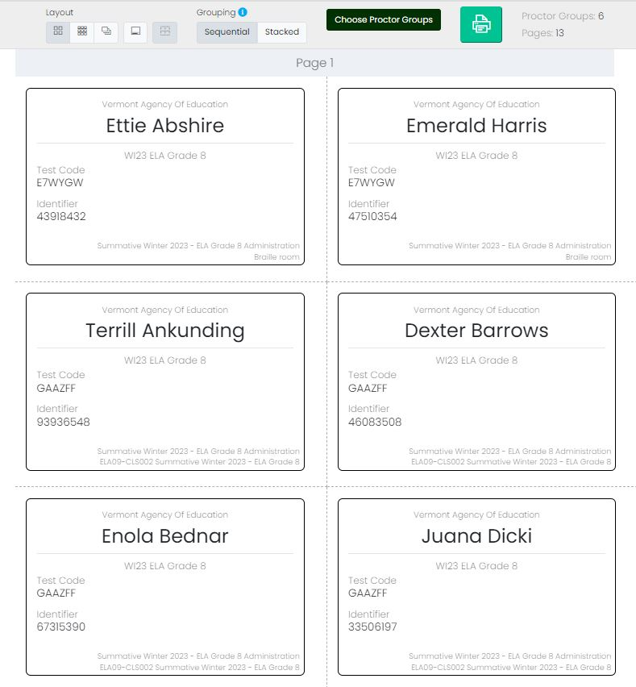
Print Cards
Click the Print cards link on the Administration view to access the print cards.

Slide 57
Test Proctoring
Image by Photographer's Name (Credit in black type) or
Image by Photographer's Name (Credit in white type)
Presentation Title Arial Bold 7 pt
57

Slide 58

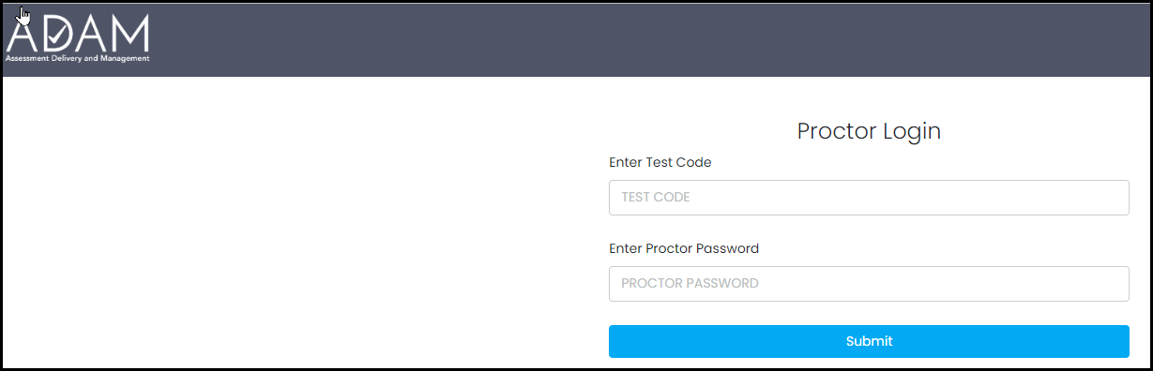
Proctor Login
Go to: https://vt.adamexam.com
Click on Proctor Login
Enter the Test Code and Proctor Password
Click Submit

Slide 59
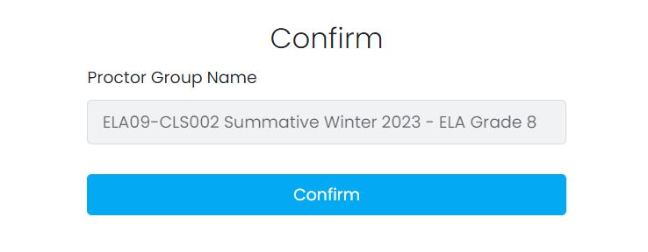
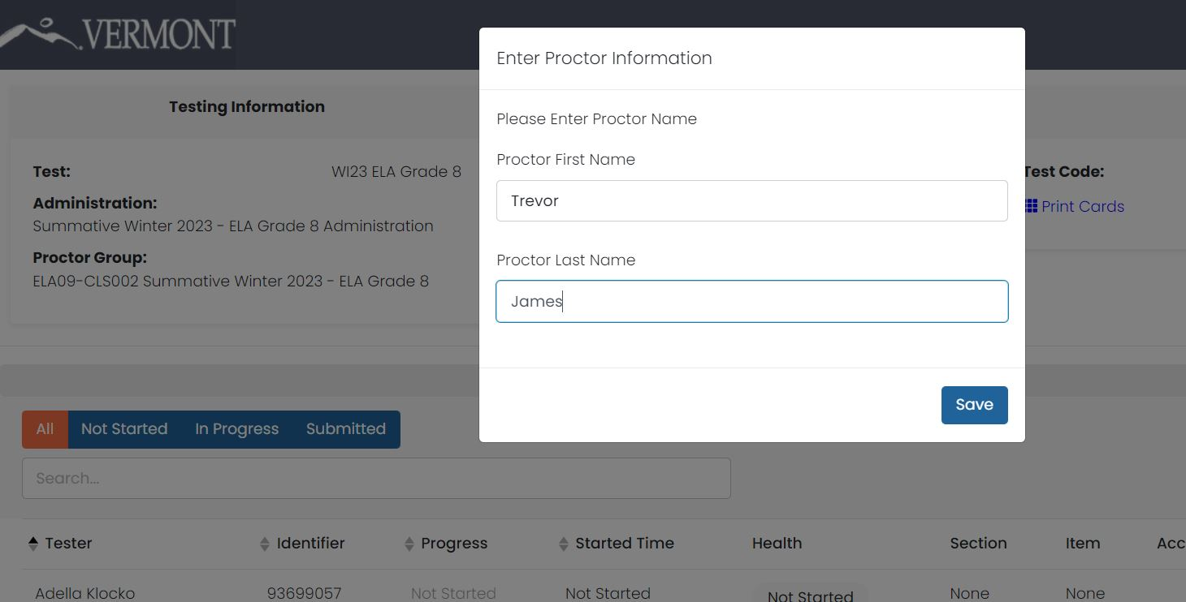
Proctor Confirmation
Click Confirm on next screen.
Type in your Proctor First Name and Last Name on next screen.
Click Save.
The Proctor dashboard screen will load.

Slide 60
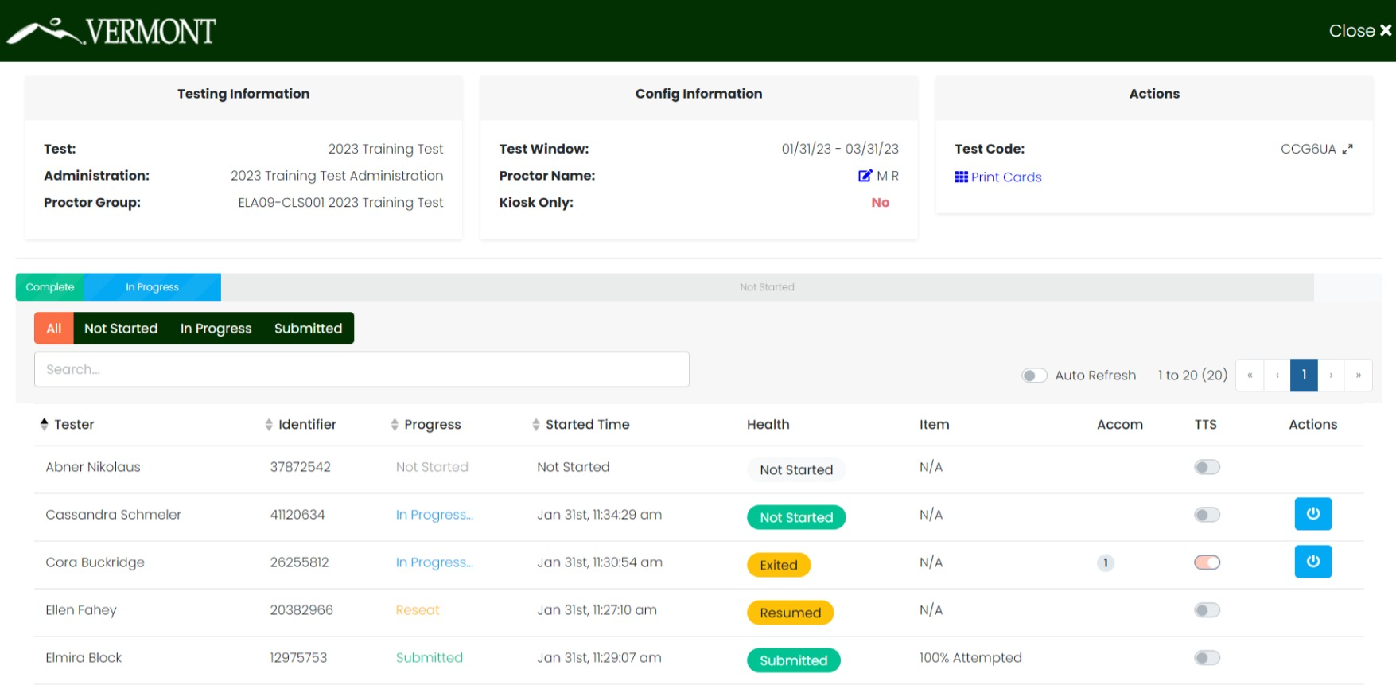
Proctor Dashboard

Slide 61
Proctor Dashboard
The following sections appear on the Proctor Dashboard:
Testing Information
This area includes the name of the Test/Assessment, the name of the administration, and the name of the Proctor Group.
Config Information
This area provides the test window for the overall Assessment, the Proctor’s name, and a field called Kiosk Only, which for the Vermont assessments will always be “No.”
Test Code
This is the test code used by all the students in this proctor group to log into the assessment.
Click the expand arrows found next to the code to maximizes the code to a full-screen view of the test code.
Click the minimize arrows (on the expanded test code window) to return to the normal Proctor Dashboard page.

Slide 62
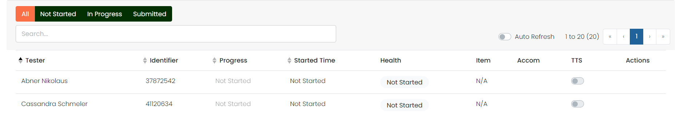
Proctor Dashboard
Print Cards
Proctors can:
print a Roster and the Assessment Cards (a.k.a, “test tickets”) for distribution to the students or
use the Print Cards function to open a second window displaying the student cards from this proctor group.
Session Management Area
In this area, you will be able to view, filter, and search for students in your proctor group and manage their sessions. Students who have access to the test are listed in the Tester column.

Slide 63
Proctor Dashboard
Tester
The name of the student.
Identifier
The student identifier used by the student to log into the test.
Progress
The progress of the students’ assessment will display one of the following. Note: The Proctor does not “start” the test from the Proctor Dashboard. Students (when instructed to do so by the Proctor) will start their tests by starting the TestNav application on their devices and entering their SSID and the test code.
  Not Started – The student has not logged into the assessment.
  In Progress – The student has logged into the assessment. No action is needed by the Proctor.
  Submitted – The student has completed the test and submitted the results.
  Reseat – The Proctor has reseated the student(s). The student has not yet logged back into the session. No action is needed by the Proctor.

Slide 64
Proctor Dashboard
Health
Health helps the Proctor know if the student is interacting with the assessment. Health can be one of the following values:
Not Started – The student has not logged into the assessment. No action is needed by the Proctor.
In Progress – The student has logged into the assessment. The student has recently interacted with the assessment.
Exited – The student has exited the TestNav app. The Proctor needs to reseat the student before they can log back into the assessment.
Resumed – The proctor has re-sat the student, and they can log back into the assessment
Submitted – The student has completed and submitted the test.
No Activity – The student has not interacted with the assessment for at least 90 seconds. This indicates the student is still in the assessment but has not interacted with the application. Proctor may choose to check on student if this status persists.

Slide 65
Proctor Dashboard
Section / Item
The Section and Item columns show the completion of a section or test. While a student is actively testing, this column will only show N/A. After student has submitted the assessment, the fields will be populated with the completion percentage.
Accom
The number of accommodations a student has appears in this column. Hover over the count to show the accommodations. Only accommodations relevant to the online assessment session administration will be displayed
TTS
When this toggle is on, the student has access to the Text To Speech player
Actions
Available actions will appear based on the testing status of the student:
  Reseat Session – Use if a student has an “interrupted” session (computer issue, session timeout, unexpected error). Reseating allows the student to re-enter their test code and SSID to resume their assessment session.

Slide 66
Student Test
Experience
Image by Photographer's Name (Credit in black type) or
Image by Photographer's Name (Credit in white type)
Presentation Title Arial Bold 7 pt
66

Slide 67
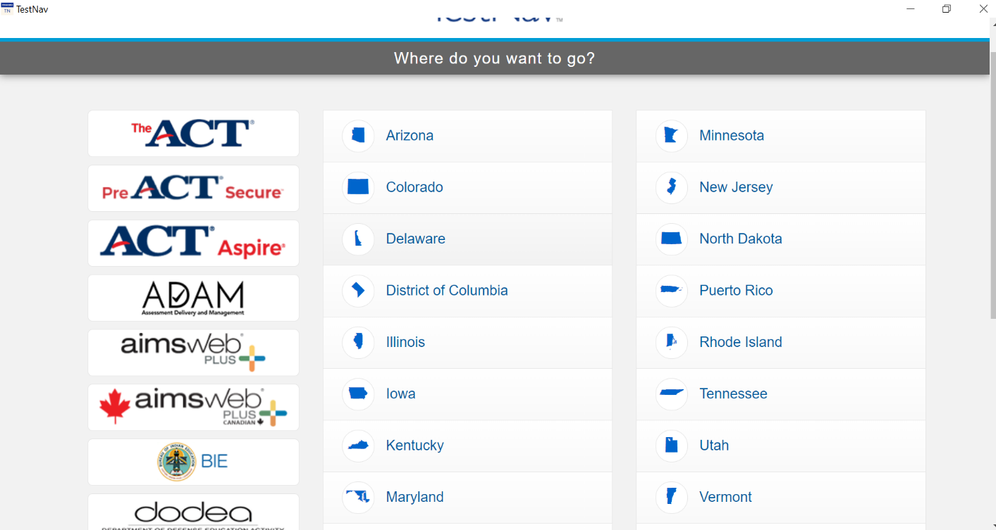
Student Experience
Log in
Before you begin, make sure TestNav is installed on your device and close all other apps.
1. Open the TestNav app.
2. Click the Vermont link on the “Where do you want to go?” screen.

Slide 68
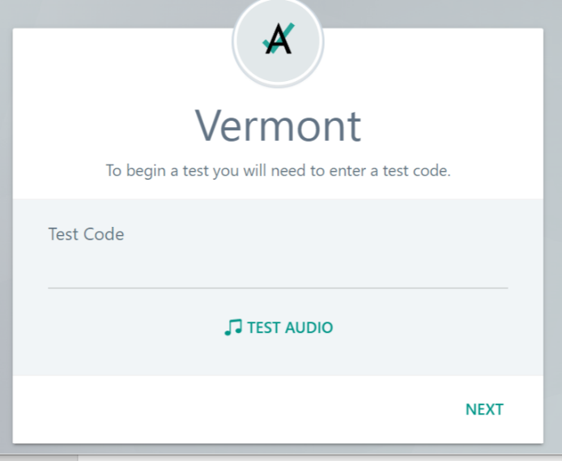
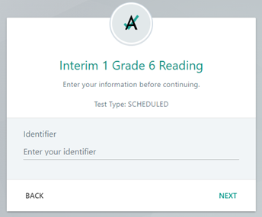
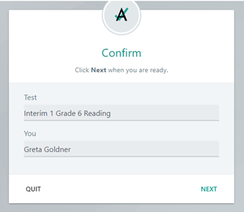
Student Experience
Log in
3. Enter your Test Code and click Next
4. Enter your Identifier and click Next
5. Verify your name and test and click Next; test will launch

Slide 69
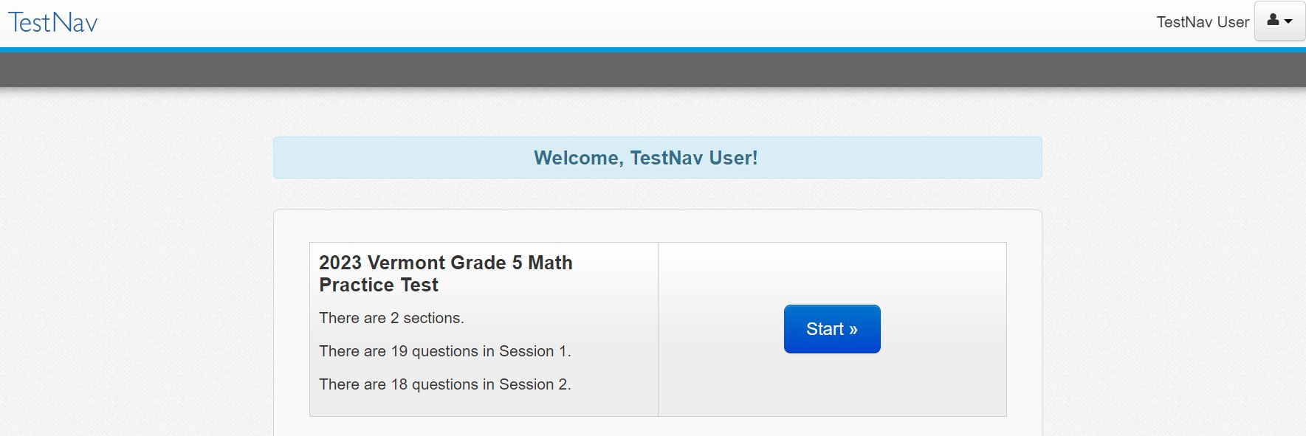
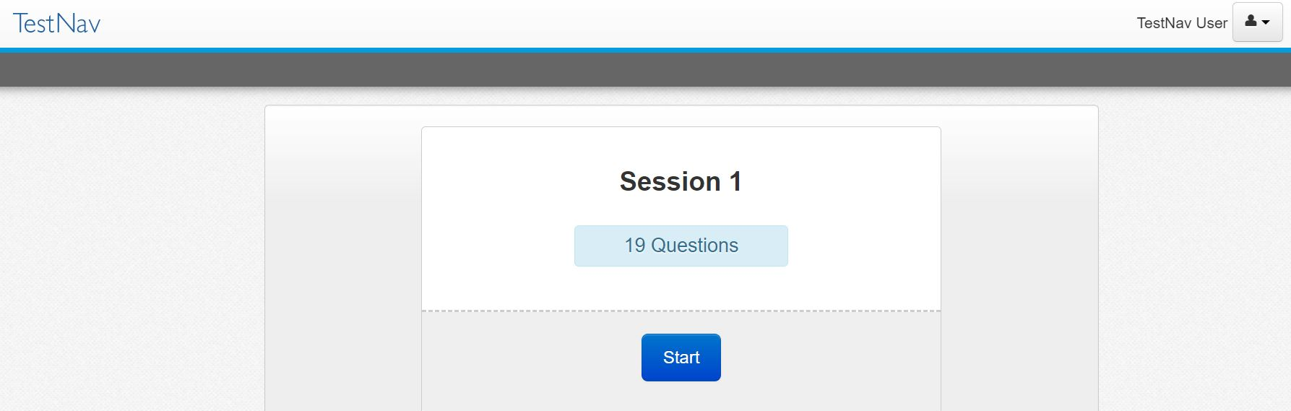
Student Experience
Press Start to begin the test.
Click Start on the first session.

Slide 70
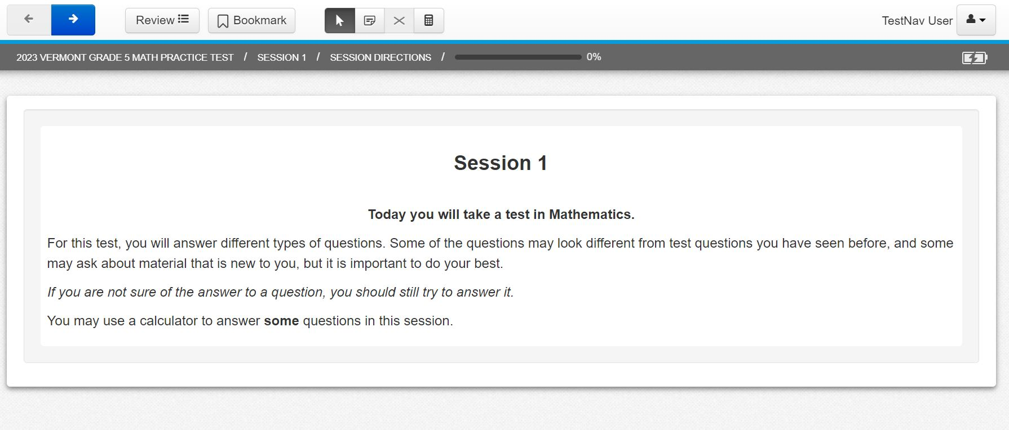
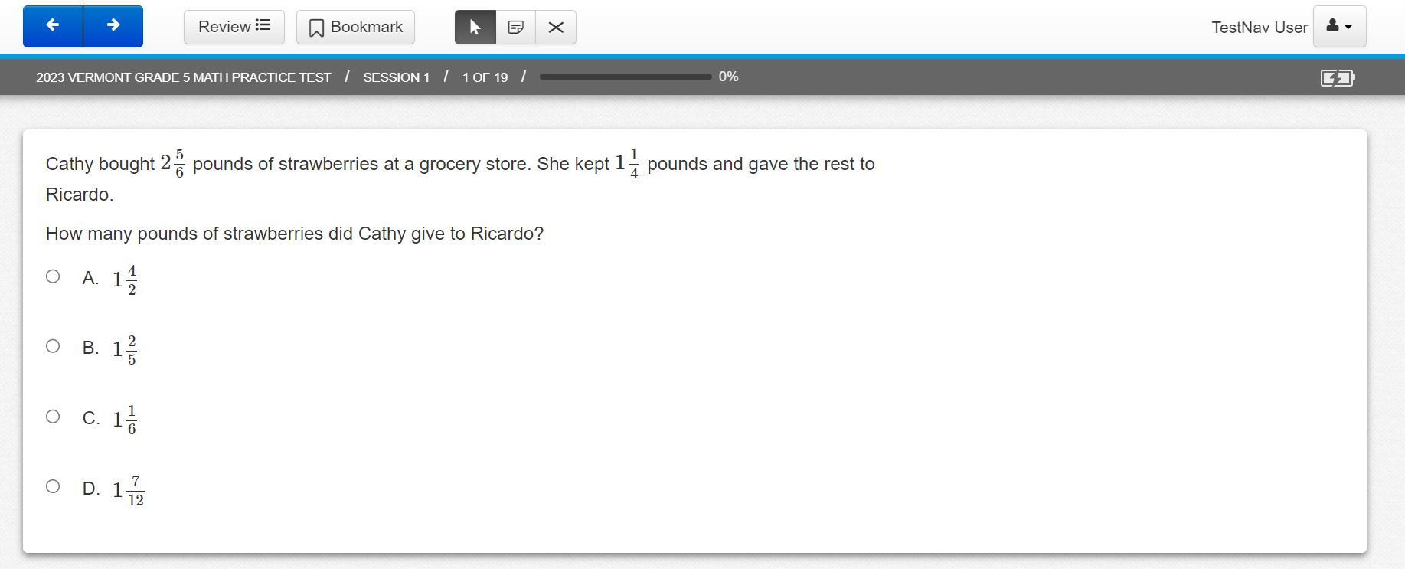
Student Experience
Read the session directions, and then navigate to the first item.
Answer the item question.

Slide 71
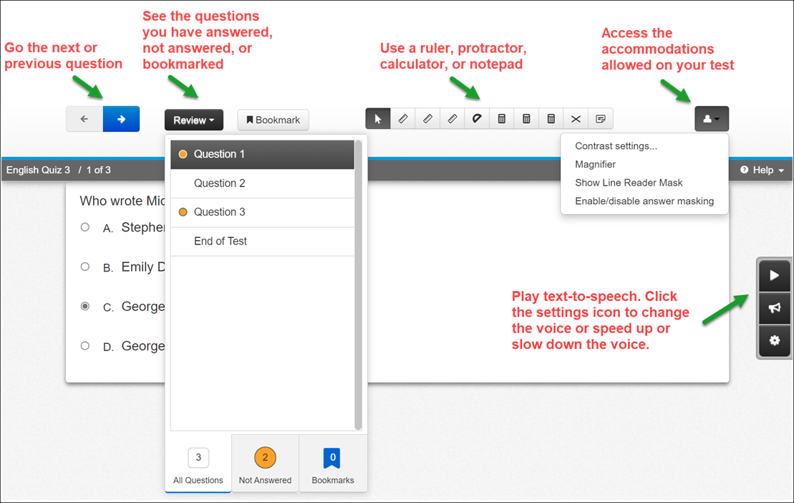
Student Experience
The student test will include the universal tools and any accommodations assigned to the student.

Slide 72
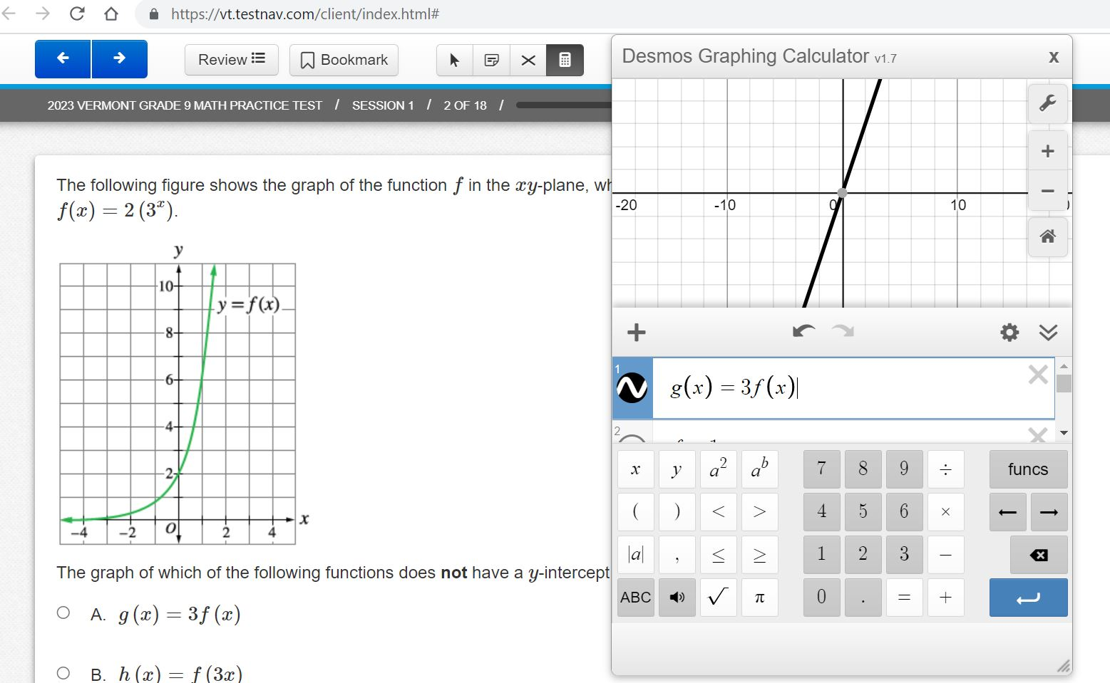
Desmos Calculator
Grades 3–5: Four function with square root and percentage functions
Grades 6–8: Scientific
Grade 9: Graphing

Slide 73
Questions?

Slide 74
Image by Photographer’s Name (Credit in black type) or
Image by Photographer’s Name (Credit in white type)
TestNav
Setup and Readiness
Presentation Title Arial Bold 7 pt
74

Slide 75
Technology
Resources
Image by Photographer's Name (Credit in black type) or
Image by Photographer's Name (Credit in white type)
Presentation Title Arial Bold 7 pt
75

Slide 76
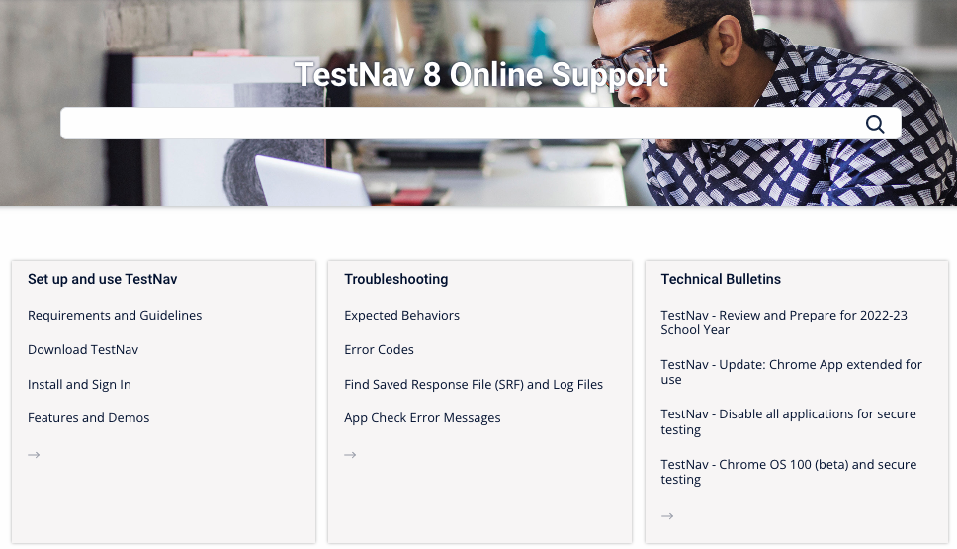
TestNav Online Support Page
https://support.assessment.pearson.com/TN/

Slide 77
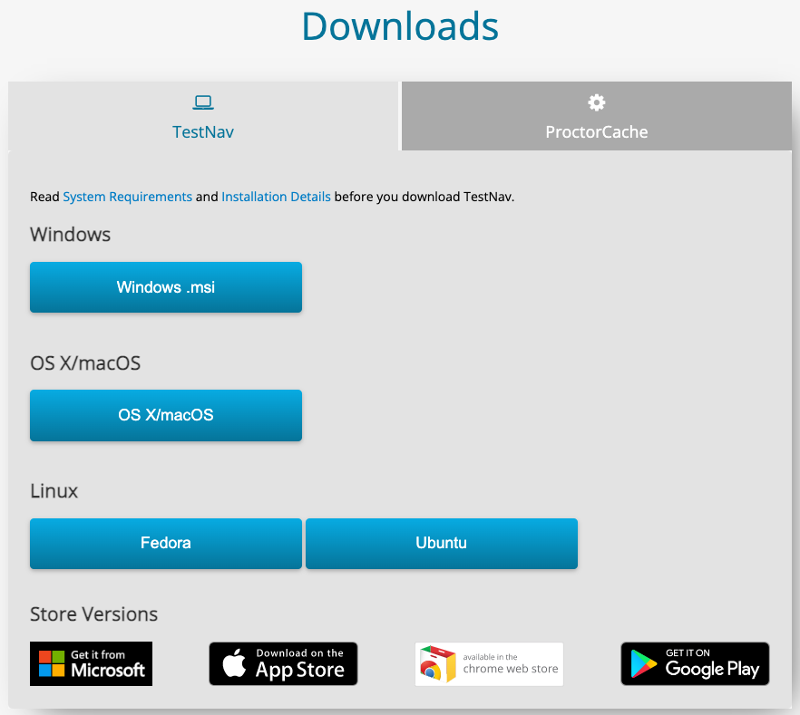
TestNav Download Page
http://download.Testnav.com

Slide 78
Components of Online Testing
Image by Photographer's Name (Credit in black type) or
Image by Photographer's Name (Credit in white type)
Presentation Title Arial Bold 7 pt
78

Slide 79
Online Testing Components
TestNav
    Delivers test content and allows student interaction
    Can be used with all major platforms
    Maintains and transmits student responses
    Early Warning System (EWS)
    AppCheck
ADAM
    Administrative site
    Set up test sessions
    Manage live testing
    Test proctoring

Slide 80
General Setup and Requirements
Set up your environment:
    Configure firewalls/content filters
    Install TestNav
    Run AppCheck
    Run Network Check

Slide 81
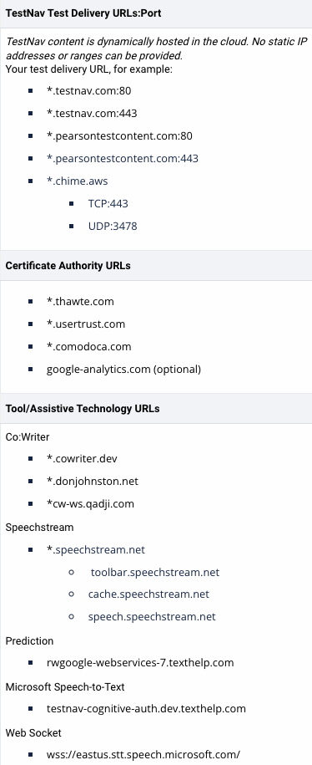
Firewalls and Content Filters
Infrastructure requirements found on TestNav Online Support page (PearsonAccessnext > TestNav Online Support > Network Requirements and Guidelines).
Configure your services, applications, and devices
Explicitly allow traffic to and from the Pearson URLs
External traffic will flow on ports 80 and 443
All appliances and services that may impede, reroute, delay, alter, or block data between TestNav or the Pearson servers should be configured to allow traffic to and from TestNav

Slide 82
Firewalls and Content Filters
Special Considerations
If using SSL Decryption/Inspection, you will need to make an exception rule to not allow the scanning of TestNav secure http traffic to or from the testing URLs.
Inspecting secure http traffic can sometimes result in interrupting TestNav traffic.
If using using Reverse-DNS Lookup, you will need to make a rule preventing Reverse-DNS checks against the provided URLs.
Test Contest hosted in Amazon Web Services
Reverse-DNS lookup may result in false positives
Failure to fully allow TestNav URLs can result in errors during student testing

Slide 83
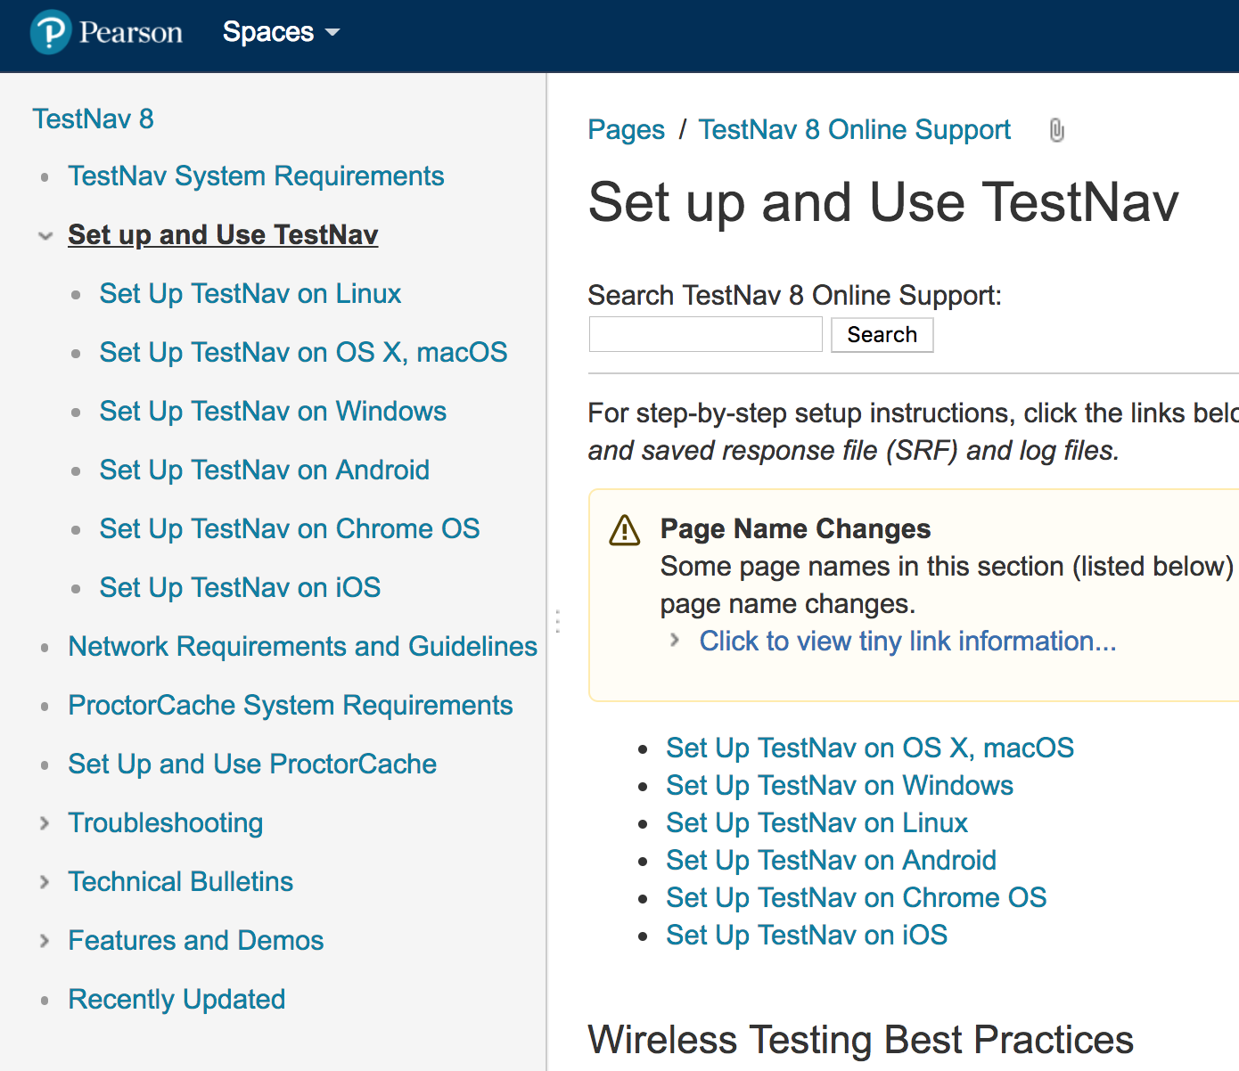
TestNav Setup
Detailed setup steps for all supported devices can be found on the TestNav Online support page (PearsonAccessnext > TestNav Online Support > Set up and Use TestNav).
Device setup varies slightly by device type
Setup generally follows a few main steps
    Verifying system requirements
    Viewing setup instructions
    Installing the app
    Verify installation using AppCheck

Slide 84
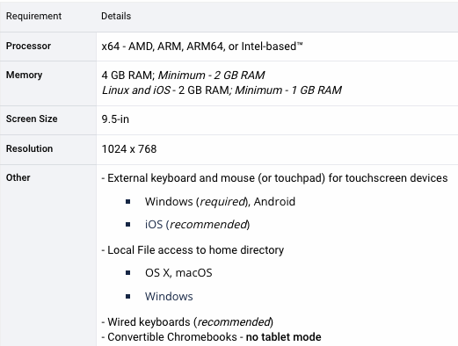
TestNav Hardware Requirements
https://support.assessment.pearson.com/display/TN/TestNav+System+Requirements

Slide 85
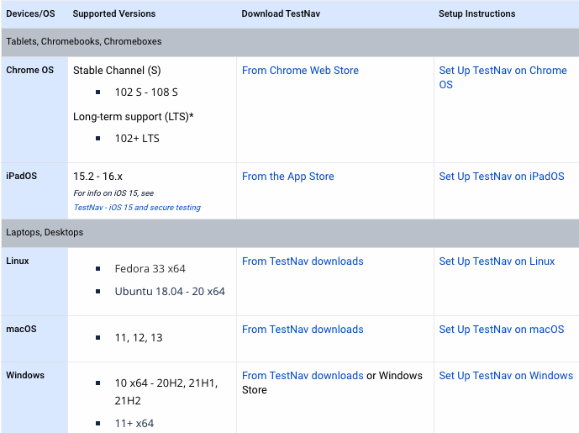
TestNav Software Requirements
https://support.assessment.pearson.com/display/TN/TestNav+System+Requirements
*System requirements as of XX. Districts should refer to the support link above to view the most current supported operating systems.

Slide 86
TestNav Support Changes
Pearson aligns support requirements with changing technologies.
When updates are released, Pearson first tests a beta version and reports bugs to developers.
When the final version is publicly released, Pearson also tests this version to ensure TestNav compatibility before supporting it.
Pearson follows the lead of Operating System vendors, and when hardware or software deprecates, Pearson drops support for it.
TestNav Support page lists Operating System versions currently being tested for compatibility, and the Recently Updated details support changes.

Slide 87
TestNav Setup - Desktop
Traditional laptop and desktop devices running the Windows, Mac, or Linux operating systems.
Main setup steps
Verify devices meet minimum system requirements
View setup instructions
Gather installation files from http://download.testnav.com/
Install TestNav
Verify the installation using AppCheck
Considerations
Device initialization applications / Desktop restoration software (ex. Deepfreeze – Preserve Pearson Directories)
User account read/write access to home directory
Background applications and processes
Windows: Cloud Clipboard History or Roaming, Windows Game Bar and Windows Cortana must be disabled
Mac: Disable Siri and/or Dictation services must be disabled

Slide 88
TestNav Setup - Chromebook
Chromebook setup steps can vary depending on the management options for the device.
Shared Setup Steps
Verify devices meet minimum system requirements
View setup instructions
Verify the installation using AppCheck
Note: It is absolutely critical that Managed Chromebooks are configured to keep User Data after Sign-out.
In the event of technical difficulties Chromebooks must not erase Student Response Files and logs needed for troubleshooting
Managed Devices
Install TestNav on all devices from the Admin console
Allow data to persist for the TestNav application
Set the TestNav application to run in kiosk mode
Unmanaged Devices
Unmanaged Chromebooks/Chromeboxes purchased in 2017 and later cannot run in kiosk mode. See Google Support for more information.

Slide 89
TestNav Setup - iOS
TestNav uses Apple Automatic Assessment Configuration (AAC) to secure the iPads for testing.
Main setup steps
Verify devices meet minimum system requirements
View setup instructions
Search for “TestNav” in App Store
Install TestNav
Verify the installation using AppCheck
The first time TestNav is launched, it displays the Enable Microphone Permission message, be sure to tap OK to grant permission.
Considerations
TestNav can be installed on multiple devices using a Mobile Device Manager (MDM)
Do not use MDM configured Single App Mode, or else AAC will not engage and result in a TestNav error

Slide 90

TestNav Update Installation
TestNav Update Path
Update methods will differ by test device
Typically TestNav will only receive major app updates over the summer, when school is not in session.
Chrome, and Windows store apps - automatically update
iOS – install from the App Store
Mac and Windows desktop app – download and install from TestNav download site

Slide 91


TestNav App Check
Select the ”Reference” customer and click the user drop-down menu, and select App Check.
App Check is used to verify student devices can launch TestNav successfully.

Slide 92

TestNav App Check

Slide 93
TestNav App Check
App Check errors for Cloud Clipboard History or Roaming, Game Bar and Cortana on Windows. App Check errors for Siri or Dictation on Macs.
TestNav will check during App Check, at login and with every navigation. If it finds these services enabled, it will display an error message and the examinee will be forced to leave the test.

Slide 94

TestNav Network Check
Network Check is used to evaluate current bandwidth and the ability to test a specified number of students.

Slide 95


TestNav Network Check
Results

Slide 96
TestNav Early Warning System
Image by Photographer's Name (Credit in black type) or
Image by Photographer's Name (Credit in white type)
Presentation Title Arial Bold 7 pt
96

Slide 97

TestNav Early Warning System
Overview
The Early Warning System (EWS) is a background process in TestNav that
Requires no additional installation or configuration efforts
Displays messaging to the screen in the case an issue is detected
Monitors background applications and connectivity
Stages student responses in an encrypted backup file and transmits student responses to the Pearson testing servers for scoring

Slide 98
TestNav Early Warning System
Triggers
Even though there are multiple error codes, the majority of the potential issues can be traced back to a few main scenarios.
Connectivity
    Unable to retrieve content
    Unable to transmit responses
Saved Response File Issues
    Unable to write or read to SRF location
Potential Security Issues
    Application launches while TestNav is in secure mode
    Application attempts to capture focus
    Running application messages the screen

Slide 99

TestNav Early Warning System
Error Codes
If an EWS message is displayed, it will contain a specific error code.
Complete error code documentation can be found on the TestNav Online Support page (PearsonAccessnext > TestNav Online Support > Troubleshooting > Error Codes).
Numeric error code is usually accompanied by a description of the error and potential resolution steps.

Slide 100


Technical Troubleshooting During Testing
Login Error
9058/9059:
If the username/password being used is accurate, the student may be on the incorrect login page.
To get on the correct login page click the User icon in the top right and select “Choose a different customer”. Then pick ADAM from the App Home Screen.

Slide 101

Technology Office Hours

Slide 102

Technology Office Hours
Schedule time with a technology field engineer.
Set up a one-on-one virtual meeting
Time slots range from 15 minutes to 1 hour
Talk through edge cases, specific setup instructions, or challenges
Schedule your Technology Office Hours at https://calendly.com/vt-field-services-engineering

Slide 103
Questions?

Slide 104
Test Security and Procedures

Slide 105
Test Security
The security of assessment instruments and the confidentiality of student information are vital to maintaining the validity, reliability, and fairness of the results. Security of test materials must be maintained before, during, and after administration.
Secure CBT test materials
Student print cards
Periodic tables written on by students
Scratch paper written on by students
Secure PBT test materials
Test booklets
Periodic tables written on by students
Scratch paper written on by students
All secure test materials must be securely destroyed by the school/district.

Slide 106
Test Security Incidents
Any breaches in test security must be reported to the SC or DC. Test security incidents are categorized below:
Student access to unapproved device/material
Cheating
Sharing, posting, or copying of secure test materials (student)
Sharing, posting, or copying of secure test materials (adult)
Student engaged with incorrect assessment
  Wrong student test, incorrect grade level
Technology issue interrupting test session (unable to restart session)
All test security incidents must be reported to AOE using the Test Security Incident Form available on the Documentation and Training page of the Vermont Help and Support website.

Slide 107

Test Security Incidents
In some cases, a test security incident has a low impact on the individual or group of students who are testing and has a low risk of potentially affecting student performance on the test, test security, or test validity.
These circumstances can be corrected and contained at the local level. Such incidents do not need to be reported to the AOE.
Examples include a fire drill occurring during a test session or minor connectivity issues interrupting testing.

Slide 108
Test Security Incidents
An unusual circumstance that impacts an individual or group of students who are testing and may potentially affect student performance on the test, test security, or test validity must be reported to the AOE.
These circumstances can be corrected and contained at the local level. An irregularity must be reported to the SC and DA immediately.
Examples include more significant technology issues, students talking to each other during testing, or inappropriate assignment/use of an accommodation.

Slide 109
Test Security Incidents
In rare cases, a test security incident may pose a threat to the validity of the test. Examples may include such situations as a release of secure materials or a security/system risk.
These circumstances have implications for anyone using the test items (perhaps outside of Vermont) and may result in a decision to remove the test item(s) from the available secure bank.
Such an incident must be reported to the DC and SC immediately and must be reported to the AOE promptly.

Slide 110
Before, During, and After Testing

Slide 111


Checklist for Test Coordinators
Refer to the TCM for a full checklist of activities for District and School Test Coordinators
Appendix A – District Test Coordinator Checklist
Appendix B – School Test Coordinator Checklist

Slide 112
Before Testing
District and School Test Coordinators
Review the Test Coordinator’s Manual
Notify schools and staff when training, manuals, and other documentation are available
Ensure staff are properly trained
Finalize testing schedules to ensure adequate time and resource planning
Ensure the proper version of TestNav is downloaded on student computers
Validate the student roster and make any necessary updates
  Are all students in ADAM?
  Are all students assigned to the correct grade?
  Is the identifier the correct, 7-digit, state assigned student ID?
  Do all students have the appropriate accommodations and supports assigned?
CBT: Prepare proctor test packets
  Proctor print cards: test name, test code, and proctor password
  Student print cards: test code, SSID
PBT: Ensure all print materials have been received, and order additional materials if needed

Slide 113
Before Testing
Teachers and Proctors
Review the Test Administrator’s Manual
Complete training facilitated by the DC/SC
Provide students the opportunity to take the practice test
Validate the student roster and notify the DC/SC of any errors
  Are all students in ADAM?
  Are all students assigned to the correct grade?
  Is the identifier the correct, 7-digit, state assigned student ID?
  Do all students have the appropriate accommodations and supports assigned?
Receive necessary student materials (e.g. scratch paper, log in information, accommodation materials)
Adhere to all school, district, and state test security policies and procedures

Slide 114
During Testing
District and School Coordinators
Monitor test progress
Ensure all staff adhere to security policies and procedures
Investigate and report any test security incidents
Teachers and Proctors
Monitor students during testing
Use of cell phones and electronic devices is strictly prohibited
Adhere to security policies and procedures
Report any test security incidents to the SC
Follow the test administration script exactly
Follow procedures for administering paper accommodations

Slide 115
After Testing
District and School Test Coordinators
Ensure all test material has been securely destroyed
Apply Accountability Codes in ADAM for students who were exempt from testing, if needed
  First Year EL
  Medical Exemption
  Participated in MSAA
Invalidate tests, if needed
  Requests for invalidation must be submitted to AOE

Slide 116
After Testing
Teachers and Proctors
Submit student responses in TestNav for any paper testers
Collect and securely destroy any testing materials
  Test booklets
  Student print cards
  Scratch paper
  Periodic tables written on by students

Slide 117
State Assessment Assurances

Slide 118
Overview of Assurances
Different roles (e.g., DA, SC, TA) have different responsibilities.
Not every assurances form must be submitted to AOE (some are kept on file at the district or school).
Some assurances are collected before testing, while others are collected during or after testing.
The AOE will be reaching out to DAs by February 1 to provide information on assurances and observations for SY24.

Slide 119
Resources
Vermont Help & Support site
  https://vermont.onlinehelp.cognia.org
Resources are posted throughout the year
  Key dates
  Announcements
  Documentation and Training
  Online Testing
  Practice Test
  Reporting
  Formative Resources

Slide 120
Vermont Service Center
Hours
  Monday–Friday 7:00 a.m.–5:00 p.m. Eastern
Contact Information
  Phone: 800-215-8975
  Email: VTServiceCenter@cognia.org

Slide 121
Thank you!

