Slide 1
Spring 2025 VTCAP Proctor Training

Slide 2
Agenda
VTCAP Overview
Test Security and Procedures
Accommodations and Designated Supports
Assessment Delivery and Management (ADAM)
Before, During, and After Computer-Based Testing
Test Proctoring
Student Testing Experience
Before, During, and After Paper-Based Testing
Resources and Support

Slide 3
VTCAP Overview

Slide 4
VTCAP Assessments
Grades and Contents
English language arts, grades 3–9
Mathematics, grades 3–9
Science, grades 5, 8, and 11
Format
Adaptive, computer-based test (CBT) – primary mode of administration
Fixed, accommodated CBT
ASL
Screen reader
Translations (Math & Science only)
Fixed, accommodated paper-based test (PBT)
Standard print
Large print
Braille (as Braille Ready Files)

Slide 5
Key Dates
Rostering window for ordering paper materials in ADAM | January 6–31, 2025
Rostering window for all testers | January 6–March 7, 2025
Initial order of paper-based materials arrives in schools | March 3, 2025
Additional materials ordering window | March 3–April 25, 2025
Test administration window | March 10–April 25, 2025
Make-up test administration window | April 28–May 2, 2025

Slide 6
Roles and Responsibilities
District Administrator (DA)
District Test Coordinator (DC)
School Test Coordinator (SC)
Teacher
Proctor
New for 2025:
IT Coordinator
Special Education Director
Superintendent

Slide 7
Roles and Responsibilities
The District Test Administrator (DA):
Assumes overall responsibility for implementing VTCAP assessments in their organization
Serves as the local point of contact for questions and information
Disseminates information about assessments with the district and schools
Organizes training for SCs
Creates accounts for other users within their organization
Uploads students for their organization
*Note: The DA can assign District Test Coordinators (DC) as needed to assist with their responsibilities or may also serve as the DC.

Slide 8
Roles and Responsibilities
The District Test Coordinator (DC):
Reviews schedule and testing requirements with SCs, teachers, and proctors
Works with SCs and technology staff to ensure all systems are properly installed and functioning
Creates accounts for other users within their organization
Uploads students for their organization
Schedules and administers training sessions
Ensures all personnel are trained on how to properly administer the VTCAP assessments
Monitors secure administration
Investigates and reports all testing irregularities and breaches reported by the SC, teacher, or proctor
Ensures all testing materials remain secure

Slide 9
Roles and Responsibilities
The School Test Coordinator (SC):
Coordinates the administration of VTCAP assessments within their school
Ensures testing within their school is conducted properly and securely
Establishes testing schedules
Works with technology staff to ensure all systems are properly installed and functioning
Ensures student information in ADAM is accurate
Ensures appropriate accommodations or designated supports are assigned in ADAM
Attends all district training and reviews the manuals
Ensures teachers and proctors attend training or review training modules
Monitors secure administration of the test
Monitors student test progress
Investigates and reports any test security incidents

Slide 10
Roles and Responsibilities
The Teacher and/or Proctor:
Completes all district and/or school training
Reviews the Test Administrator’s Manual (TAM)
Reviews student information prior to testing to ensure each student receives the proper test with appropriate supports.
Administers the VTCAP assessments
Reports any test security incidents to the SC or DC

Slide 11
Roles and Responsibilities
IT Coordinator, Special Education Director, and Superintendent
Optional roles than can be used in your district as needed
District-level access to student information
The IT Coordinator can:
Add/edit student accounts and accommodations
Create proctor groups
View reports
The Special Education Director can:
Add/edit student accounts and accommodations
View reports
The Superintendent can:
View reports

Slide 12
Test Security and Procedures

Slide 13
Test Security
The security of assessment instruments and the confidentiality of student information are vital to maintaining the validity, reliability, and fairness of the results. Security of test materials must be maintained before, during, and after administration.
Secure CBT test materials
Student print cards
Scratch paper written on by students
Secure PBT test materials
Test booklets
Periodic tables written on by students
Scratch paper written on by students
All secure test materials must be securely destroyed by the school/district.

Slide 14
Test Security Incidents
Any breaches in test security must be immediately reported to the SC or DC. Test security incidents are categorized below:
Student access to unapproved device/material
Cheating
Sharing, posting, or copying of secure test materials (student)
Sharing, posting, or copying of secure test materials (adult)
Student engaged with incorrect assessment
Wrong student test, incorrect grade level
Technology issue interrupting test session (unable to restart session)
All test security incidents must be reported to AOE using the Test Security Incident (Irregularity) Form.

Slide 15
Test Security Incidents
In some cases, a test security incident has a low impact on the individual or group of students who are testing and has a low risk of potentially affecting student performance on the test, test security, or test validity.
These circumstances can be corrected and contained at the local level. Such incidents do not need to be reported to the AOE.
Examples include a fire drill occurring during a test session or minor connectivity issues interrupting testing.

Slide 16
Test Security Incidents
An unusual circumstance that impacts an individual or group of students who are testing and may potentially affect student performance on the test, test security, or test validity must be reported to the AOE.
These circumstances can be corrected and contained at the local level. An irregularity must be reported to the SC and DA immediately.
Examples include more significant technology issues, students talking to each other during testing, or inappropriate assignment/use of an accommodation.

Slide 17
Test Security Incidents
In rare cases, a test security incident may pose a threat to the validity of the test. Examples may include such situations as a release of secure materials or a security/system risk.
These circumstances have implications for anyone using the test items (perhaps outside of Vermont) and may result in a decision to remove the test item(s) from the available secure bank.
Such an incident must be reported to the DC and SC immediately and must be reported to the AOE promptly.

Slide 18
Accommodations & Designated Supports

Slide 19
Universal Tools
Embedded Universal Tools
Answer eliminator
Desmos calculator
Highlighter
Line reader mask
Magnifier
Notepad
Pop-up glossary
Writing tools
Zoom
Non-Embedded Universal Tools
Breaks
English dictionary (Math and Science)
Scratch paper
Thesaurus (Math and Science)

Slide 20
Designated Supports
Embedded Designated Supports
Text-to-speech (Math and Science)
Translations (Math and Science)
Arabic (Standard MENA)
Chinese (Simplified Mandarin)
French
Spanish (Nicaraguan)
Swahili
Non-Embedded Designated Supports
Amplification
Bilingual dictionary (Math, Science, and Writing)
Color overlays
Magnification
Medical device
Noise buffers
Separate setting
Simplified test directions

Slide 21
Accommodations
Embedded Accommodations
American Sign Language (ASL)
Closed captioning
Color contrast
Screen reader
Speech to text (ELA & Science)
Text to speech (ELA)
Non-Embedded Accommodations
100s number table
Abacus
Alternate response options
Calculator (talking or braille)
Multiplication table
Read aloud/human reader
Scribe
Speech to text (Math)
Print-Based Accommodations
Standard print
Large print
Braille

Slide 22
Administering Accommodations
Some accommodations require the student to take a fixed-form test.
ASL and closed captioning
Screen reader
Alternate languages
Print-based forms (paper, large print, braille)
Additional considerations:
The screen reader will not have an embedded calculator. Students should be provided with a handheld calculator or other appropriate calculator based on their accommodations.
For Science, the fixed form has three sessions. The CAT form has two sessions.
Refer to the Accessibility and Accommodations Guidelines on the Documentation and Training page of the Vermont Help and Support website for additional details on your students’ specific accommodations.

Slide 23
Assessment Delivery and Management (ADAM)

Slide 24
ADAM and TestNav
ADAM is the platform used to manage users, accommodations, administrations,
classes, proctor groups, and view reports.
ADAM is used by:
District Administrators
District Test Coordinators
School Test Coordinators
Teachers
IT Coordinators
Special Education Directors
Superintendents
TestNav is the testing engine used to deliver summative assessments.
TestNav is used by:
Students

Slide 25
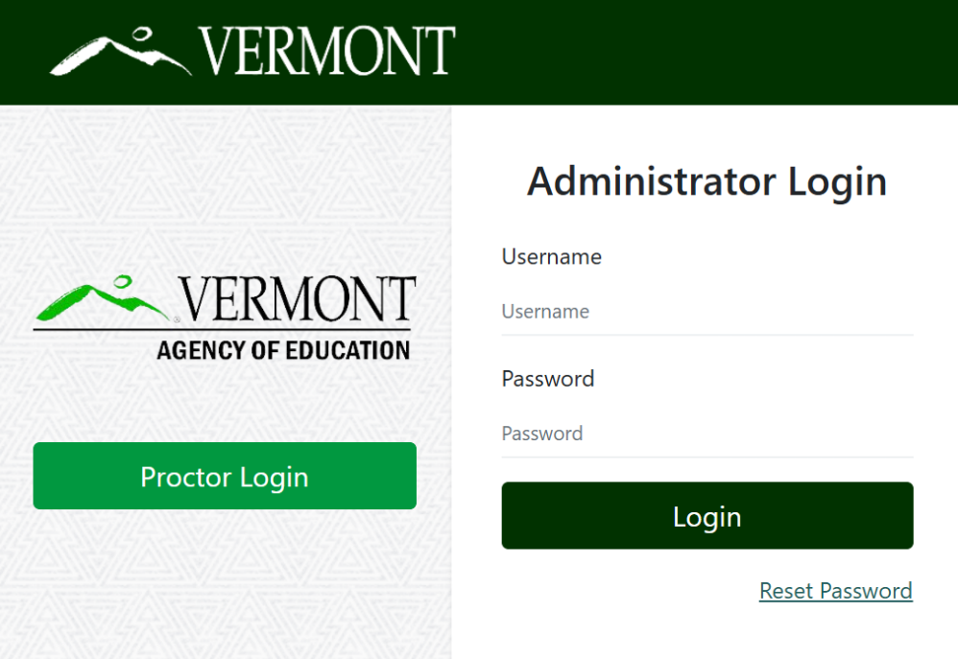
Logging in to ADAM
Go to: https://vt.adamexam.com/
2. Enter username and password (received via email)
3. Click Login
4. To reset your password, click “Reset Password”.

Slide 26
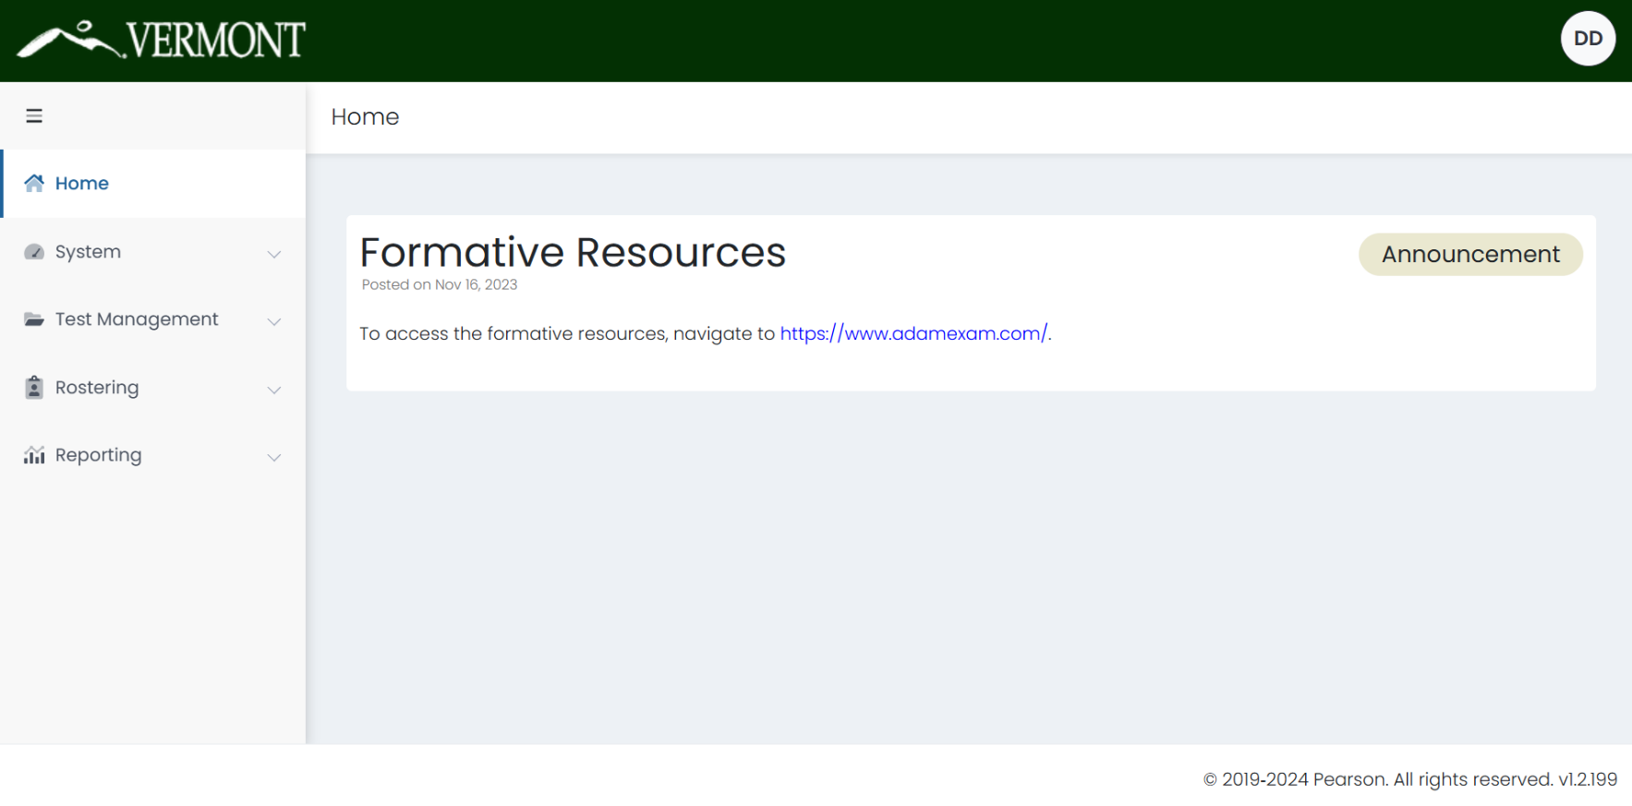
Logging in to ADAM
Once logged in to ADAM you will see the main dashboard screen.
From here you can navigate to System > Profile to view your role, and to Rostering to upload and view your students.

Slide 27
User Roles
Role | Add/Edit Students | Add/Edit Users | Add/Edit Accommodations | Proctor Test | View Reports
District Administrator | X | X | X | X | X
District Test Coordinator | X | X | X | X | X
School Test Coordinator | X | X | X | X | X
IT Coordinator | X | X | X | X | X
Special Education Director | X | X | X |  | X
Superintendent |  |  |  |  | X
Teacher |  |  |  | X | X*
Proctor |  |  |  | X
*Teachers will be able to view reports under My Classes if a class is assigned to them during
administration.

Slide 28
View Roster Data
To search for a user including students:
On the left side of the User Config page, enter or select the appropriate filters. The search is dynamic, so you change the filter fields at any time to alter the search.
Name or ID
Org – Filter by a specific district or school.
Class – If you have filtered by School, the Class filter will also display. This can then be used if classes have been created within that org.
Role
Course
User Status
Accommodation – Filter by a specific accommodation (e.g. Paper or Text to Speech).

Slide 29
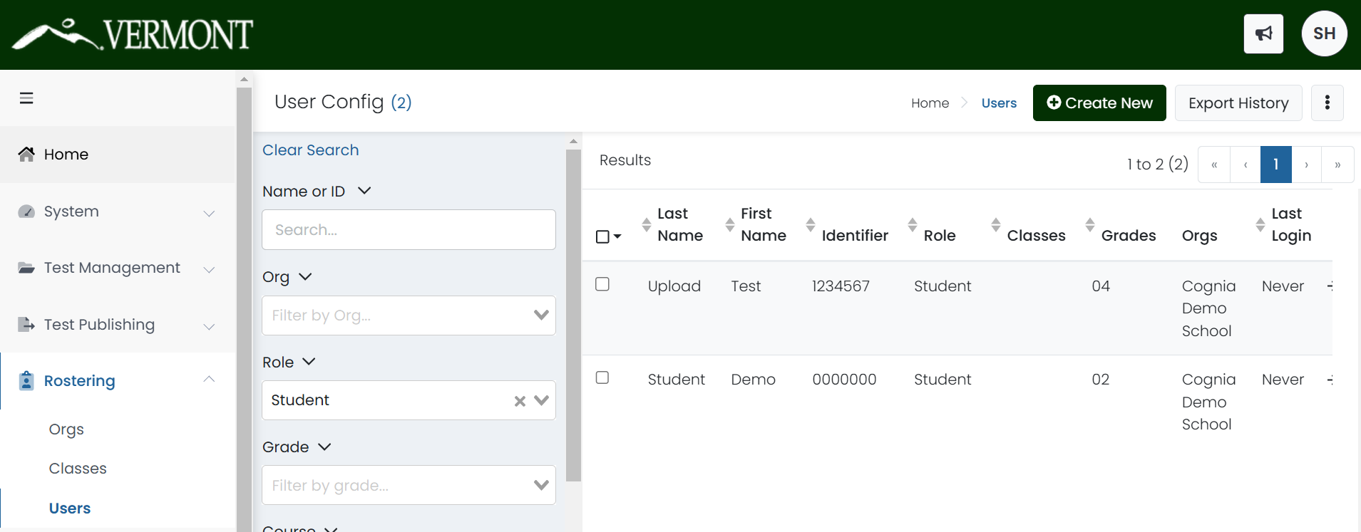
View Roster Data

Slide 30
Before, During, and After Computer-Based Testing (CBT)

Slide 31
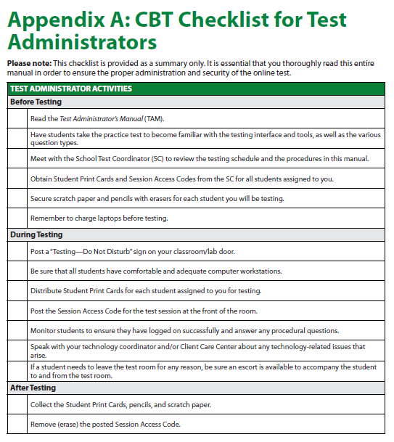
CBT Checklist for Test Administrators
Refer to Appendix A of the TAM for the CBT Checklist for Test Administrators
It may be helpful to print this checklist out to ensure proper administration

Slide 32
Before CBT Testing
Teachers and Proctors
Assurance: Complete training facilitated by the DC/SC
Assurance: Sign the Non-Embedded Accommodation Non-Disclosure Agreement if administering non-embedded accommodations and submit to the SC
Review the Test Administrator’s Manual (TAM)
Provide students the opportunity to take the practice test
Validate the student roster and notify the DC/SC of any errors
Are all students in ADAM?
Are all students assigned to the correct grade?
Is the identifier the correct, 7-digit, state assigned student ID?
Do all students have the appropriate accommodations and supports assigned?
Review your school’s testing schedule
Receive necessary student materials (e.g. scratch paper, log in information, accommodation materials)
Adhere to all school, district, and state test security policies and procedures

Slide 33
Before CBT Testing
Teachers and Proctors
Prepare the testing environment
Ensure laptops are fully charged and workstations are set up to prevent student’s from seeing each other’s work
Obtain scratch paper and pencils for each student
Obtain Session Access Codes and Student Login Tickets
Hang a “Testing—Do Not Disturb” sign on the door
Ensure nothing is visible in the room that could clue any test answers
Ex: rubrics, writing guides, word walls, hundreds charts, multiplication fact tables

Slide 34
During CBT Testing
Teachers and Proctors
Monitor students during testing
Use of cell phones and electronic devices is strictly prohibited
Adhere to security policies and procedures
Report any test security incidents to the SC
Follow the test administration script exactly
Beginning on p. 23 of the TAM

Slide 35
After CBT Testing
Teachers and Proctors
Ensure all students click Submit once they complete a test session and are showing in the Proctor Dashboard as Submitted
Collect and securely destroy any testing materials
Test booklets
Student print cards
Scratch paper
Periodic tables written on by students

Slide 36
Test Proctoring

Slide 37
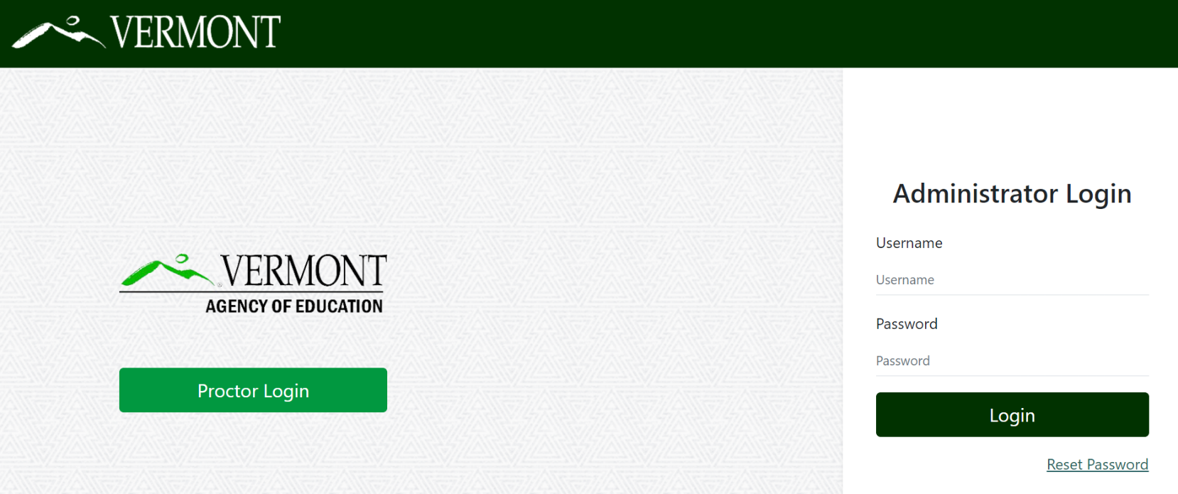
Proctor Login
Go to: https://vt.adamexam.com
Click on Proctor Login

Slide 38
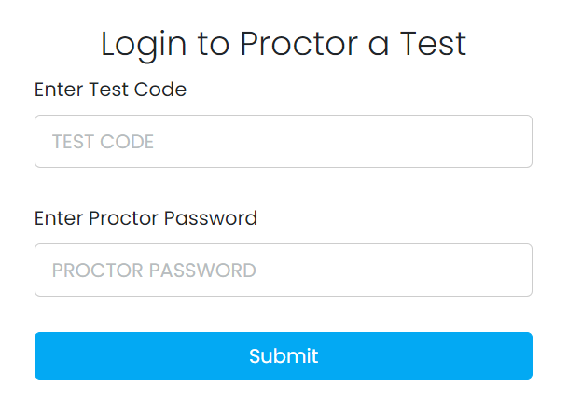
Proctor Login
Enter the Test Code and Proctor Password provided by your school.
Click Submit.

Slide 39
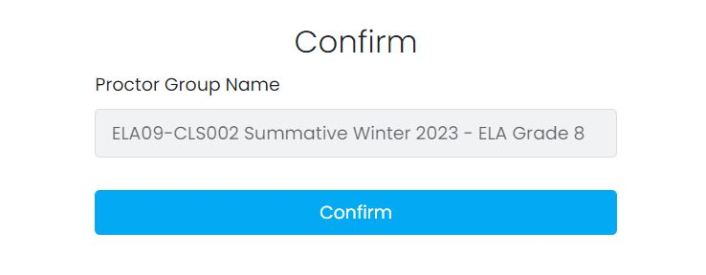
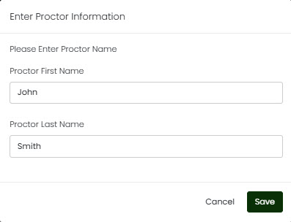
Proctor Login
On the next screen, confirm the Proctor Group Name is accurate, then click Confirm.
Enter your first and last name, then click Save.

Slide 40
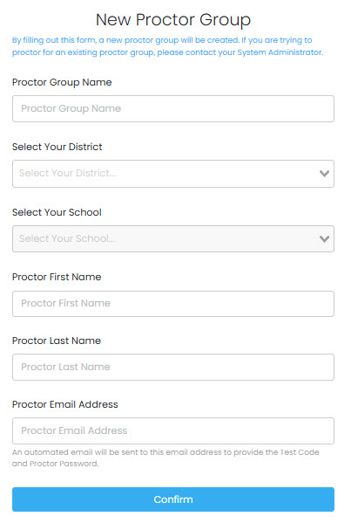
Create a New Proctor Group
To create a new proctor group, enter the:
Proctor group name
District
School
Proctor first name
Proctor last name
Proctor email address
*Note: Make the Proctor Group Name unique, such as S.Hanlon Grade 6 Math First Period

Slide 41
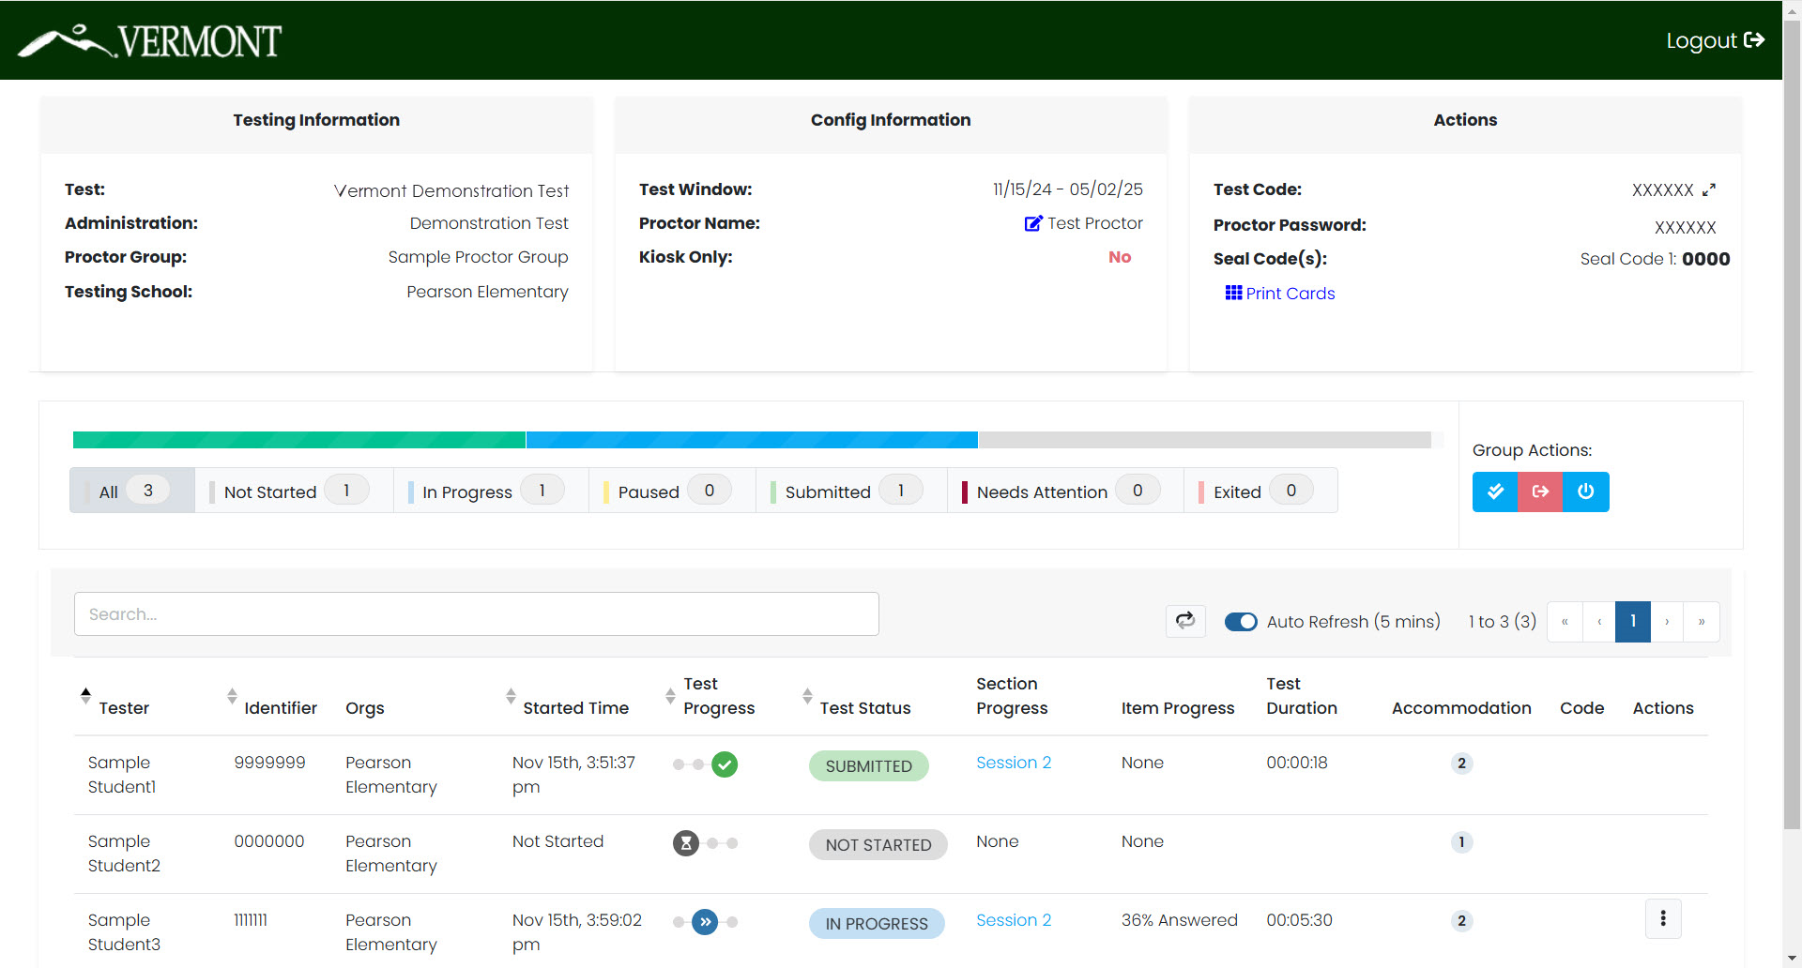
Proctor Dashboard

Slide 42
Proctor Dashboard
The following sections appear on the Proctor Dashboard:
Testing Information
This section includes the name of the test, administration, proctor group, and testing school.
Config Information
This section provides the VTCAP testing window, the proctor name, and a field called Kiosk Only, which for the Vermont assessments will always be “No.”
Actions
This section includes the test code, proctor password, and seal code(s).
Click the expand arrows found next to the code to maximizes the code to a full-screen view of the test code.
Click the Print Cards button to open a new window with the student print cards for that proctor group. These can be printed and distributed to students.

Slide 43
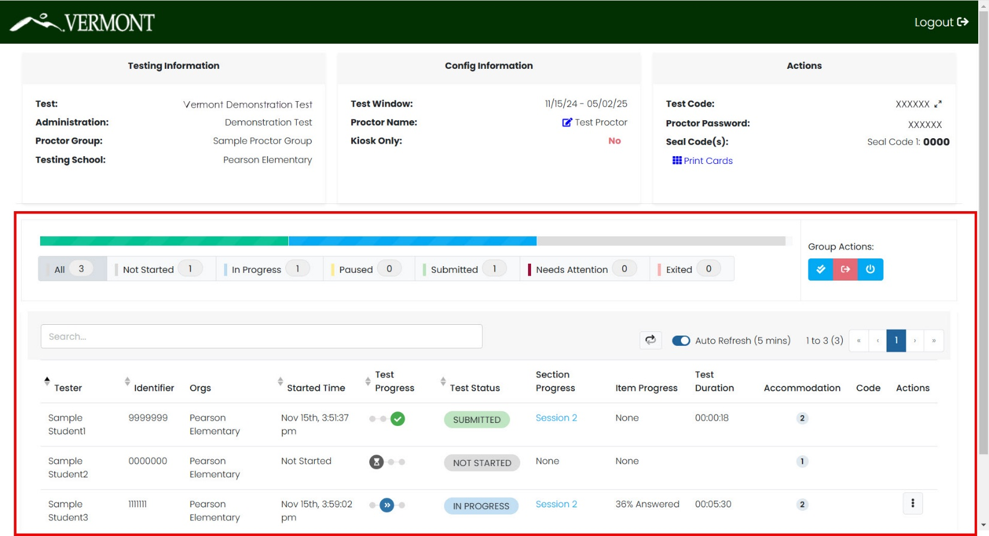
Proctor Dashboard
Session Management Area
In this area, you will be able to view, filter, and search for students in your proctor group and manage their sessions.

Slide 44
Proctor Dashboard
The Session Management area has the following information:
Tester: Student’s name
Identifier: Student’s state-assigned student ID
Orgs: The student’s assigned testing school
Started Time: The time the student began testing.
Test Progress:
– Not Started
– Started
– Submitted

Slide 45
Proctor Dashboard
Test Status:
Not Started – The student has not logged into the assessment. No action is needed by the Proctor.
In Progress – The student has logged into the assessment. The student has recently interacted with the assessment.
Exited – The student has exited the TestNav app. The Proctor needs to reseat the student before they can log back into the assessment.
Reseat – The proctor has reseated the student, and the student has not logged back into the test session. No action needed.
Need Attention – The student has logged into the test, but the proctor needs to approve the session for the student to begin.
Submitted – The student has completed and submitted the test.

Slide 46
Proctor Dashboard
Section Progress/Item Progress:
The Section Progress and Item Progress columns show the completion of a section or test. While a student is actively testing, this column will only show N/A.
Test Duration: The amount of time the student has been testing.
Accommodation:
The number of accommodations a student has appears in this column. Hover over the count to show the accommodations. Only accommodations relevant to the online assessment session administration will be displayed.
Code: This will display if a student has an accountability code assigned.
Actions:
Available actions will appear based on the testing status of the student:
Reseat Session – Use if a student has an “interrupted” session (computer issue, session timeout, unexpected error). Reseating allows the student to re-enter their test code and SSID to resume their assessment session.

Slide 47
Proctor Dashboard
Session Details
Another action available may be View Session Details.
Section Information
Section ID ● Seal Code
Section Name ● Start Time
Section Type ● End/Exited Time
Progress
Item graphic
Item information
Item # ● Item UIN
Section ID ● Progress
Sequence ● Last Update

Slide 48
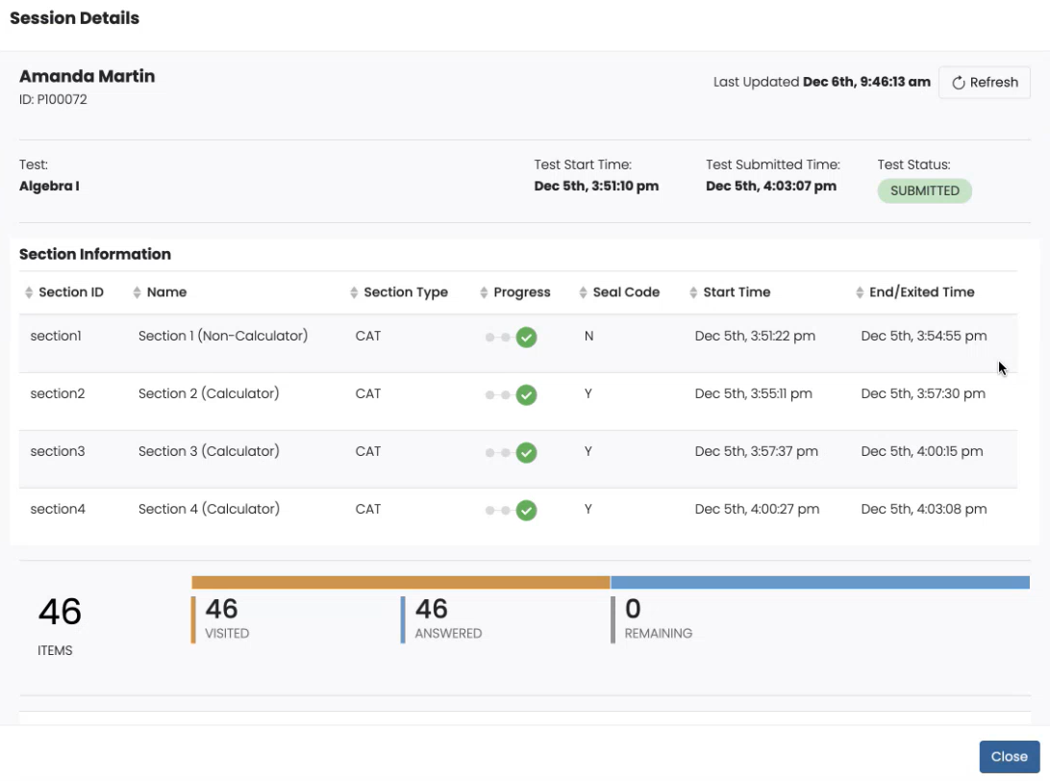
Proctor Dashboard
Session Details

Slide 49
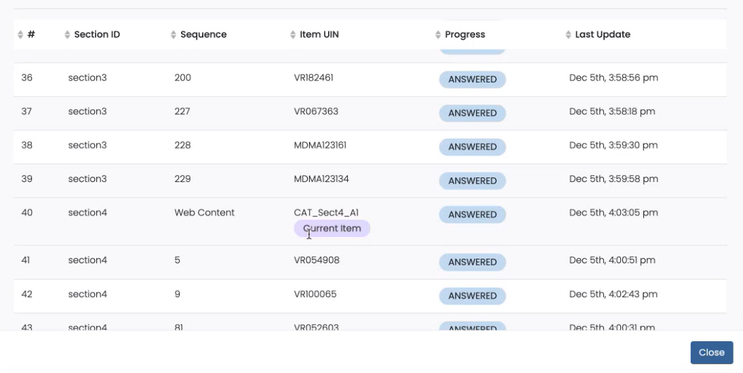
Proctor Dashboard
Session Details

Slide 50
Student Testing Experience

Slide 51
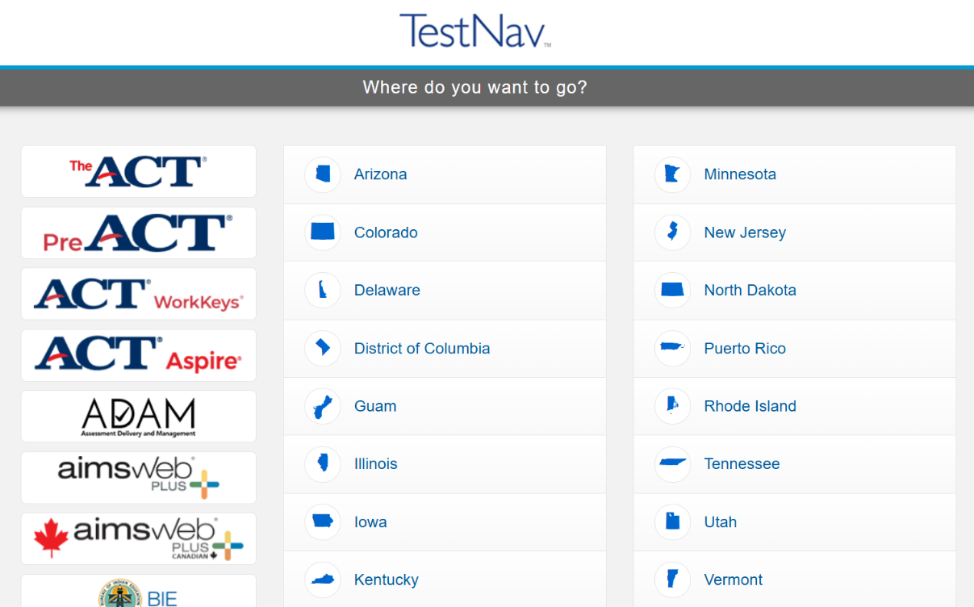
Student Experience
Log in
Make sure TestNav is installed on your device and close all other apps.
1. Open the TestNav app.
2. Click the Vermont link on the “Where do you want to go?” screen.

Slide 52
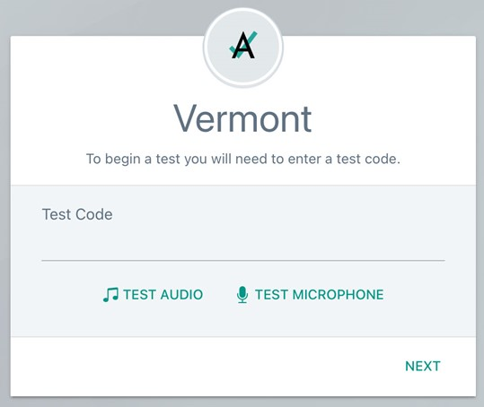
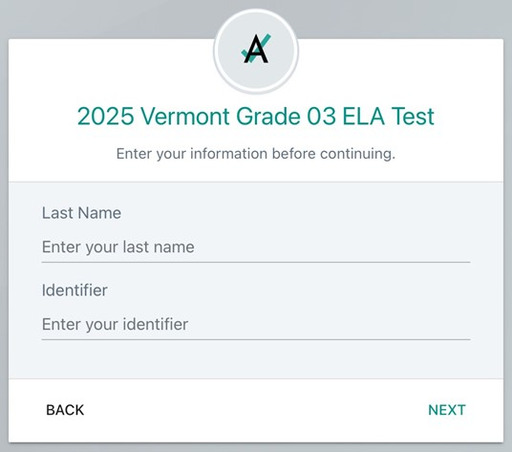
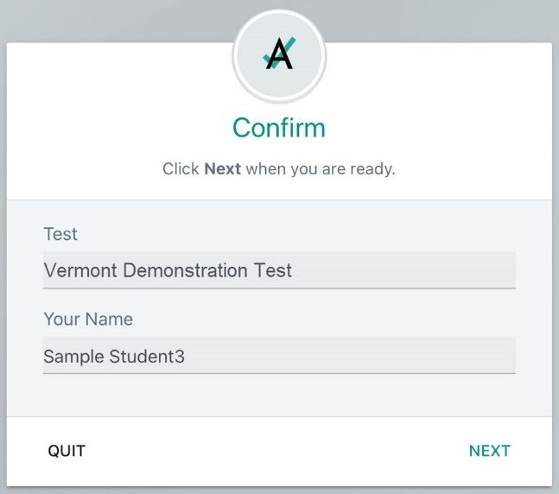
Student Experience
Log in
3. Enter your Test Code and click Next.
4. Enter your Last Name and Identifier, then click Next.
5. Verify your name and test and click Next; test will launch.

Slide 53
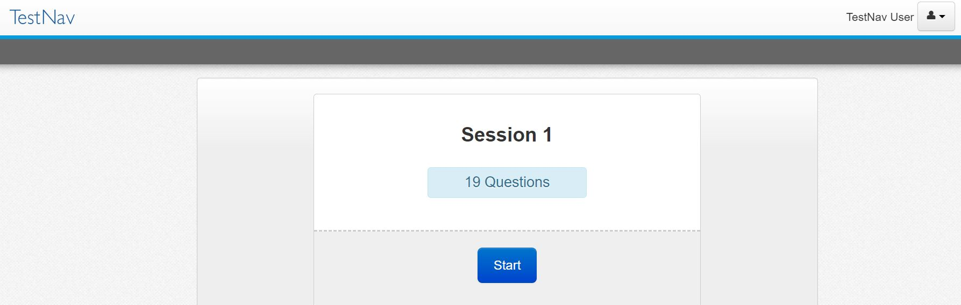
Student Experience
Press Start to begin the test.
Click Start on the first session.

Slide 54
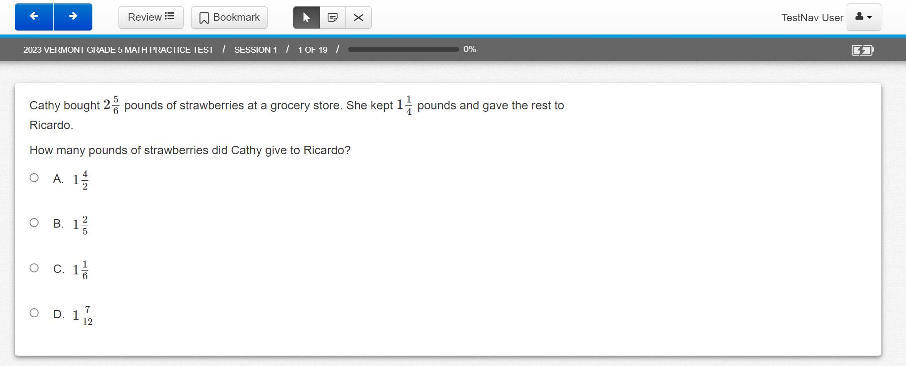
Student Experience
Read the session directions, and then navigate to the first item.
Answer the item question.

Slide 55
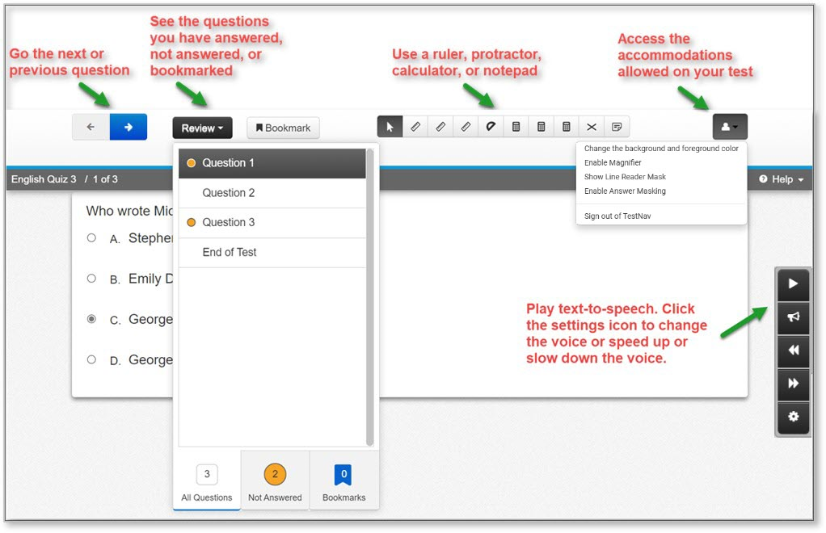
Student Experience
The student test will include the universal tools and any accommodations assigned to the student.

Slide 56
Desmos Calculator
Mathematics
Grades 3–5: Four-function with square root and percentage functions
Grades 6–8: Scientific
Grade 9: Graphing
Science
Grades 5 & 8: Four-function with square root and percentage functions
Grade 11: Scientific

Slide 57
Before, During, and After
Paper-Based Testing (PBT)

Slide 58
Before PBT Testing
Teachers and Proctors
Assurance: Complete training facilitated by the DC/SC
Assurance: Sign the Non-Embedded Accommodation Non-Disclosure Agreement if administering non-embedded accommodations and submit to the SC
Review the Test Administrator’s Manual (TAM)
Provide students the opportunity to take the practice test
Review your school’s testing schedule
Adhere to all school, district, and state test security policies and procedures

Slide 59
Before PBT Testing
Teachers and Proctors
Prepare the testing environment
Ensure there is sufficient lighting and space between desks
Hang a “Testing—Do Not Disturb” sign on the door
Ensure nothing is visible in the room that could clue any test answers
Ex: rubrics, writing guides, word walls, hundreds charts, multiplication fact tables
Prepare student materials
Test booklets
Obtain scratch paper and pencils for each student
Other support materials based on grade/content
Calculators (Math and Science only)
Periodic table (Science, Grade 11)

Slide 60
During PBT Testing
Teachers and Proctors
Monitor students during testing
Use of cell phones and electronic devices is strictly prohibited
Adhere to security policies and procedures
Report any test security incidents to the SC
Follow the test administration script exactly
Beginning on p. 50 of the TAM

Slide 61
During PBT Testing
Large Print
Read the directions and scripts exactly as you would for a standard administration
It is recommended that students work at tables to allow for the booklet’s size
Student responses are recorded directly into the test booklet
Braille
Read the directions and scripts exactly as you would for a standard administration
Students may record their responses:
Using braille on a separate sheet of braille paper
Directly in the braille version of the test booklet
Using a word processor (without spelling and grammar check) for short-answer or open-ended response questions
Using a scribe, if indicated in the student’s IEP

Slide 62
After PBT Testing
Teachers and Proctors
All student responses must be submitted by the teacher or proctor into TestNav for scoring
All student responses must be transcribed verbatim into TestNav
Collect and securely destroy any testing materials
Test booklets
Scratch paper
Periodic tables written on by students

Slide 63
Resources & Support

Slide 64
Practice Test
Practice tests are available for all grades and contents assessed
Standard
Text to Speech
ASL
Student test experience may vary from operational test experience
Review & Bookmark buttons
Available in some operational forms but restrict students within an item set for computer-adaptive tests
End of Session Review Screen shows which items were answered
Score Report available after a student submits that provides information on whether machine-scored items were answered correctly

Slide 65
Resources
https://vermont.onlinehelp.cognia.org
Resources are posted throughout the year
Key dates
Announcements
Documentation and Training
Online Testing
Practice Test
Reporting
Formative Resources

Slide 66
Vermont Service Center
Hours
Monday–Friday 7:00 a.m.–5:00 p.m. Eastern
Contact Information
Phone: 800-215-8975
Email: VTServiceCenter@cognia.org

Slide 67
Thank you!

