Slide 1
2025 VTCAP Administration Training

Slide 2
Agenda
Welcome and Introductions
VTCAP Assessment Overview and Key Dates
Assessment Delivery and Management (ADAM)
Logging in
Adding/editing students
Accommodations
Creating Classes
Adding/editing users
Test administration and test proctoring
TestNav
Student testing experience
Technology set up
Resources and troubleshooting
Before, During, and After Testing
Test Security
AOE Observations
Resources and Support

Slide 3
Welcome & Introductions
Vermont Agency of Education (AOE)
Danielle Dupuis, Director of Assessment and Accountability
Mabika Goma, VTCAP Assessment Coordinator
Cognia
Sara Hanlon, Senior Program Manager
Pearson
Stephanie Ada, Senior Project Manager
Vidyasagar Sunkara, Technical Project Manager

Slide 4
VTCAP Overview

Slide 5
VTCAP Assessments
Grades and Contents
English language arts, grades 3–9
Mathematics, grades 3–9
Science, grades 5, 8, and 11
Format
Adaptive, computer-based test (CBT) – primary mode of administration
Fixed, accommodated CBT
ASL
Screen reader
Translations (Math & Science only)
Fixed, accommodated paper-based test (PBT)
Standard print
Large print
Braille (as Braille Ready Files)

Slide 6
Key Dates
Rostering window for ordering paper materials in ADAM | January 6–31, 2025
Rostering window for all testers | January 6–March 7, 2025
Initial order of paper-based materials arrives in schools | March 3, 2025
Additional materials ordering window | March 3–April 25, 2025
Test administration window | March 10–April 25, 2025
Make-up test administration window | April 28–May 2, 2025

Slide 7
Roles and Responsibilities
District Administrator (DA)
District Test Coordinator (DC)
School Test Coordinator (SC)
Teacher
Proctor
New for 2025:
IT Coordinator
Special Education Director
Superintendent

Slide 8
Roles and Responsibilities
The District Test Administrator (DA):
Assumes overall responsibility for implementing VTCAP assessments in their organization
Serves as the local point of contact for questions and information
Disseminates information about assessments with the district and schools
Organizes training for SCs
Creates accounts for other users within their organization
Uploads students for their organization
*Note: The DA can assign District Test Coordinators (DC) as needed to assist with their responsibilities or may also serve as the DC.

Slide 9
Roles and Responsibilities
The District Test Coordinator (DC):
Reviews schedule and testing requirements with SCs, teachers, and proctors
Works with SCs and technology staff to ensure all systems are properly installed and functioning
Creates accounts for other users within their organization
Uploads students for their organization
Schedules and administers training sessions
Ensures all personnel are trained on how to properly administer the VTCAP assessments
Monitors secure administration
Investigates and reports all testing irregularities and breaches reported by the SC, teacher, or proctor
Ensures all testing materials remain secure

Slide 10
Roles and Responsibilities
The School Test Coordinator (SC):
Coordinates the administration of VTCAP assessments within their school
Ensures testing within their school is conducted properly and securely
Establishes testing schedules
Works with technology staff to ensure all systems are properly installed and functioning
Ensures student information in ADAM is accurate
Ensures appropriate accommodations or designated supports are assigned in ADAM
Attends all district training and reviews the manuals
Ensures teachers and proctors attend training or review training modules
Monitors secure administration of the test
Monitors student test progress
Investigates and reports any test security incidents

Slide 11
Roles and Responsibilities
The Teacher and/or Proctor:
Completes all district and/or school training
Reviews the Test Administrator’s Manual (TAM)
Reviews student information prior to testing to ensure each student receives the proper test with appropriate supports.
Administers the VTCAP assessments
Reports any test security incidents to the SC or DC
Note: Proctors should be licensed school personnel.
If a paraprofessional or substitute teacher must serve as a proctor, the individual must be fully trained in test administration and test security procedures.

Slide 12
Roles and Responsibilities
IT Coordinator, Special Education Director, and Superintendent
Optional roles than can be used in your district as needed
District level access to student information
The IT Coordinator can:
Add/edit student accounts and accommodations
Create proctor groups
View reports
The Special Education Director can:
Add/edit student accounts and accommodations
View reports
The Superintendent can:
View reports

Slide 13
ADAM and TestNav
ADAM is the platform used to manage users, accommodations, administrations,
classes, proctor groups, and view reports.
ADAM is used by:
District Administrators
District Test Coordinators
School Test Coordinators
Teachers
IT Coordinators
Special Education Directors
Superintendents
TestNav is the testing engine used to deliver summative assessments.
TestNav is used by:
Students

Slide 14
Assessment Delivery and Management (ADAM)

Slide 15
Logging in to ADAM

Slide 16
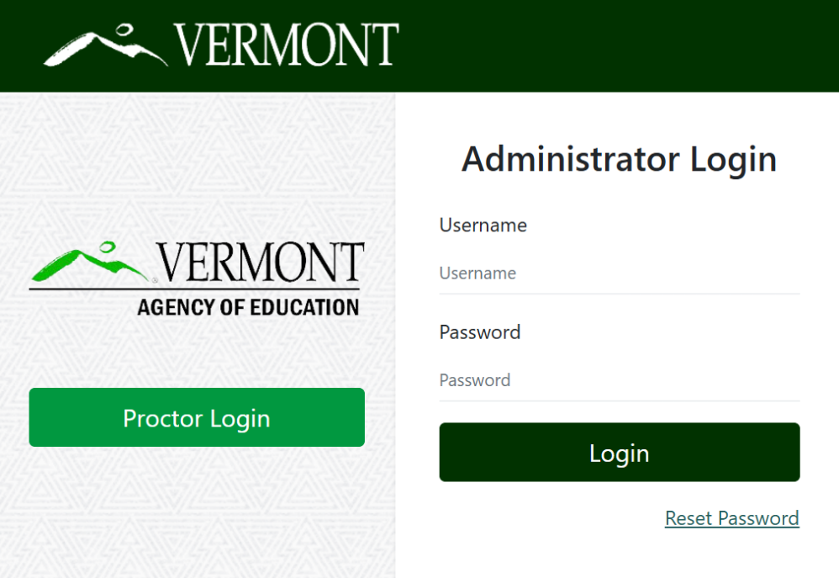
Logging in to ADAM
Go to: https://vt.adamexam.com/
2. Enter username and password (received via email)
3. Click Login
4. To reset your password, click “Reset Password”.

Slide 17
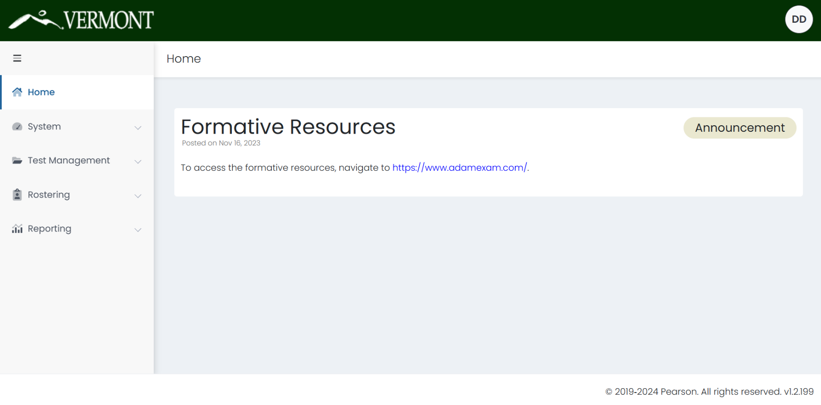
Logging in to ADAM
Once logged in to ADAM you will see the main dashboard screen.
From here you can navigate to System > Profile to view your role, and to Rostering to upload and view your students.

Slide 18
User Roles
Role | Add/Edit Students | Add/Edit Users | Add/Edit Accommodations | Proctor Test | View Reports
District Administrator | X | X | X | X | X
District Test Coordinator | X | X | X | X | X
School Test Coordinator | X | X | X | X | X
IT Coordinator | X | X | X | X | X
Special Education Director | X | X | X |  | X
Superintendent |  |  |  |  | X
Teacher |  |  |  | X | X*
Proctor |  |  |  | X
*Teachers will be able to view reports under My Classes if a class is assigned to them during
administration.

Slide 19
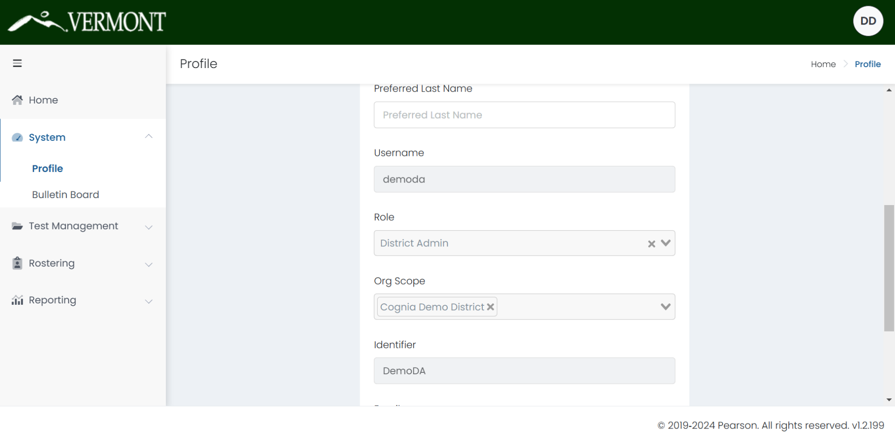
What is My Role?
You can view your profile and role by navigating to System > Profile. On this screen you can also change your password.

Slide 20
Adding/Editing Users

Slide 21
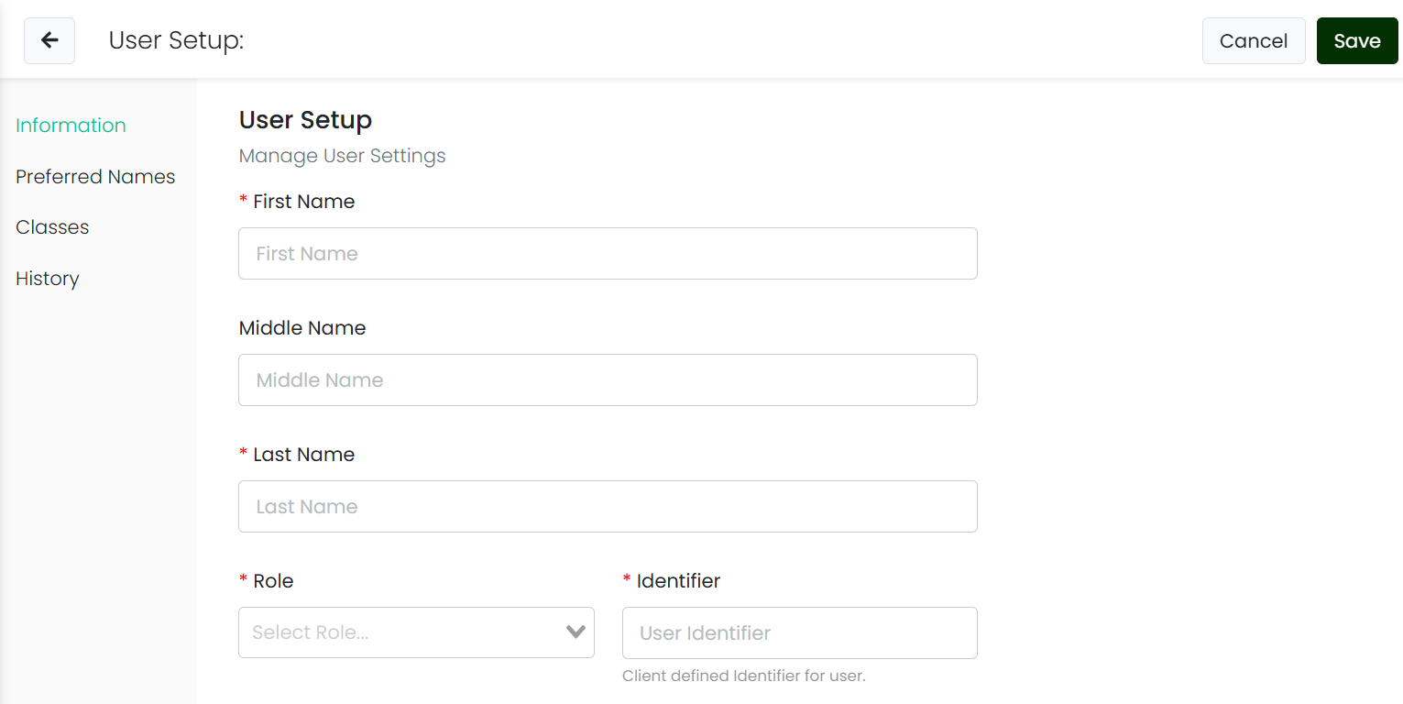
Create Users Manually
Click Rostering > Users > Create New (from the top righthand corner).
This will load the User Setup page.

Slide 22
Create Users Manually
Enter the user’s information and click Save.
*First Name
Middle Name
*Last Name
*Role – pick one only
*Identifier – must be unique
For students, this must be the 7-digit state assigned student ID
For educators, we recommend using their email
Grades (*required for students)
*Org Scopes – enter the highest organization only
*Sourced ID – must be unique; recommended to use the Identifier
*Username – this is what user will use to sign in (pick a schema for all accounts, district email is a common choice option)
User Email – recommended for educator users
User Enabled – must be checked for user to be able to log in to ADAM
Send Welcome Email(s) – check to send a system welcome email to the user with their login information
Students should not receive a welcome email as they cannot log in to ADAM.

Slide 23
Welcome Email
The welcome email will be sent from "ADAM Assessment System" with a noreply@mail.adamexam.com address.
Sample welcome email:
Hello (Name),
Welcome to the ADAM Assessment Delivery and Management system. An account has been created for you with the username of: (Username) .
To complete the setup of your account and create your own password, follow these steps:
Follow this link to Set Your Password. This will allow you to create a password of your choice that you will use to login to ADAM. Follow the instructions on the webpage that opens from this link:
Set Password
2. Login into ADAM, follow the prompts on the page to the Administrator Login area..
Log into ADAM using (Username) as your username and the password you just created.
Click the Login button.
To login to the assessment system again, go to ADAM and enter this username and password. You can change your password at any time from within ADAM, or by using the Forgot Password link on the ADAM homepage.
If you have questions about this account, please contact your Assessment Program administrator. Happy Testing! The ADAM Team

Slide 24
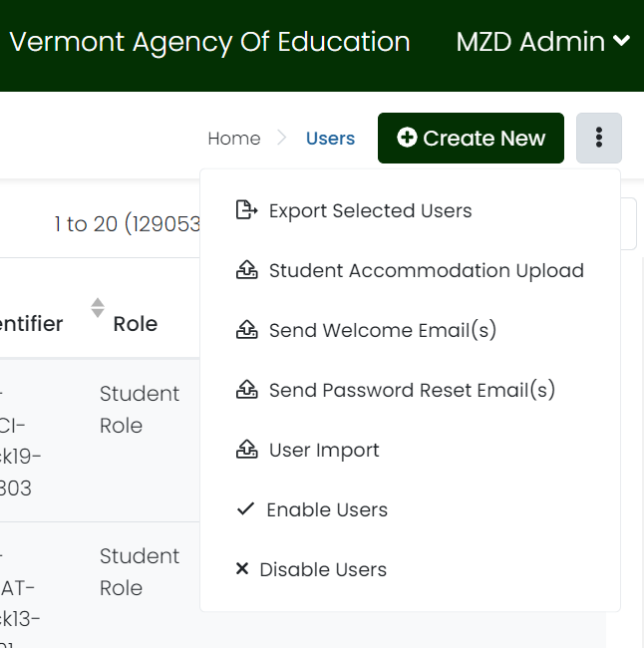
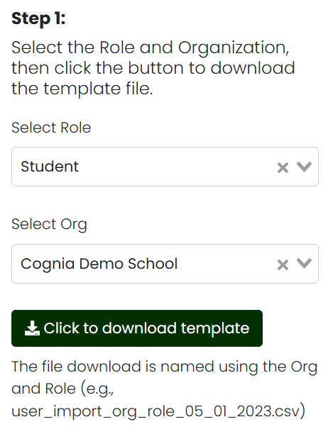
Quick User Upload
To upload users, including students, to the Vermont ADAM site, click on the ellipsis button, then click on “User Import”.
When the User Import screen loads,
follow the steps to import your users.
Step 1: Select the role and school you are importing to.
Click the “Click to download template” to download the CSV template file.

Slide 25
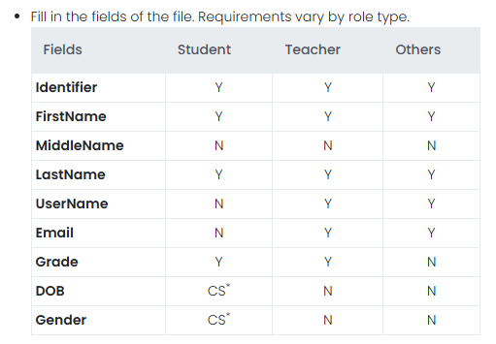
Quick User Upload
Step 2: Open the CSV file in Excel, Sheets, or Numbers, and complete the required fields based on the role you are uploading.
A table of required fields is available on the User Import page in ADAM.
For students, the Identifier must be the 7-digit student’s state assigned student ID.
Refer to the Quick User Upload Layout & Template on the Help & Support site.

Slide 26
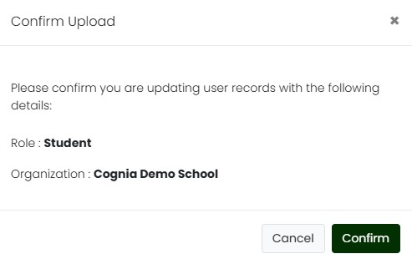
Quick User Upload
Step 3: Upload the CSV back into the platform by dropping the file into the Step 3 location on the screen.
The Confirm Upload dialog box will display. Confirm the role and organization are accurate, then click the Confirm button.

Slide 27
Quick User Upload
Upload Status
To view the status of your upload, click the Upload History button in the upper right.

Slide 28
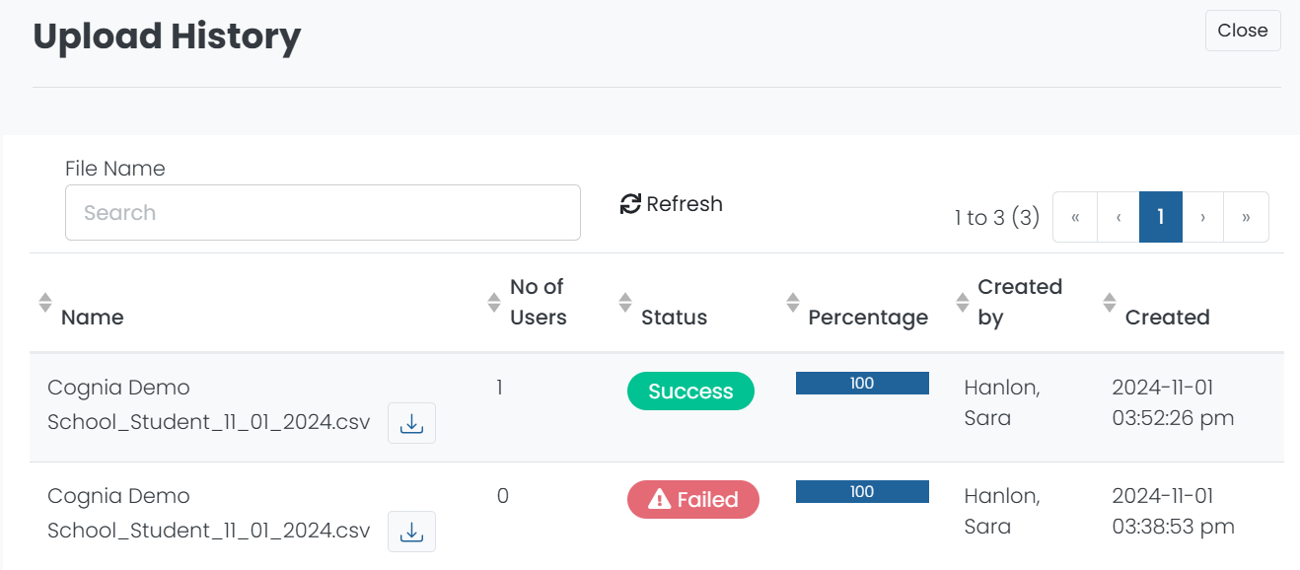
Quick User Upload
Upload Status
The Upload History page will display all user uploads with the file information and status of the import. The import status will display as In Progress, Success, or Failed.

Slide 29
Quick User Upload
Upload Status – Failed
If the user import Failed, click the download icon to download a csv file with the validation errors.
Correct the errors as indicated in the file, and delete column J, Errors. Save the csv file and repeat the user import process.

Slide 30
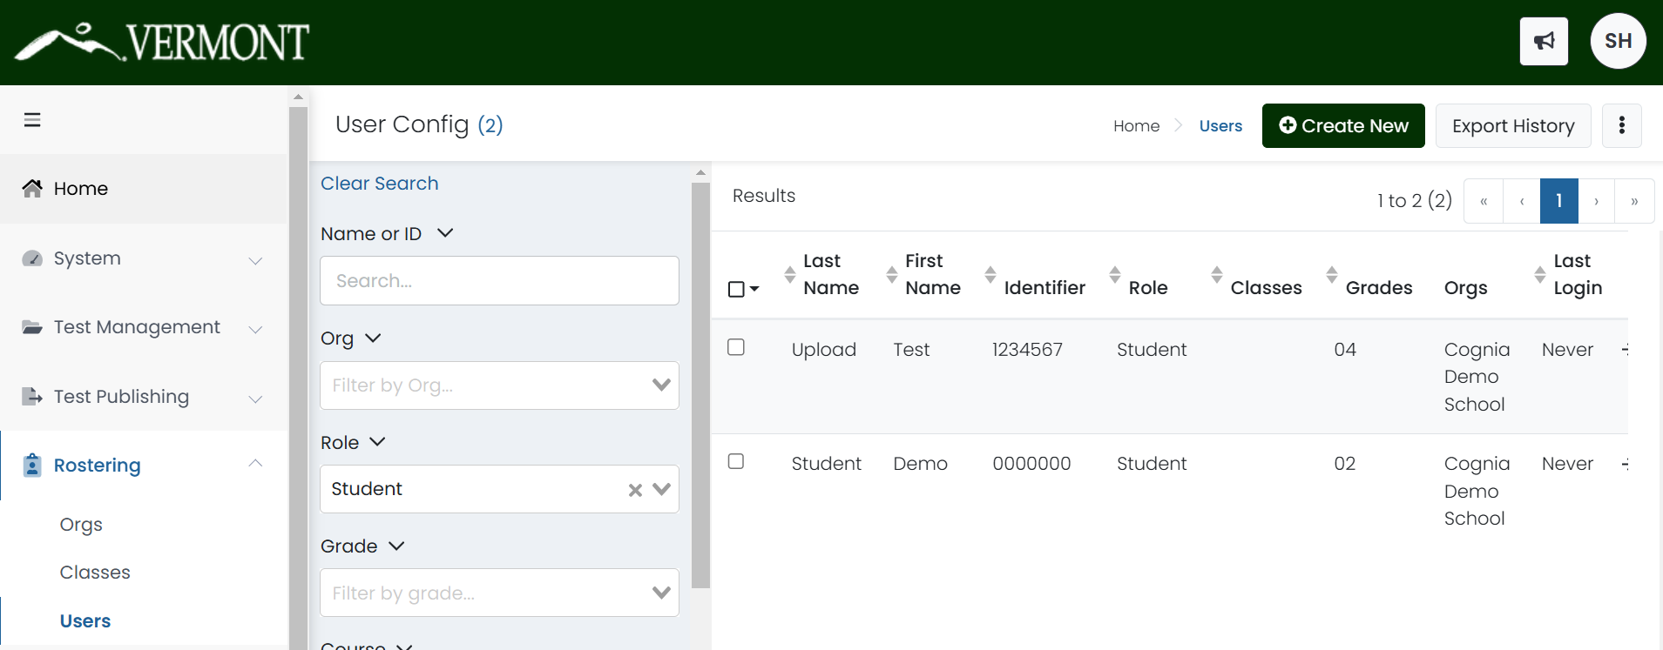
View Roster Data
Once imported or added manually, users will display on the User Config page within ADAM. This page can be accessed by navigating to Rostering > Users.

Slide 31
View Roster Data
To search for a user including students:
On the left side of the User Config page, enter or select the appropriate filters. The search is dynamic, so you change the filter fields at any time to alter the search.
Name or ID
Org – Filter by a specific district or school.
Class – If you have filtered by School, the Class filter will also display. This can then be used if classes have been created within that org.
Role
Course
User Status
Accommodation – Filter by a specific accommodation (e.g. Paper or Text to Speech).

Slide 32
Edit Users
To edit a user, click the edit icon ( ) to the right of their name in the Users list.
From the User Setup page, there will be tabs for the user’s
Information
Preferred Names
Classes
History
Demographics (Students only)
Accommodations (Students only)

Slide 33
Reporting Orgs
On the Information tab of a student profile, there will be a field for Reporting Orgs. This field is to be used by independent schools to identify the student’s sending district and ensure that both their enrolled school and the sending district receive student reports.

Slide 34
Accommodations

Slide 35
Universal Tools
Embedded Universal Tools
Answer eliminator
Desmos calculator
Highlighter
Line reader mask
Magnifier
Notepad
Pop-up glossary
Writing tools
Zoom
Non-Embedded Universal Tools
Breaks
English dictionary (Math and Science)
Scratch paper
Thesaurus (Math and Science)

Slide 36
Designated Supports
Embedded Designated Supports
Text to speech (Math and Science)
Translations (Math and Science)
Arabic (Standard MENA)
Chinese (Simplified Mandarin)
French
Spanish (Nicaraguan)
Swahili
Non-Embedded Designated Supports
Amplification
Bilingual dictionary (Math, Science, and Writing)
Color overlays
Magnification
Medical device
Noise buffers
Separate setting
Simplified test directions

Slide 37
Accommodations
Embedded Accommodations
American Sign Language (ASL)
Closed captioning
Color contrast
Screen reader
Speech to text (ELA & Science)
Text to speech (ELA)
Non-Embedded Accommodations
100s number table
Abacus
Alternate response options
Calculator (talking or braille)
Multiplication table
Read aloud/human reader
Scribe
Speech to text (Math)
Print-Based Accommodations
Standard print
Large print
Braille

Slide 38
Administering Accommodations
Some accommodations require the student to take a fixed form test.
ASL and closed captioning
Screen reader
Alternate languages
Print based forms (paper, large print, braille)
Additional considerations:
The screen reader will not have an embedded calculator. Students should be provided with a handheld calculator or other appropriate calculator based on their accommodations.
For Science, the fixed form has three sessions. The CAT form has two sessions.
Refer to the Accessibility and Accommodations Guidelines on the Documentation and Training page of the Vermont Help and Support website for additional details on your students’ specific accommodations.

Slide 39
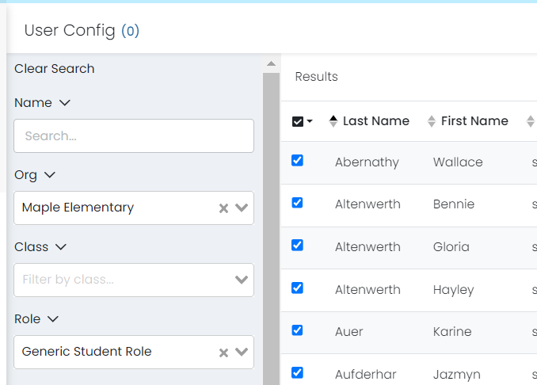
Upload Accommodations
Navigate to Rostering > Users and select the students whose accommodations you would like to upload.

Slide 40
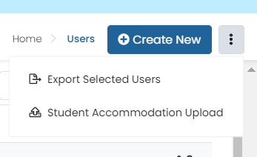
Upload Accommodations
Click the ellipsis in the upper right and select Student Accommodation Upload.
The Student Accommodation Upload page will display. Follow each step on screen.
Step 1: Click the button to download the template file.

Slide 41
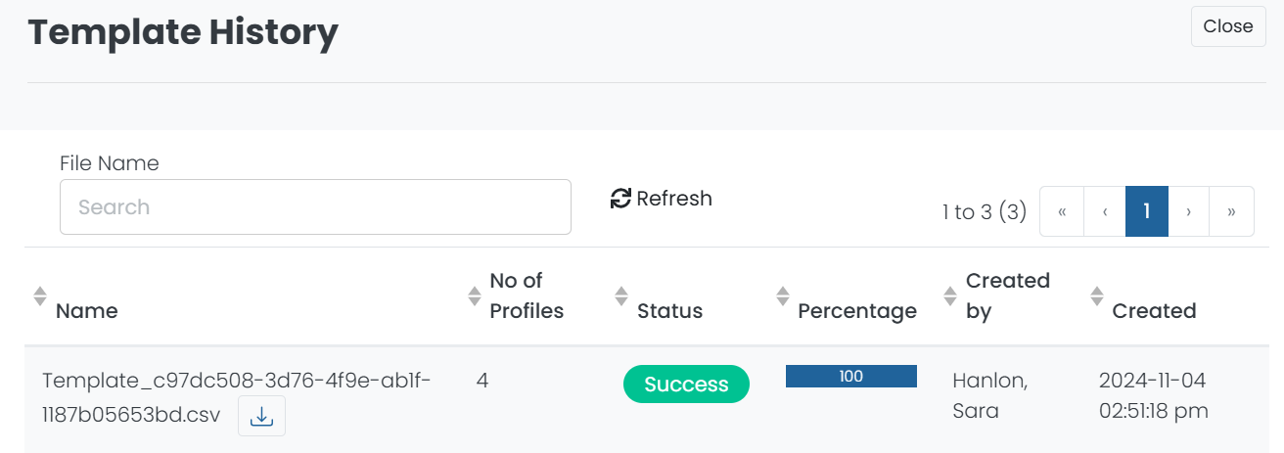
Upload Accommodations
Step 2: Open, edit, and save the file.
Click the Template History in the upper right to download the template.
Click the download icon next to the file name.

Slide 42
Upload Accommodations
Step 2 (cont.)
Open the file.
For each selected student, there will be two rows, one for mathematics and science and one for ELA.
Add a “1” to each accommodation or designated support that should be assigned to the student. If a student requires the accommodation in all content areas, be sure to indicate in both rows.
In the Temporary Accommodation field, enter a text description of the accommodation.
Save the updated file as a csv.

Slide 43
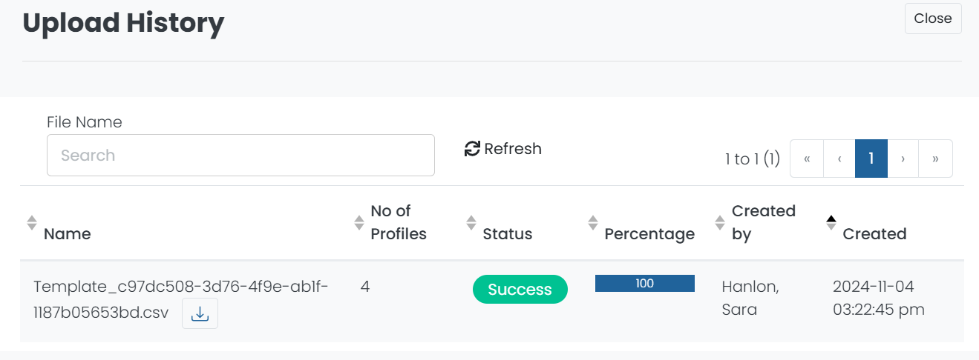
Upload Accommodations
Step 3: Upload the modified file into ADAM.
Click the Upload History button in the upper right to view the status of your accommodation upload. The Upload History page will display the file name, number of student profiles modified, status, import percentage, the user who uploaded the file, and the date and time the file was uploaded.

Slide 44
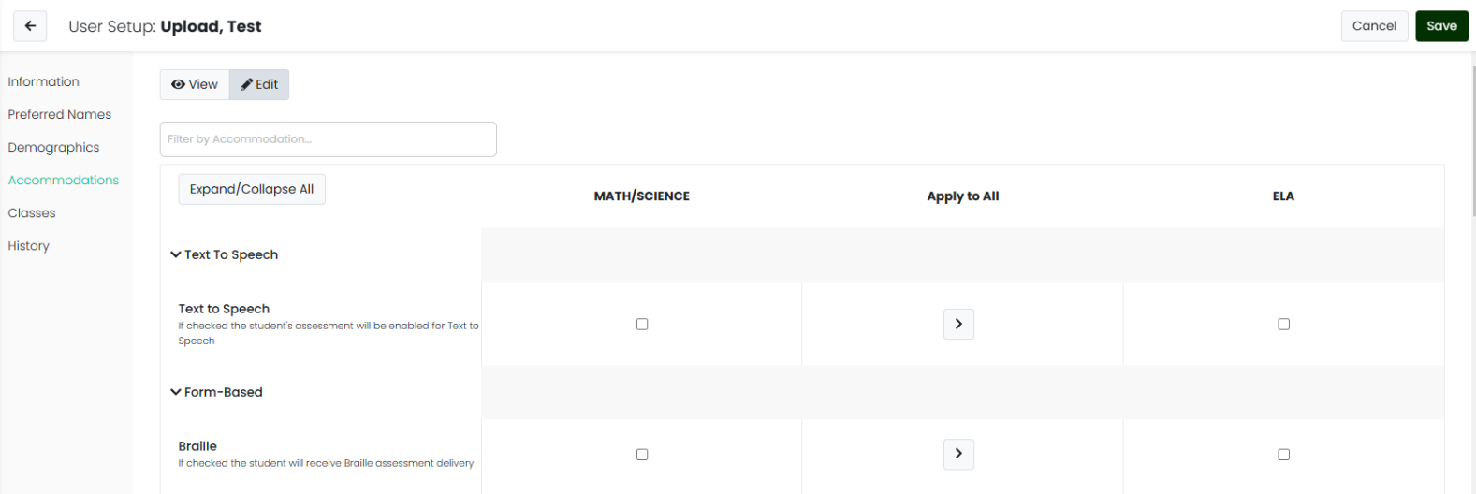
Edit Accommodations
Accommodations can also be added and editing manually. Follow the steps to edit the student’s profile, then select Accommodations from left user set up navigation.
Set the toggle to Edit and complete the form. There are three columns – Math/Science, Apply to All, and ELA. Check or select accommodations and designated supports in the appropriate content column.

Slide 45
Creating Classes

Slide 46
Create a New Class
From the Class Config page, click the Create New button in the upper right to create a new class.

Slide 47
Create a New Class
Complete all fields on the Class Setup page.
Title
Class Code
Location
Class Type (homeroom or scheduled)
School
Course (grade)
Academic Session
Sourced ID (must be unique)
Subject(s)
Grade(s)
Period(s)
Class naming convention:
This naming convention should help you identify these students and classes
Should be meaningful for the Proctor
Consider subject, grade, school, teacher name, class period, time
Example: ELA Grade 3 Teacher A Period 2 10am

Slide 48
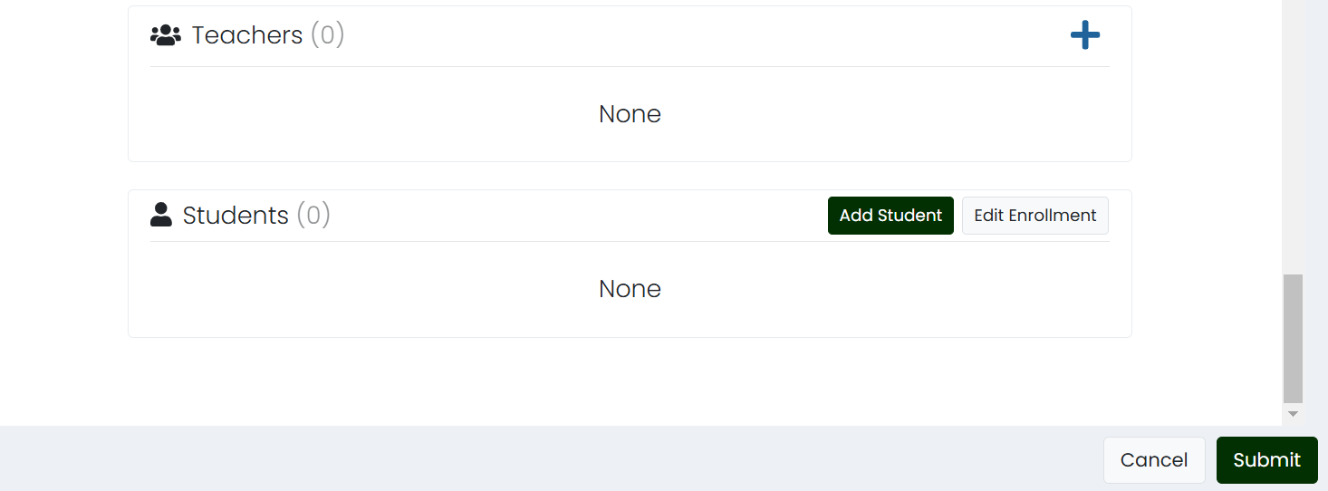
Create a New Class
Use the plus sign to assign teacher(s) to the class. You can add students manually from this page or add them via the Quick Class Upload.
Click Submit to save the new class.

Slide 49
Assigning Students to Classes

Slide 50
Quick Class Upload
Navigate to the Quick Class Upload page by clicking: Rostering> Classes.
Click the ellipsis in the upper right and select Quick Class Upload.

Slide 51
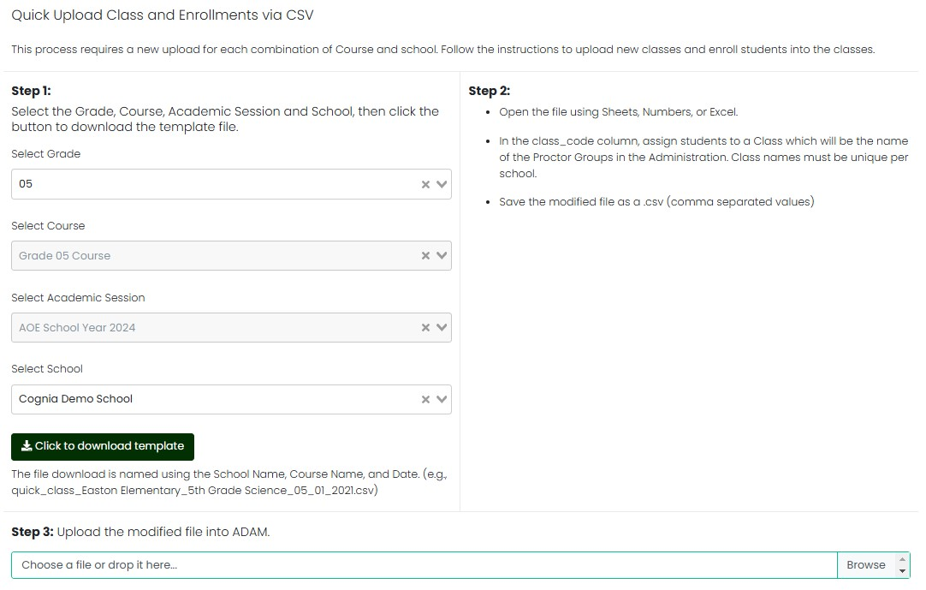
Quick Class Upload

Slide 52
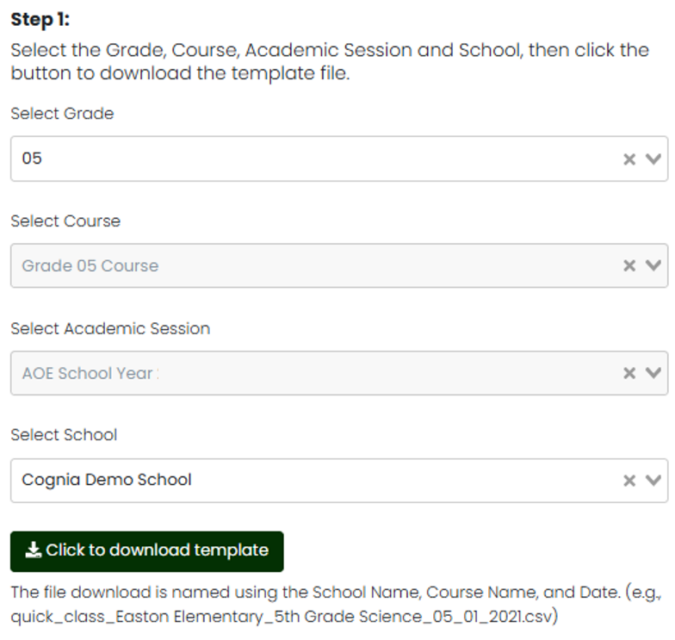
Quick Class Upload
Step 1: Generate a roster file.
Select Grade
Select Course (will autopopulate based on grade selection)
Select Academic Session (will autopopulate)
Select School
Click the Click to download template button

Slide 53
Quick Class Upload
Step 2: Populate the roster file.
For each record, add the Sourced ID of the class previously created to the class_code column.
If a student should be added to multiple classes, duplicate their row and add each class code on its own line.
Save the updated file as a csv.
Step 3: Upload the modified file into ADAM.

Slide 54
Test Administrations
& Proctor Groups

Slide 55
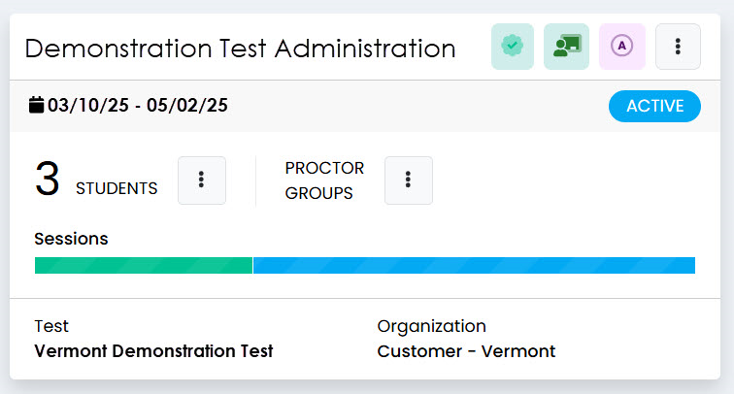
Test Administrations
Administrations are visible to DAs, DCs, SCs, IT Coordinators, and Special Education Directors. Navigate to Test Management > Administrations.
There will be one administration per test for which you have eligible students. For example, a high school may only have Grade 9 ELA, Grade 9 Math, and Grade 11 Science.

Slide 56
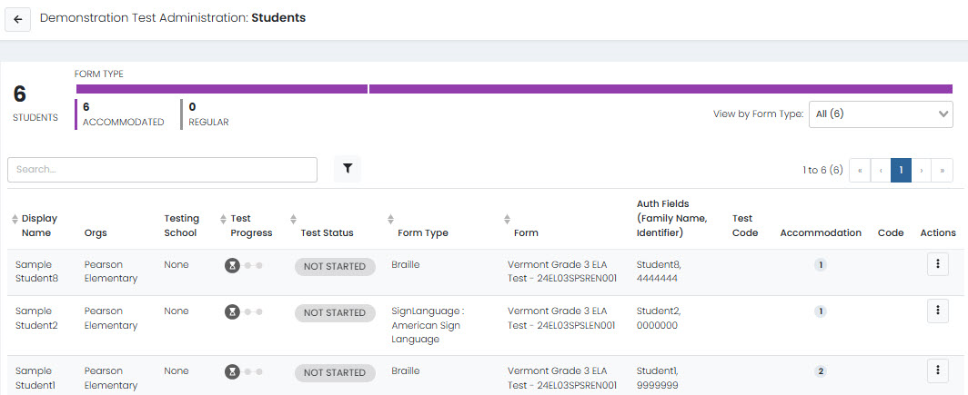
Test Administrations
Students
On the test administration card, the number of students will display. Click the vertical ellipsis to show the three action buttons: View, Export, and Print Cards.
Student View
Student Export

Slide 57
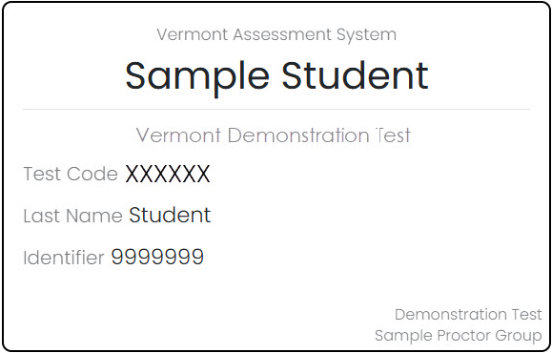
Test Administrations
Students
There will be one print card for each student in that test administration. The print cards include:
Student name
Test name
Last name (needed to log in)
Identifier

Slide 58
Test Administrations
Proctor Groups
Click the ellipsis next to Proctor Groups to display the action buttons: View, Export, Print Cards, and Print Cards (PG Create Only).
Proctor Groups View
Proctor Group Export

Slide 59
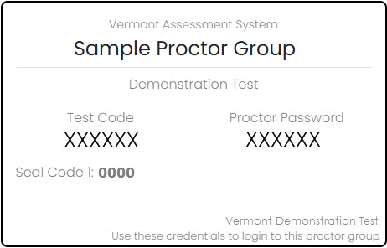
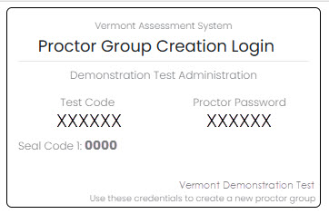
Test Administrations
Proctor Groups
The Print Cards option will print a card for all proctor groups created. The Print Cards (PG Create only) will print the card proctors will use to create their own proctor groups.
Both cards include the same information:
Proctor group name Proctor name
Test code
Proctor password
Seal code(s)

Slide 60
Creating Proctor Groups

Slide 61
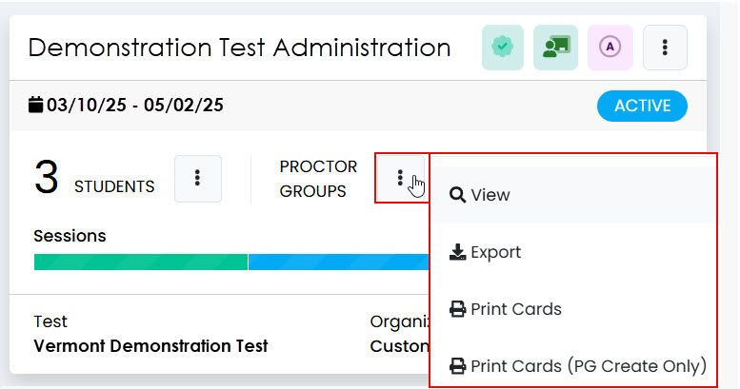
Create a New Proctor Group
Step 1: Access the proctor groups.
Navigate to Test Management > Administrations
Select the administration you’d like to make a proctor group for
Click the View button under Proctor Groups
Step 2: Click Create Group.

Slide 62
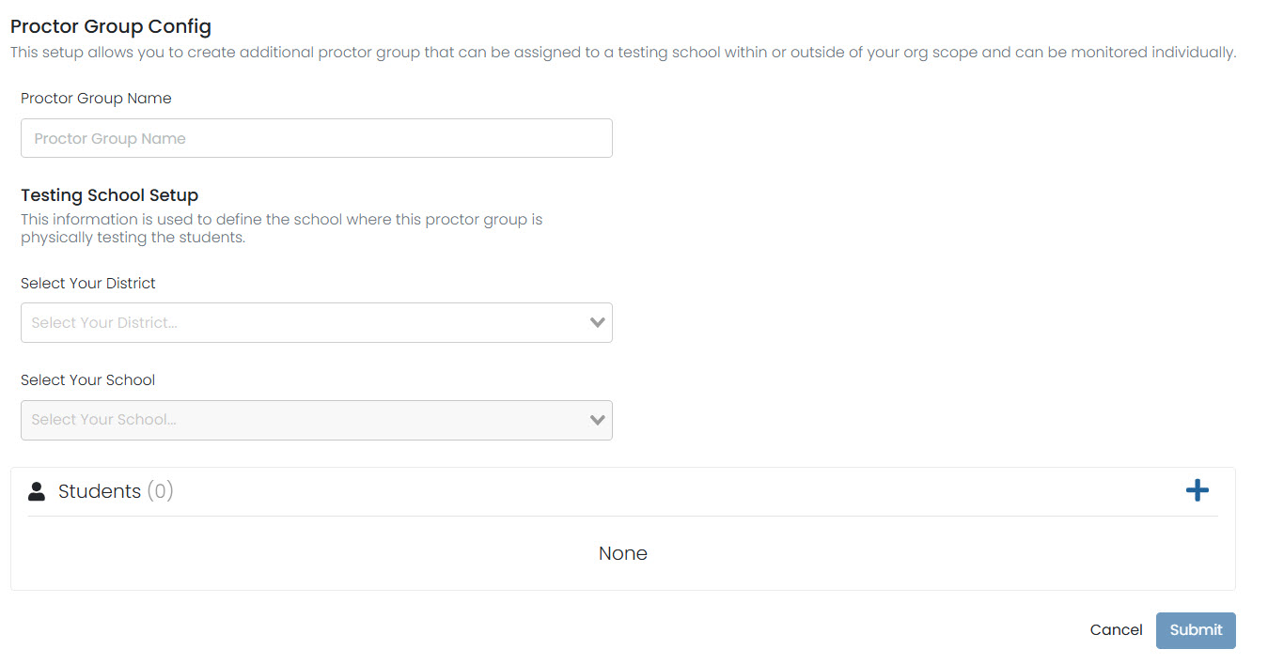
Create a New Proctor Group
This will load the Proctor Group Config page.
Type the Proctor Group Name
Select your district and school from the drop-down menus

Slide 63
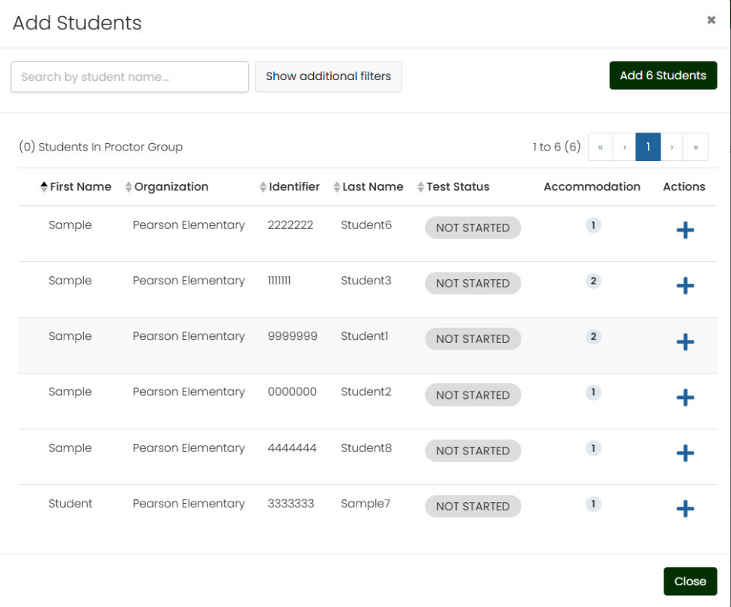
Create a New Proctor Group
Step 3 (Optional): Add students to the proctor group.
To manually add students to the proctor group, click the plus sign in the Students area.
Add students one by one by clicking the + sign next to their name or add all students from the list by clicking the Add Students button in the upper right.

Slide 64
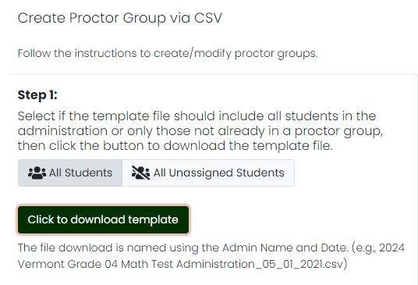
Upload Students to a Proctor Group
Once a proctor group has been created, students can also be added via upload.
To add students to proctor groups via upload, click the Upload Group button from the Proctor Groups page.
Download the template and update by adding the school ID and proctor group name.

Slide 65
Upload Students to a Proctor Group
Update the csv file by completing the Testing Org ID and New Proctor Group Name fields.
Upload the modified file into ADAM.

Slide 66
Monitoring Test Progress

Slide 67
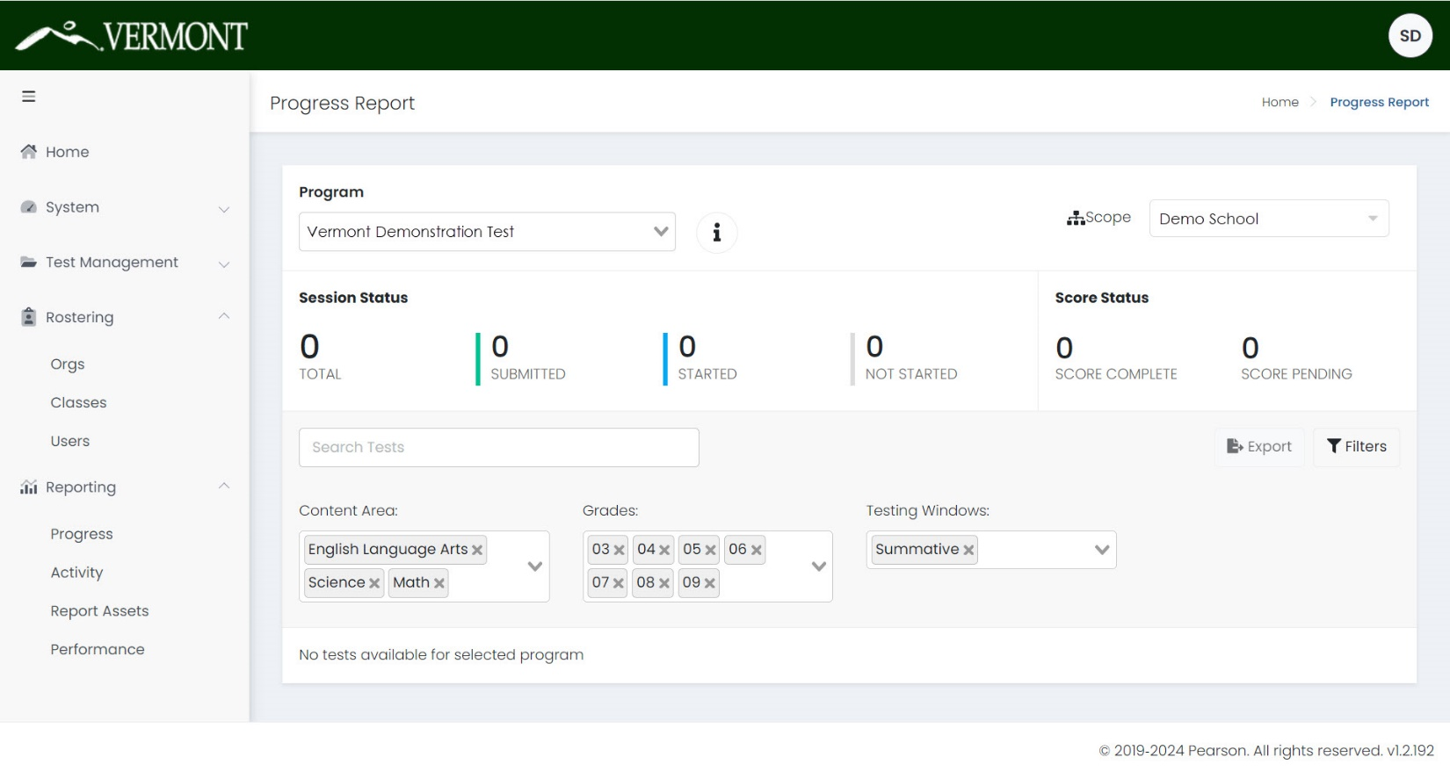
Reporting > Progress
The Reporting > Progress page provides coordinators with a snapshot of testing progress in their organization.

Slide 68
Reporting > Progress
Use the filters to view tests by Content Area or Grade.
Once your filters are selected, you can view the test progress in ADAM or click the Export button to export a csv.

Slide 69
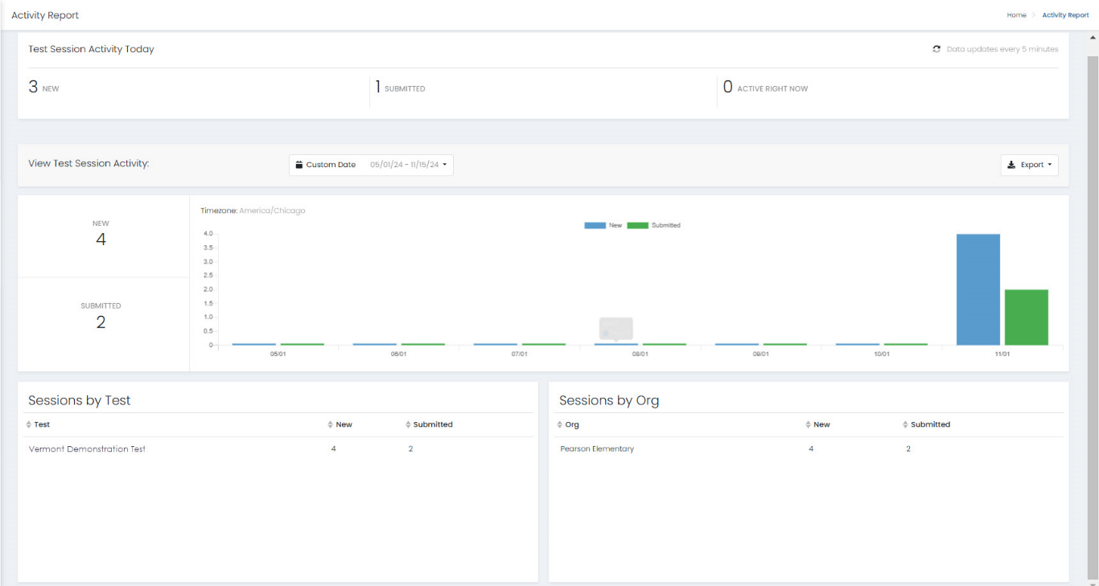
Reporting > Activity
The Reporting > Activity page provides insight on testing activity within your organization.
View the test sessions started and submitted for that day or a specific date range. At the bottom, you can view the number of sessions by test or org.

Slide 70
Proctoring a Test

Slide 71
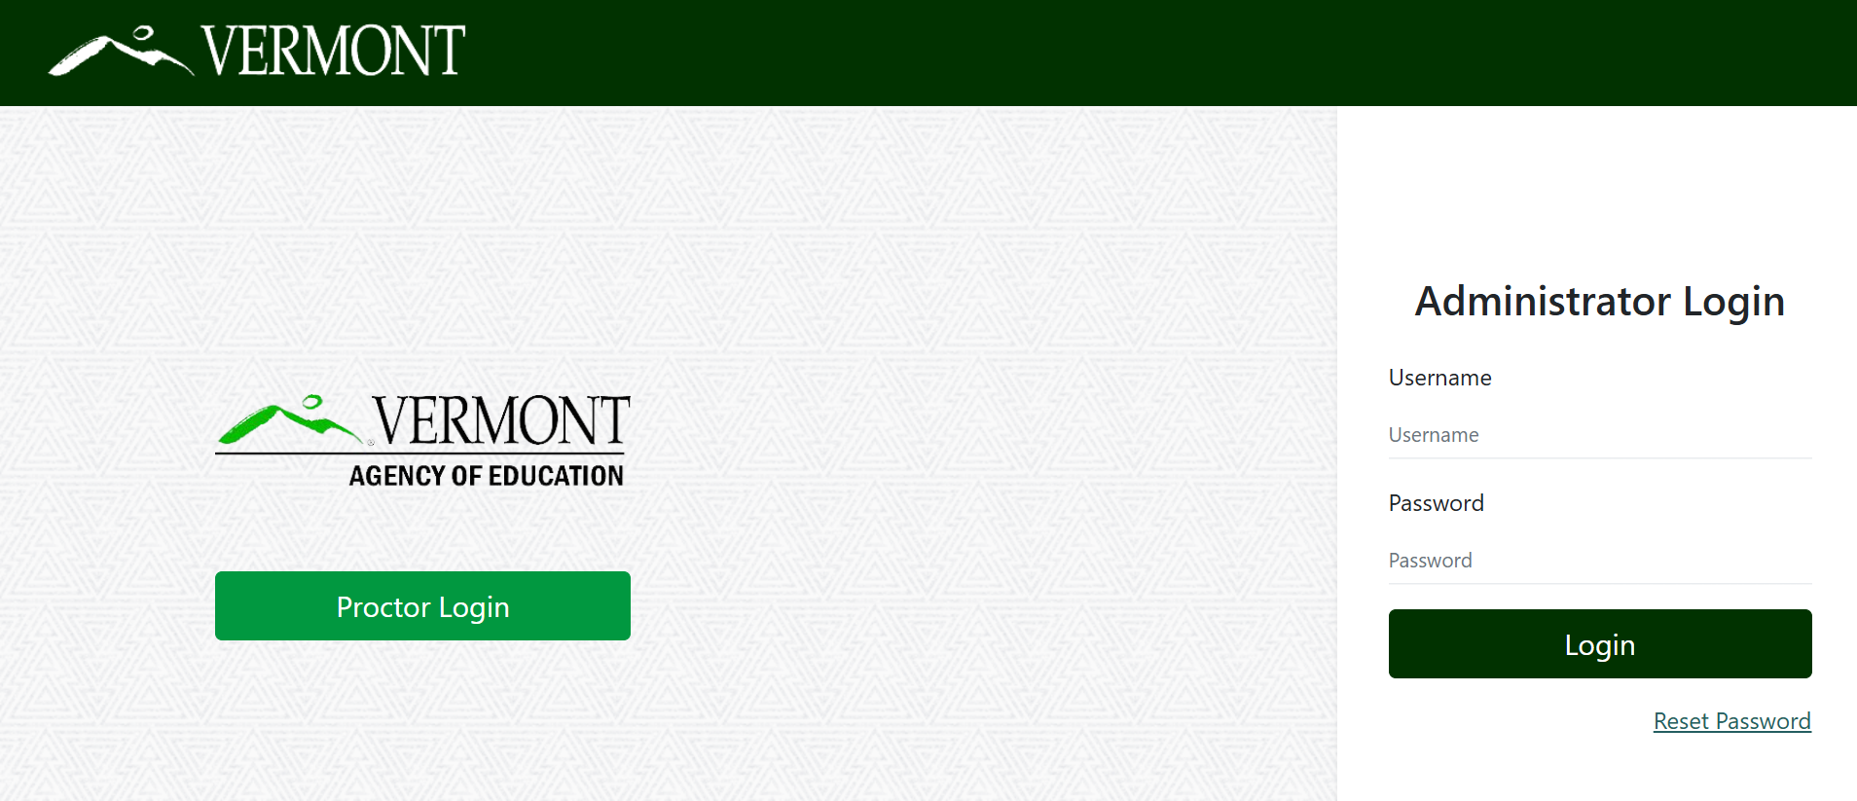
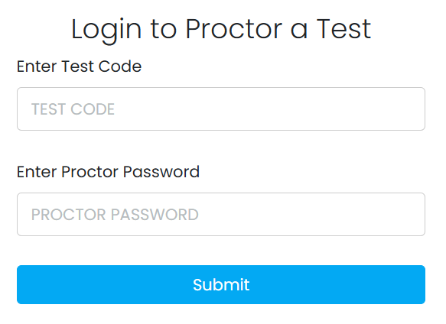
Proctor Login
Go to: https://vt.adamexam.com
Click on Proctor Login
Enter the Test Code and Proctor Password
Click Submit

Slide 72
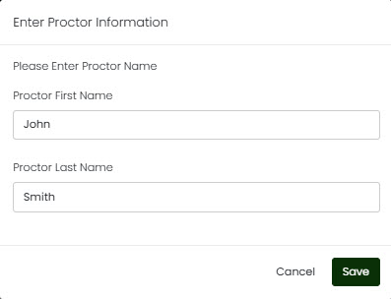
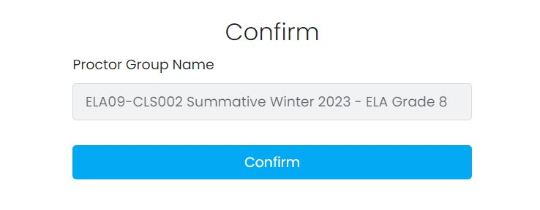
Proctor Confirmation
If a proctor group has already been created, the proctor will be prompted to confirm the proctor group name and enter their proctor information.

Slide 73
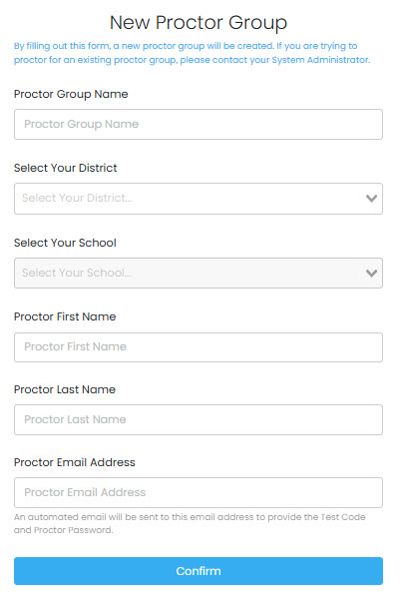
Create a New Proctor Group
If the proctor is logging in through the unassigned proctor group, they will need to create a new proctor group.
The New Proctor Group form includes the
following fields:
Proctor Group Name
Select Your District
Select Your School
Proctor First Name
Proctor Last Name
Proctor Email Address

Slide 74
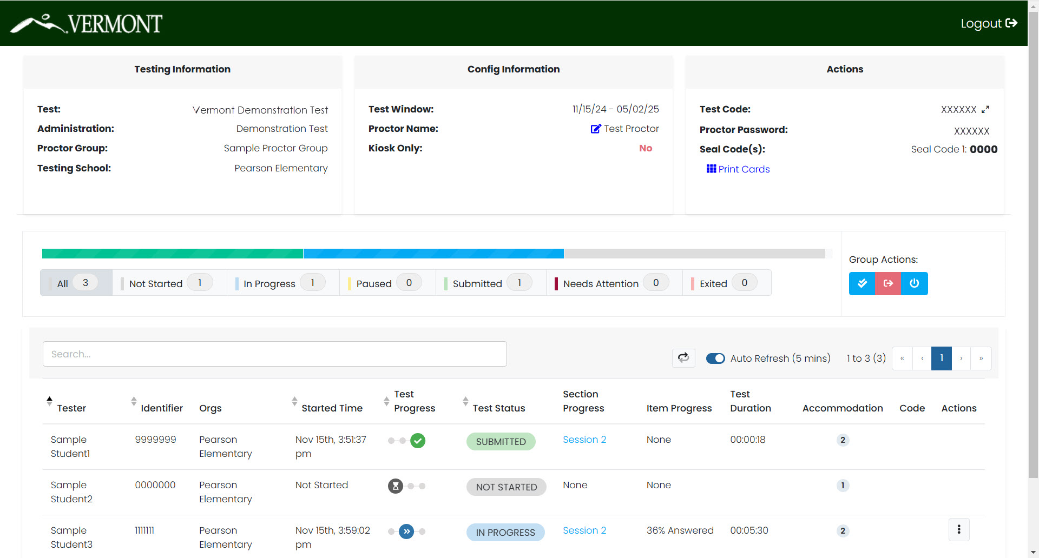
Proctor Dashboard

Slide 75
Proctor Dashboard
The following sections appear on the Proctor Dashboard:
Testing Information
This area includes the name of the test, administration, proctor group, and testing school.
Config Information
This area provides the VTCAP testing window, the proctor name, and a field called Kiosk Only, which for the Vermont assessments will always be “No.”
Actions
This area includes the test code, proctor password, and seal code(s).
Click the expand arrows found next to the code to maximizes the code to a full-screen view of the test code.
Click the Print Cards button to open a new window with the student print cards for that proctor group. These can be printed and distributed to students.

Slide 76
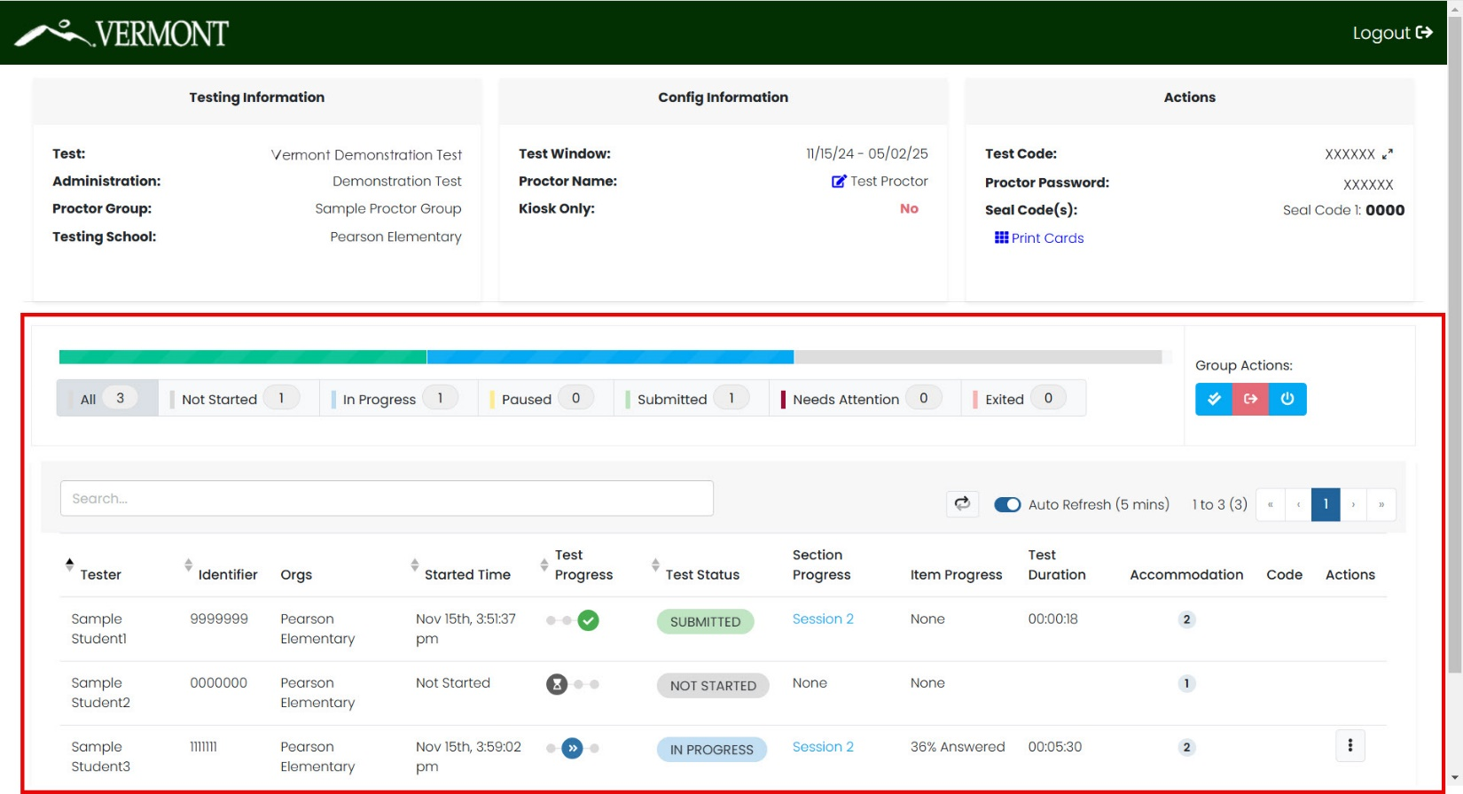
Proctor Dashboard
Session Management Area
In this area, you will be able to view, filter, and search for students in your proctor group and manage their sessions.

Slide 77
Proctor Dashboard
The Session Management area has the following information:
Tester: Student’s name
Identifier: Student’s state assigned student ID
Orgs: The student’s assigned testing school
Started Time: The time the student began testing.
Test Progress:
– Not Started
– Started
– Submitted

Slide 78
Proctor Dashboard
Test Status:
Not Started – The student has not logged into the assessment. No action is needed by the Proctor.
In Progress – The student has logged into the assessment. The student has recently interacted with the assessment.
Exited – The student has exited the TestNav app. The Proctor needs to reseat the student before they can log back into the assessment.
Reseat – The proctor has reseated the student, and the student has not logged back into the test session. No action needed.
Need Attention – The student has logged into the test, but the proctor needs to approve the session for the student to begin.
Submitted – The student has completed and submitted the test.

Slide 79
Proctor Dashboard
Section Progress/Item Progress:
The Section Progress and Item Progress columns show the completion of a section or test. While a student is actively testing, this column will only show N/A.
Test Duration: The amount of time the student has been testing.
Accommodation:
The number of accommodations a student has appears in this column. Hover over the count to show the accommodations. Only accommodations relevant to the online assessment session administration will be displayed.
Code: This will display if a student has an accountability code assigned.
Actions:
Available actions will appear based on the testing status of the student:
Reseat Session – Use if a student has an “interrupted” session (computer issue, session timeout, unexpected error). Reseating allows the student to re-enter their test code and SSID to resume their assessment session.

Slide 80
Proctor Dashboard
Session Details
Another action available may be View Session Details.
Section Information
Section ID ● Seal Code
Section Name ● Start Time
Section Type ● End/Exited Time
Progress
Item graphic
Item information
Item # ● Item UIN
Section ID ● Progress
Sequence ● Last Update

Slide 81
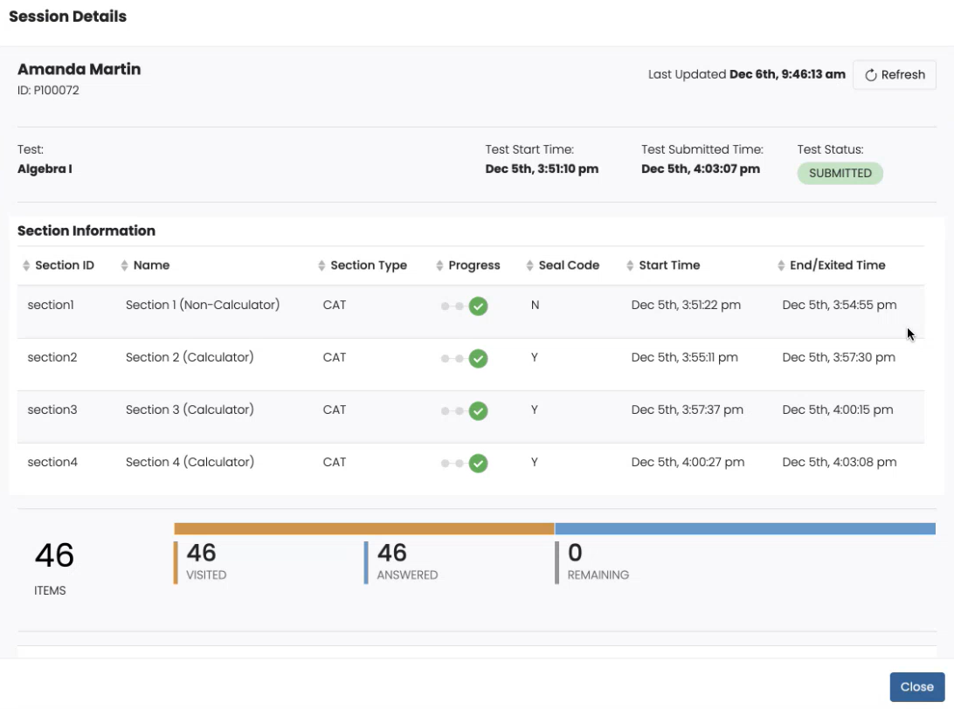
Proctor Dashboard
Session Details

Slide 82
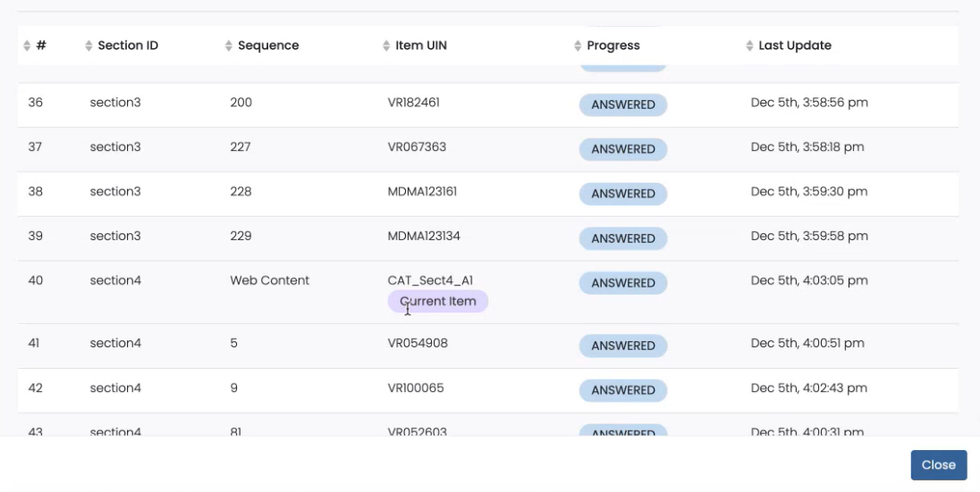
Proctor Dashboard
Session Details

Slide 83
Student Test Experience

Slide 84
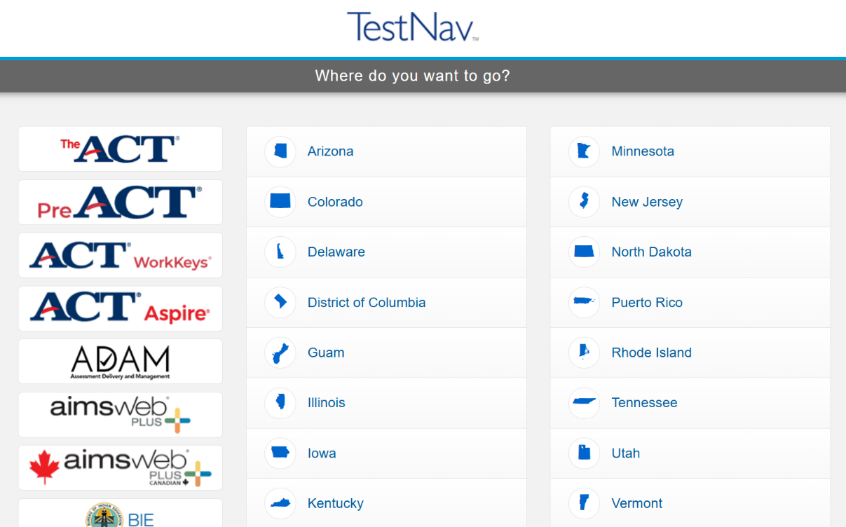
Student Experience
Log in
Make sure TestNav is installed on your device and close all other apps.
1. Open the TestNav app.
2. Click the Vermont link on the “Where do you want to go?” screen.

Slide 85
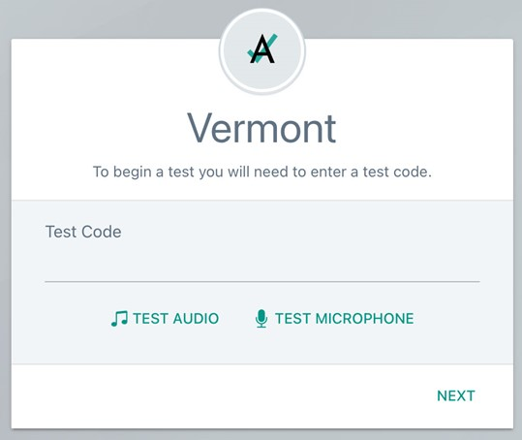
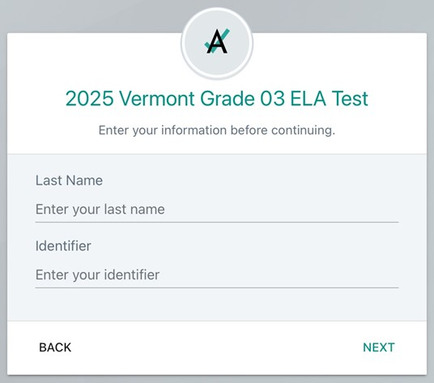
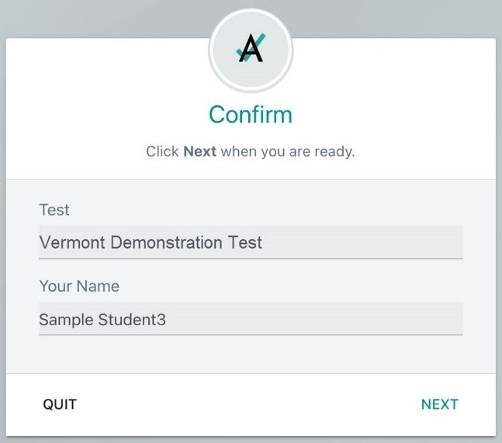
Student Experience
Log in
3. Enter your Test Code and click Next.
4. Enter your Last Name and Identifier, then click Next.
5. Verify your name and test and click Next; test will launch.

Slide 86
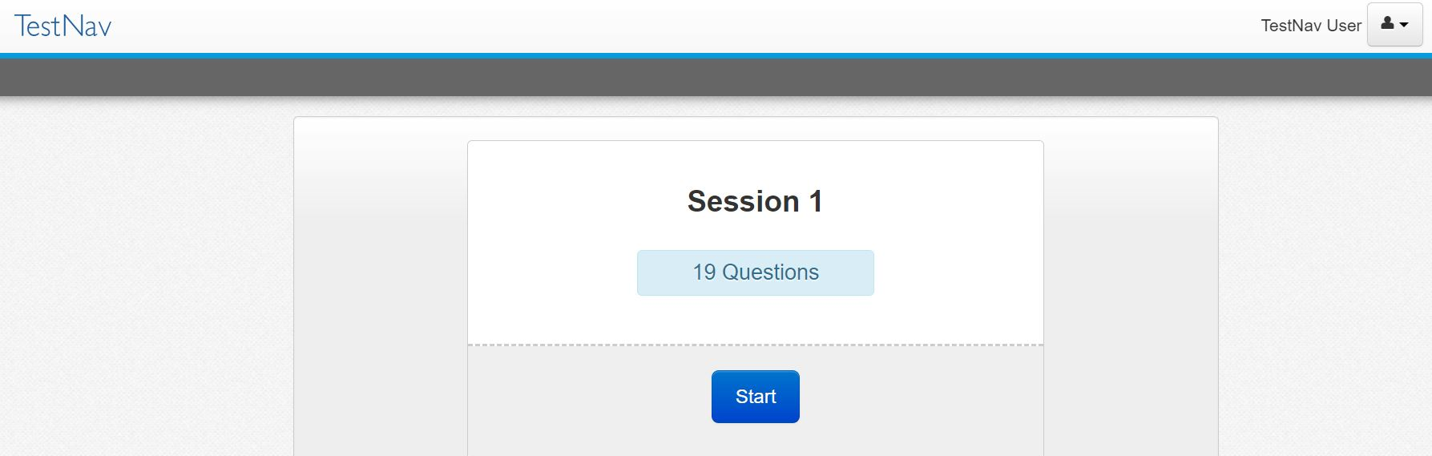
Student Experience
Press Start to begin the test.
Click Start on the first session.

Slide 87
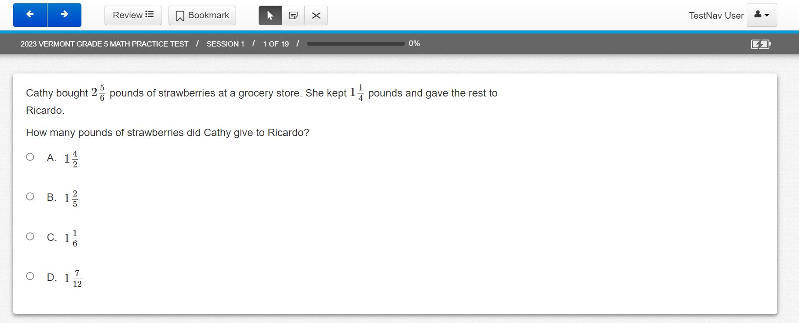
Student Experience
Read the session directions, and then navigate to the first item.
Answer the item question.

Slide 88
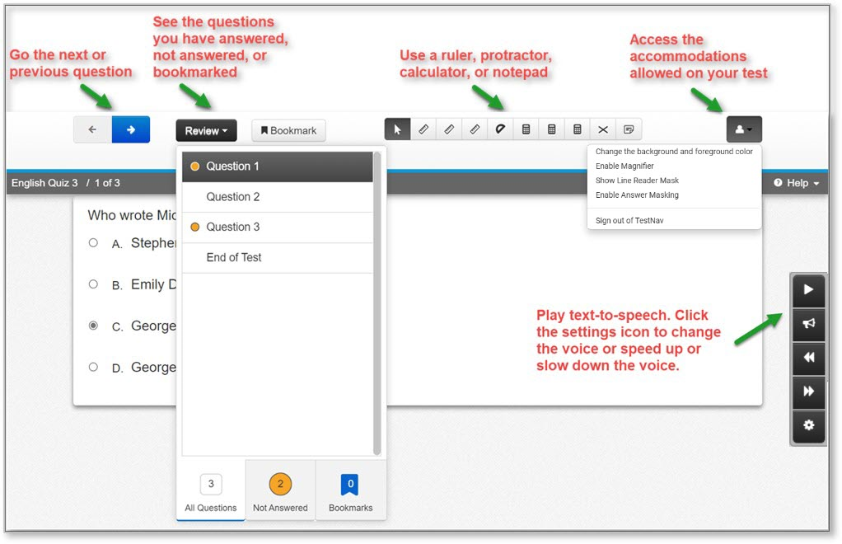
Student Experience
The student test will include the universal tools and any accommodations assigned to the student.
Notes:
Review and Bookmark will not be available in Math 3–8. For all other grades/contents, students will only be able to review/navigate within an item set.

Slide 89
Desmos Calculator
Mathematics
Grades 3–5: Four-function with square root and percentage functions
Grades 6–8: Scientific
Grade 9: Graphing
Science
Grades 5 & 8: Four-function with square root and percentage functions
Grade 11: Scientific

Slide 90
Questions?

Slide 91
TestNav Setup and Readiness

Slide 92
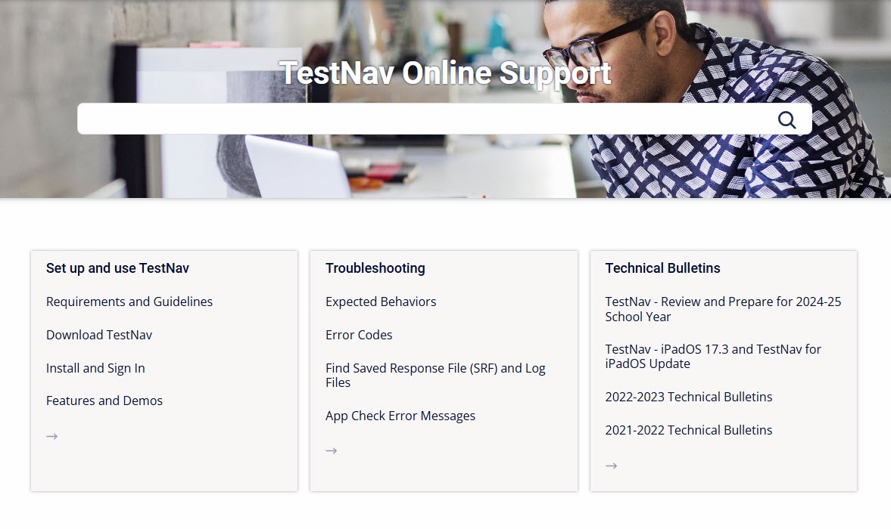
TestNav Online Support Page
https://support.assessment.pearson.com/TN/

Slide 93
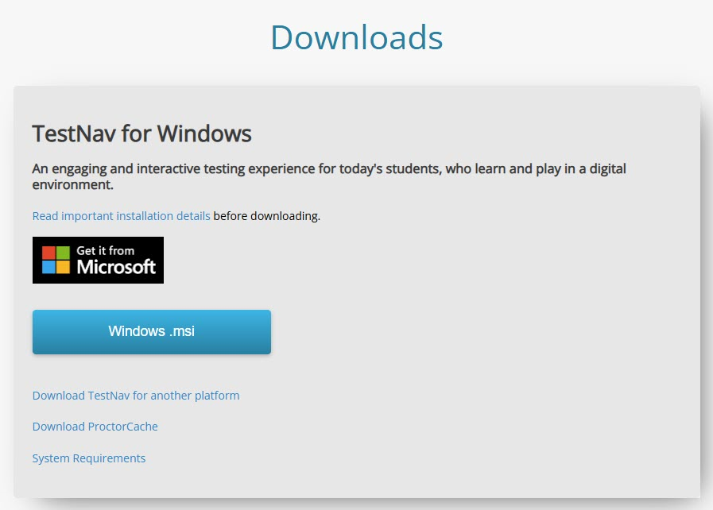
TestNav Download Page
http://download.Testnav.com

Slide 94
General Setup and Requirements
Set up your environment:
Configure firewalls/content filters
Install TestNav
Run AppCheck
Run Network Check

Slide 95
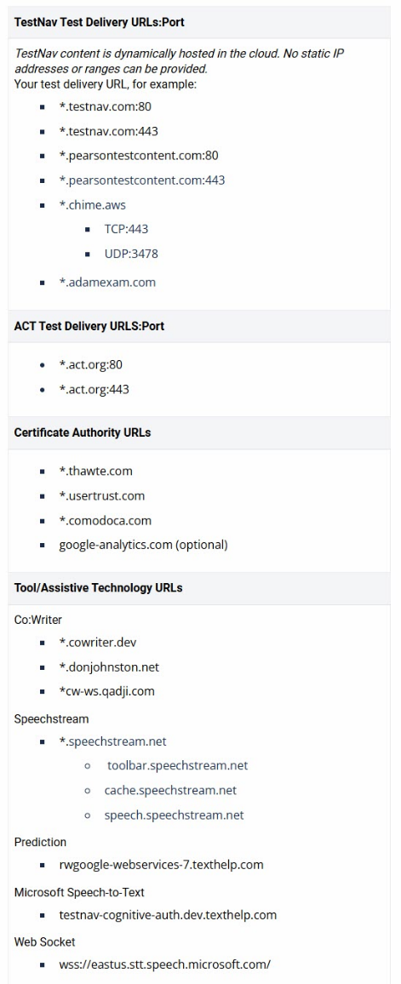
Firewalls and Content Filters
Infrastructure requirements found on TestNav Online Support page (TestNav Online Support > Requirements and Guidelines > Network Requirements and Guidelines).
Configure your services, applications, and devices
Ensure that all applicable test delivery URLs are exempted from filtering and inspection in all layers of network security such as Content Filters, Firewalls, and Anti-Virus/Anti-Malware services.
External traffic will flow on ports 80 and 443
All security appliances and services that may impede, reroute, delay, modify, or block data between TestNav or the Pearson servers should be configured to allow traffic to and from TestNav.

Slide 96
Firewalls and Content Filters
Special Considerations
If using SSL Decryption/Inspection, you will need to make an exception rule to not allow the scanning of TestNav secure http traffic to or from the testing URLs.
Inspecting secure http traffic can sometimes result in interrupting TestNav traffic.
If using using Reverse-DNS Lookup, you will need to make a rule preventing Reverse-DNS checks against the provided URLs.
Test Contest hosted in Amazon Web Services
Reverse-DNS lookup may result in false positives
Failure to fully allow TestNav URLs can result in errors during student testing
Most modern Firewall appliances utilize gateway level anti-malware services where test delivery URLs may need to be exempted separately.

Slide 97
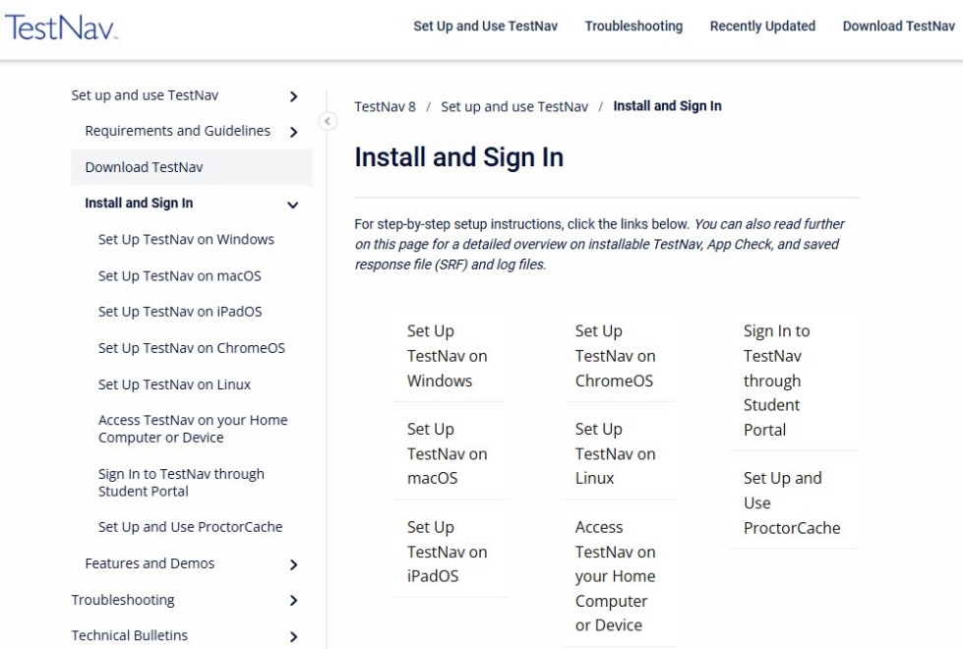
TestNav Setup
Detailed setup steps for all supported devices can be found on the TestNav Online support page (TestNav Online Support > Set up and Use TestNav > Install and Sign In).
Device setup varies slightly by device type
Setup generally follows a few main steps
Verifying system requirements
Viewing setup instructions
Installing the app
Verify installation using AppCheck

Slide 98
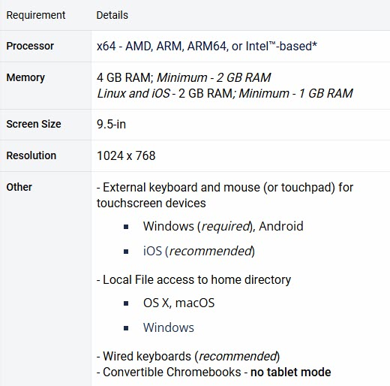
TestNav Hardware Requirements
https://support.assessment.pearson.com/TN/testnav-system-requirements-18613791.html

Slide 99
TestNav Software Requirements
https://support.assessment.pearson.com/TN/testnav-system-requirements-18613791.html
*System requirements as of November 2024. Districts should refer to the support link
above to view the most current supported operating systems.

Slide 100
TestNav Support Changes
Pearson follows the lead of Operating System vendors and aligns support requirements with changing technologies.
When updates are released, Pearson first tests a beta version and reports bugs to developers.
When the final version is publicly released, Pearson also tests this version to ensure TestNav compatibility before supporting it.
TestNav Support page lists Operating System versions currently being tested for compatibility, and the Recently Updated details support changes.

Slide 101
TestNav Setup - Desktop
Traditional laptop and desktop devices running the Windows, Mac, or Linux operating systems.
Main setup steps
Verify devices meet minimum system requirements
View setup instructions
Gather installation files from http://download.testnav.com/
Install TestNav
Verify the installation using AppCheck
Considerations
Device initialization applications / Desktop restoration software (ex. Deepfreeze – Preserve Pearson Directories)
User account read/write access to home directory
Background applications and processes
Windows: Cloud Clipboard History or Roaming, Windows Game Bar and Windows Cortana must be disabled
Mac: Siri and/or Dictation services must be disabled

Slide 102
TestNav Setup - Chromebook
Chromebook setup steps can vary depending on the management options for the device.
Shared Setup Steps
Verify devices meet minimum system requirements
View setup instructions
Verify the installation using AppCheck
Managed Devices
Install TestNav on all devices from the Admin console
Allow data to persist for the TestNav application
Set the TestNav application to run in kiosk mode
Ensure that TestNav is NOT set to auto-launch
Unmanaged Devices
Unmanaged Chromebooks/Chromeboxes purchased in 2017 and later cannot run in kiosk mode. See Google Support for more information.
Note: It is absolutely critical that Managed Chromebooks are configured to keep User Data after Sign-out.
In the event of technical difficulties Chromebooks must not erase Student Response Files and logs needed for troubleshooting

Slide 103
TestNav Setup - iOS
TestNav uses Apple Automatic Assessment Configuration (AAC) to secure the iPads for testing.
Main setup steps
Verify devices meet minimum system requirements
View setup instructions
Search for “TestNav” in App Store
Install TestNav
Verify the installation using AppCheck
The first time TestNav is launched, it displays the Enable Microphone Permission message, be sure to tap OK to grant permission.
Considerations
TestNav can be installed on multiple devices using a Mobile Device Manager (MDM)
Do not use MDM configured Single App Mode, or else AAC will not engage and result in a TestNav error

Slide 104
TestNav Update Installation
TestNav Update Path
Update methods will differ by test device
Typically, TestNav will only receive major app updates over the summer, when school is not in session
Chrome and Windows store apps - automatically update
iOS – install from the App Store
Mac and Windows desktop app – download and install from TestNav download site

Slide 105
TestNav App Check
Select the ”Reference” customer and click the user drop-down menu and select App Check.
App Check is used to verify student devices can launch TestNav successfully.

Slide 106
TestNav App Check

Slide 107
TestNav App Check
App Check errors for Cloud Clipboard History or Roaming, Game Bar and Cortana on Windows. App Check errors for Siri or Dictation on Macs.
TestNav will check during App Check, at login and with every navigation. If it finds these services enabled, it will display an error message, and the examinee will be forced to leave the test.

Slide 108
TestNav Network Check
Network Check is used to evaluate current bandwidth and the ability to test a specified number of students.

Slide 109
TestNav Network Check
Results

Slide 110
TestNav – Additional Checks
If you had significant technical issues in previous administration or encounter errors in the App Check and/or Network Check that you are unable to resolve, contact the Vermont Service Center.
Technical issues will be escalated to Pearson’s support team, as needed.
Pearson Support can assist with running additional checks, including an infrastructure trial, and provide guidance to resolve technical issues.

Slide 111
TestNav Early Warning System

Slide 112
TestNav Early Warning System
Overview
The Early Warning System (EWS) is a background process in TestNav that:
Requires no additional installation or configuration efforts
Displays messaging to the screen in the case an issue is detected
Monitors background applications and connectivity
Stages student responses in an encrypted backup file and transmits student responses to the Pearson testing servers for scoring

Slide 113
TestNav Early Warning System
Triggers
Even though there are multiple error codes, most issues can be traced back to a few main scenarios.
Connectivity
Unable to retrieve content
Unable to transmit responses
Saved Response File Issues
Unable to write or read to SRF location
Potential Security Issues
Application launches while TestNav is in secure mode
Application attempts to capture focus
Running application messages the screen

Slide 114
TestNav Early Warning System
Error Codes
If an EWS message is displayed, it will contain a specific error code.
Complete error code documentation can be found on the TestNav Online Support page (TestNav Online Support > Troubleshooting > Error Codes).
Numeric error code is usually accompanied by a description of the error and potential resolution steps.

Slide 115
Technical Troubleshooting During Testing
Login Error
9058/9059: The username or password you entered is incorrect
If the username/password being used is accurate, the student may be on the incorrect login page.
To get on the correct login page click the User icon in the top right and select “Choose a different customer”. Then pick Vermont from the App Home Screen.

Slide 116
Technology Office Hours
Schedule time with a technology field engineer.
Set up a one-on-one virtual meeting
Time slots range from 15 minutes to 1 hour
Talk through edge cases, specific setup instructions, or challenges
Schedule your Technology Office Hours at https://outlook.office365.com/book/FieldServicesEngineeringOfficeHours@pearsoneducationinc.onmicrosoft.com/

Slide 117
Questions?

Slide 118
Before, During, and After Testing

Slide 119
Checklist for Test Coordinators
Refer to the TCM for a full checklist of activities for District and School Test Coordinators
Appendix A – District Test Coordinator Checklist
Appendix B – School Test Coordinator Checklist

Slide 120
Before Testing
District Administrators & District Test Coordinators
Assurance: Complete training provided by AOE & Cognia
Assurance: Provide trainings to all SCs and complete the SC Training Attendance Log. The SC Training Attendance Log must be kept on file for three years.
Review the Test Coordinator’s Manual
Notify schools and staff when training, manuals, and other documentation are available
Finalize testing schedules
Ensure TestNav is downloaded on student computers
Validate the student roster and make any necessary updates
PBT: Ensure all print materials have been received, and order additional materials if needed

Slide 121
Before Testing
School Test Coordinators
Assurance: Complete training provided by the DA
Assurance: Provide training to proctors and complete the School Training Log. The Test Administration Training Log must be kept on file for three years.
Review the Test Coordinator’s Manual
Notify staff when training, manuals, and other documentation are available
Finalize testing schedules
Ensure TestNav is downloaded on student computers
Validate the student roster and make any necessary updates
CBT: Prepare proctor test packets
Proctor print cards: test name, test code, and proctor password
Student print cards: test code, SSID, last name
PBT: Ensure all print materials have been received, and order additional materials if needed

Slide 122
Before Testing
Teachers and Proctors
Assurance: Complete training facilitated by the DC/SC
Assurance: Sign the Non-Embedded Accommodation Non-Disclosure Agreement if administering non-embedded accommodations and submit to the SC
Review the Test Administrator’s Manual
Provide students the opportunity to take the practice test
Validate the student roster and notify the DC/SC of any errors
Are all students in ADAM?
Are all students assigned to the correct grade?
Is the identifier the correct, 7-digit, state assigned student ID?
Do all students have the appropriate accommodations and supports assigned?
Receive necessary student materials (e.g. scratch paper, log in information, accommodation materials)
Adhere to all school, district, and state test security policies and procedures

Slide 123
During Testing
District and School Coordinators
Monitor test progress
Ensure all staff adhere to security policies and procedures
Investigate and report any test security incidents
Teachers and Proctors
Monitor students during testing
Use of cell phones and electronic devices is strictly prohibited
Adhere to security policies and procedures
Report any test security incidents to the SC
Follow the test administration script exactly
Follow procedures for administering paper accommodations

Slide 124
After Testing
District Administrators & District Test Coordinators
Assurance: Electronically sign the Appropriate Assessments and Accommodations Certification form. This must be completed May 5–9, 2025.
Ensure all test material has been securely destroyed
Apply Accountability Codes in ADAM for students who were exempt from testing, if needed
First Year EL (ELA only)
Medical Exemption
Participated in MSAA
Invalidate tests, if needed
Requests for invalidation must be submitted to AOE

Slide 125
After Testing
School Test Coordinators
Assurance: Electronically sign the Certification of Proper Test Administration form. This must be completed May 5–9, 2025.
Ensure all test material has been securely destroyed
Apply Accountability Codes in ADAM for students who were exempt from testing, if needed
First Year EL (ELA only)
Medical Exemption
Participated in MSAA
Invalidate tests, if needed
Requests for invalidation must be submitted to AOE

Slide 126
After Testing
Teachers and Proctors
Submit student responses in TestNav for any paper testers
Collect and securely destroy any testing materials
Test booklets
Student print cards
Scratch paper
Periodic tables written on by students

Slide 127
Test Security and Procedures

Slide 128
Test Security
The security of assessment instruments and the confidentiality of student information are vital to maintaining the validity, reliability, and fairness of the results. Security of test materials must be maintained before, during, and after administration.
Secure CBT test materials
Student print cards
Scratch paper written on by students
Secure PBT test materials
Test booklets
Scratch paper written on by students
Periodic tables written on by students
All secure test materials must be securely destroyed by the school/district.

Slide 129
Test Security Incidents
Any breaches in test security must be reported to the SC or DC. Test security incidents are categorized below:
Student access to unapproved device/material
Cheating
Sharing, posting, or copying of secure test materials (student)
Sharing, posting, or copying of secure test materials (adult)
Student engaged with incorrect assessment
Wrong student test, incorrect grade level
Technology issue interrupting test session (unable to restart session)
All test security incidents must be reported to AOE using the Test Security Incident Form available on the Documentation and Training page of the Vermont Help and Support website.

Slide 130
Test Security Incidents
In some cases, a test security incident has a low impact on the individual or group of students who are testing and has a low risk of potentially affecting student performance on the test, test security, or test validity.
These circumstances can be corrected and contained at the local level. Such incidents do not need to be reported to the AOE.
Examples include a fire drill occurring during a test session or minor connectivity issues interrupting testing.

Slide 131
Test Security Incidents
An unusual circumstance that impacts an individual or group of students who are testing and may potentially affect student performance on the test, test security, or test validity must be reported to the AOE.
These circumstances can be corrected and contained at the local level. An irregularity must be reported to the SC and DA immediately.
Examples include more significant technology issues, students talking to each other during testing, or inappropriate assignment/use of an accommodation.

Slide 132
Test Security Incidents
In rare cases, a test security incident may pose a threat to the validity of the test. Examples may include such situations as a release of secure materials or a security/system risk.
These circumstances have implications for anyone using the test items (perhaps outside of Vermont) and may result in a decision to remove the test item(s) from the available secure bank.
Such an incident must be reported to the DC and SC immediately and must be reported to the AOE promptly.

Slide 133
AOE Observations

Slide 134
Observations by AOE’s Assessment Team
During testing, AOE will conduct school visits to observe:
Proper and secure test administration
Following security protocol
Completing necessary training
Maintaining a proper testing environment
Secure administration of non-embedded accommodations
AOE staff will use the opportunity to solicit feedback from staff on how AOE can better support test administration.
Each year, a sample of four SU/SDs are selected. SU/SDs selected for the 2025 administration have already been notified.

Slide 135
Resources & Support

Slide 136
Practice Test
Practice tests are available for all grades and contents assessed
Standard
Text to Speech
ASL
Student test experience may vary from operational test experience
Review & Bookmark buttons
Available in some operational forms but restrict students within an item set for computer-adaptive tests
End of Session Review Screen shows which items were answered
Score Report available after a student submits that provides information on whether machine-scored items were answered correctly

Slide 137
Resources
Vermont Help & Support site
https://vermont.onlinehelp.cognia.org
Resources are posted throughout the year
Key dates
Announcements
Documentation and Training
Online Testing
Practice Test
Reporting
Formative Resources
Vermont AOE – Statewide Assessments in ELA, Math and Science
https://datacollection.education.vermont.gov/Assessments/Statewide-Assessments-in-ELA%2C-Math-and-Science/

Slide 138
Vermont Service Center
Hours
Monday–Friday 7:00 a.m.–5:00 p.m. Eastern
Contact Information
Phone: 800-215-8975
Email: VTServiceCenter@cognia.org

Slide 139
Thank you!

