Slide 1


LENS Reporting
Vermont Alternate Assessment (MSAA)
Notes:
SPEAKER NOTES
This training covers LENS Reporting for the Vermont Alternate Assessment.

Slide 2
Agenda
User Access
MSAA Reporting Summary
Live Demonstration
General Navigation
Logging in to LENS
Reports
Support
VT-Alt LENS
Notes:
SPEAKER NOTES
The following items will be covered in today’s training: MSAA Reporting Summary, Vermont-Alt LENS, Reports, User Access, Logging in to LENS, General Navigation, a live demonstration, and how to get support.

Slide 3
MSAA Reporting Summary
Platform | Description | Dates
MSAA System | Same platform that is used for administration and testing. The following static reports (*official reports) are available and contain data for the previous testing year: Data file (student results) – State | District | School Summary Reports – State | District | School Roster Reports – District | School Student Reports – School There is an 8-week window for Test Coordinators (TCs) to download their reports. Fast/quick access to mega zip files is available (covered in the MSAA Test Coordinator User Guide). | 7/15/2024 – 9/06/2024
ADAM | Platform that is used by Vermont for administration and testing. | -
LENS | Platform that provides access to dynamic reports that contain data for all previous testing years. Allows data filtering and aggregations. Specially used by Vermont. | AY24 data will be available on 7/15/2024 to align with the MSAA System dates
Notes:
SPEAKER NOTES
There are three different platforms used by MSAA.
MSAA System > [read the description] > the MSAA System will be available July 15, 2024 to September 6, 2024
ADAM > [read the description]
LENS > [read the description] > 2024 data in LENS will be available July 15, 2024

Slide 4
VT-Alt LENS
VT-ALT LENS stands for the Vermont Alternate Assessments Reporting System.
LENS provides confidential access to information about how students performed on state alternate assessments in the following subjects and grades:
Mathematics: Grades 03–09
English Language Arts/Literacy: Grades 03–09
Science: Grades 05, 08 and 11
LENS uses the FocalPoint platform and is available year-round.
Notes:
SPEAKER NOTES
[read the slide]

Slide 5
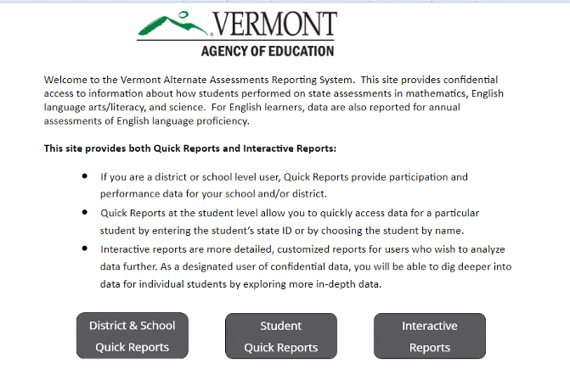
Performance Reports
There are three types of Performance Reports available in LENS:
District & School Quick Reports
Student Quick Reports
State Assessments Interactive Reports
The different reports can be printed and
exported to various formats, such as PDF
and Excel.
Notes:
SPEAKER NOTES
[read the slide]

Slide 6
User Access
District & School Quick Reports,
Student Quick Reports, Interactive Reports
All report data shows district usage.
District & School Quick Reports,
Student Quick Reports, Interactive Reports
All report data shows school usage.
District User
School User
Notes:
SPEAKER NOTES
There are two types of LENS user account access: District user and School user.
While both accounts have access to the same reports, district users see district usage data and school users see only school usage data.

Slide 7
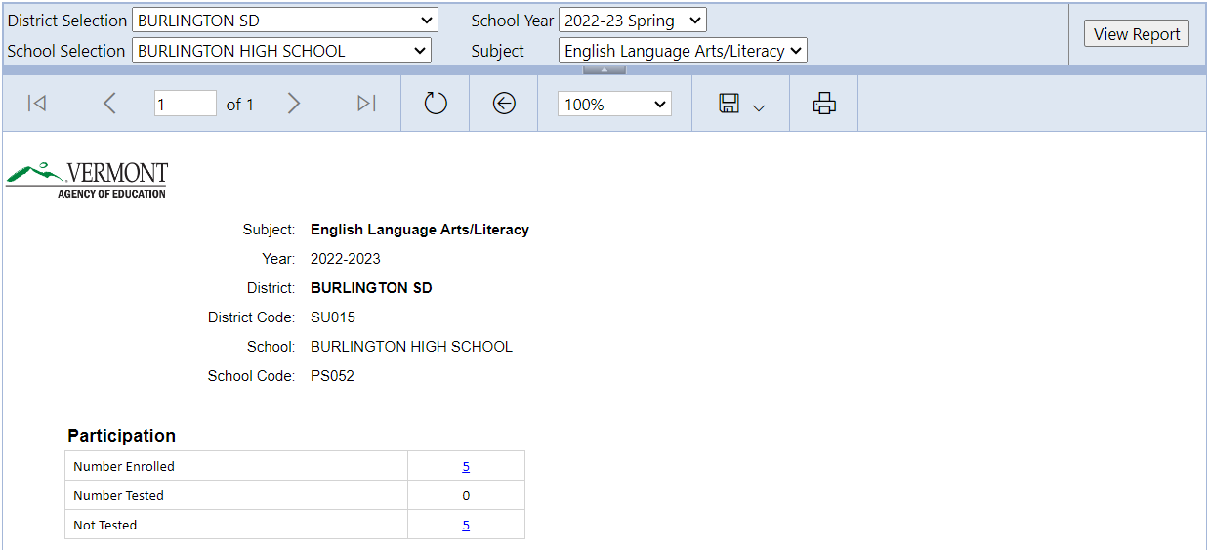
District and School Quick Reports
District users see data for all schools under their district. School users see data for their school only.
Provides participation and performance data for each school, district, and the state as a whole. These reports can be drilled down to a student roster list.
Notes:
SPEAKER NOTES
[read the slide]

Slide 8
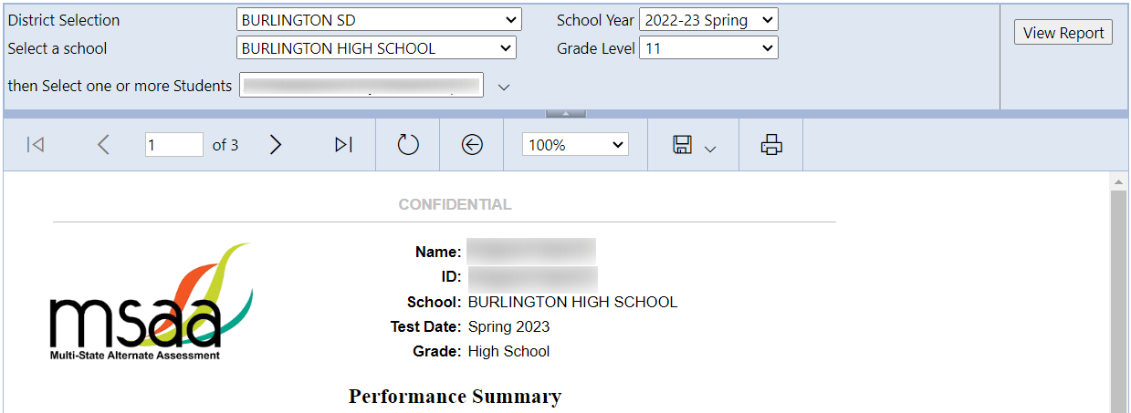
Student Quick Reports
District users see data for all students under their district. School users see data for all students under their school.
Provides quick access to individual student reports.
Notes:
SPEAKER NOTES
[read the slide]

Slide 9
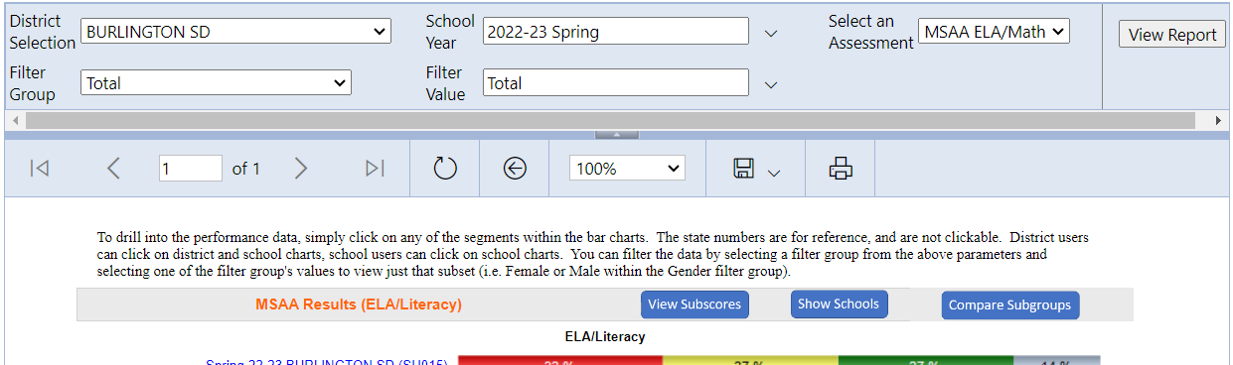
State Assessments Interactive Reports
District users see data for all schools under their district. School users see data for their school.
Provides access to interactive, drillable reports to allow the data to be analyzed more in-depth, such as by subscore and grade level. Also provides a comparison of the schools against the district and the state as a whole. These reports can be filtered and can be drilled down to a student roster list.
Notes:
SPEAKER NOTES
[read the slide]

Slide 10
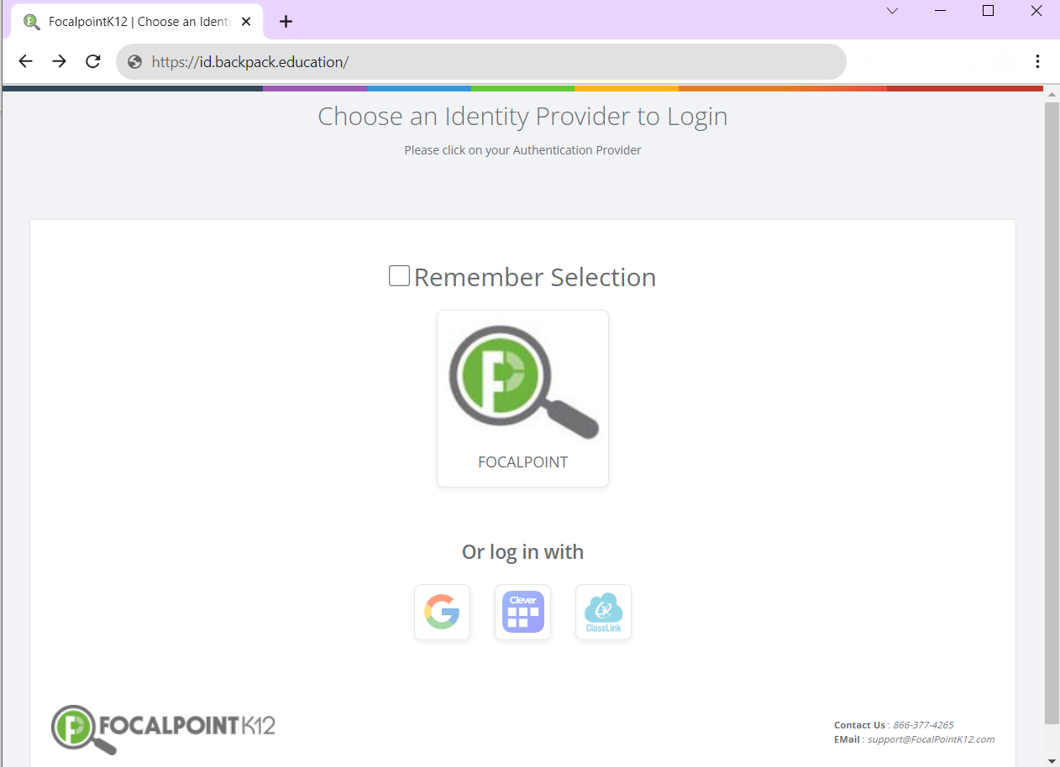

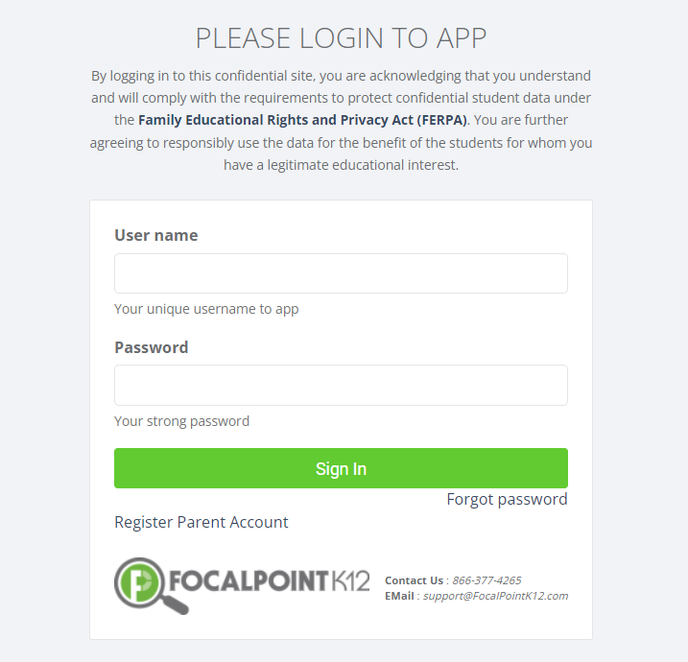
Logging in to LENS
URL: lms.backpack.education
Select the FOCALPOINT icon
Existing LENS users will use the same information as last
year. New LENS users will receive a system-generated
welcome email.
Enter your LENS username and password. Use the
Forgot password link if you need to reset your password.
Notes:
SPEAKER NOTES
To log in to LENS, open the LENS URL.
Select the FocalPoint icon.
Existing users will use the same information as last year to log in. New users will receive a system-generated welcome email with information on how to log in.
Enter your LENS username and password. Use the Forgot password link if you need to reset your password.

Slide 11
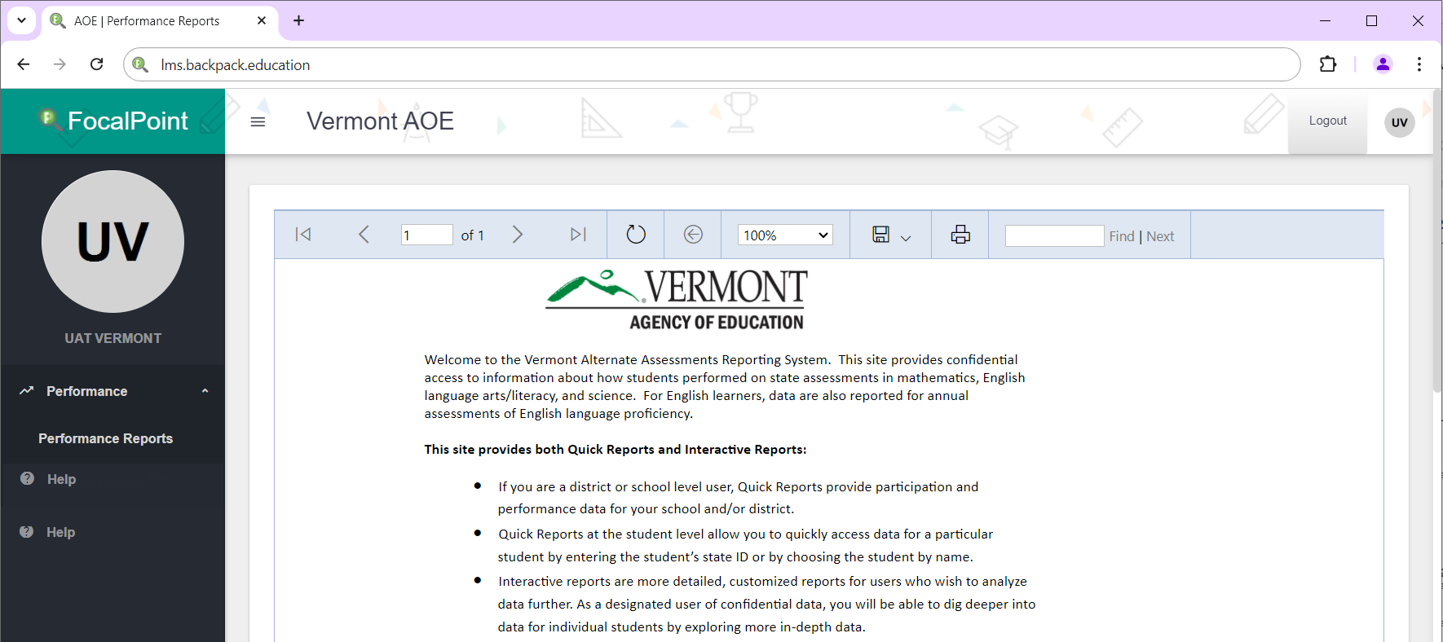

General Navigation
30-minute inactivity timeout
Users can change their LENS password from their profile.
Users can customize the layout, style, and color of their page view.
Use the back arrow within the LENS header when available to go back to the previous page. Do not use the browser back button.
Notes:
SPEAKER NOTES
[read the slide]
There is a 30-minute inactivity timeout. After logging in to LENS, once you have been inactive for 30 minutes, a warning popup will appear on the page and a 5-minute countdown will begin. If you do not have any activity before the timer hits zero, you will be logged out.

Slide 12
Live Demonstration
Notes:
SPEAKER NOTES
We are now going to a live demonstration of how to use the LENS Reporting platform.

Slide 13
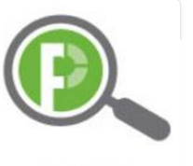
Support
Service Center
866.834.8879
MSAAServiceCenter@cognia.org
Help center
support.focalpointk12.com
Notes:
SPEAKER NOTES
The MSAA Service Center is available via phone and email to provide support.
The online Help Center is available as a resource for additional information and step-by-step instructions for using the LENS Reporting platform.

Slide 14
Thank You!
Notes:
SPEAKER NOTES
This concludes the LENS Reporting training for the Vermont Alternate Assessment. Thank you.

