Slide 1


LENS Reporting
Vermont Alternate Assessment (MSAA)

Slide 2
Agenda
User Access
MSAA Reporting Summary
Live Demonstration
General Navigation
Logging in to LENS
Reports
Support
VT-Alt LENS

Slide 3
MSAA Reporting Summary
Platform | Description
MSAA System | Used for administration and testing. The following static reports (*official reports) are available and contain data for the previous testing year: Data file (student results) – District | School Summary Reports – District | School Roster Reports – District | School Student Reports – School There is a 10-week window for Test Coordinators (TCs) to download their reports. Fast/quick access to mega zip files is available (covered in the MSAA Test Coordinator User Guide).
LENS | Provides access to dynamic reports that contain data for all previous testing years. Allows data filtering and aggregations. Specifically used by Vermont. LENS uses the FocalPoint platform and is available year-round.

Slide 4
VT-Alt LENS
VT-ALT LENS stands for the Vermont Alternate Assessments Reporting System.
LENS provides confidential access to information about how students performed on state alternate assessments in the following subjects and grades:
Mathematics: Grades 03–09
English Language Arts/Literacy: Grades 03–09
Science: Grades 05, 08 and 11

Slide 5
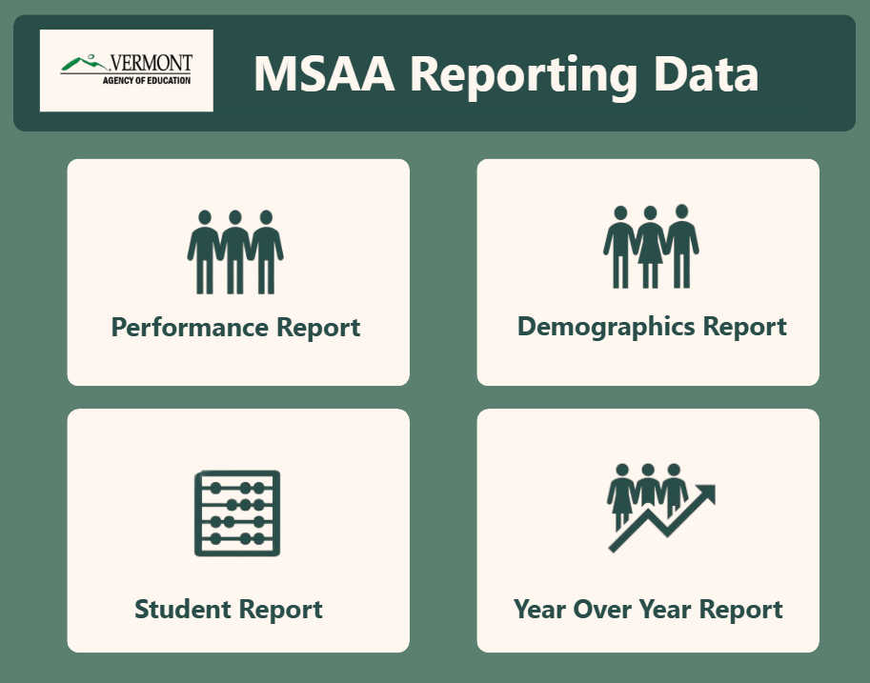
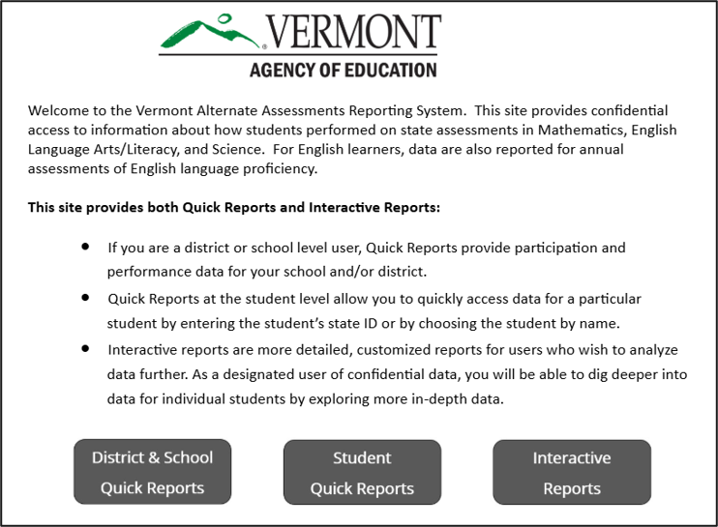
Reports
LENS offers two different views and sets of reports:
MSAA Dashboards (New view) | Performance Reports (Legacy view)
Available reports include: Performance Report Demographic Report Student Report Year Over Year Report | Available reports include: District & School Quick Reports Student Quick Reports Interactive Reports

Slide 6
User Access
District-level user
Access to report data for their district and schools.
School-level user
Access to report data for their school only.

Slide 7
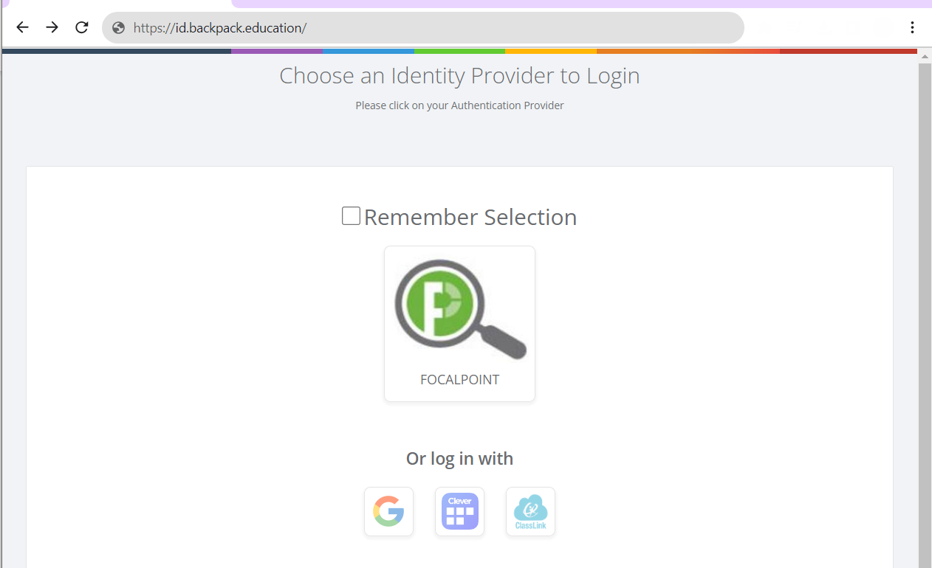
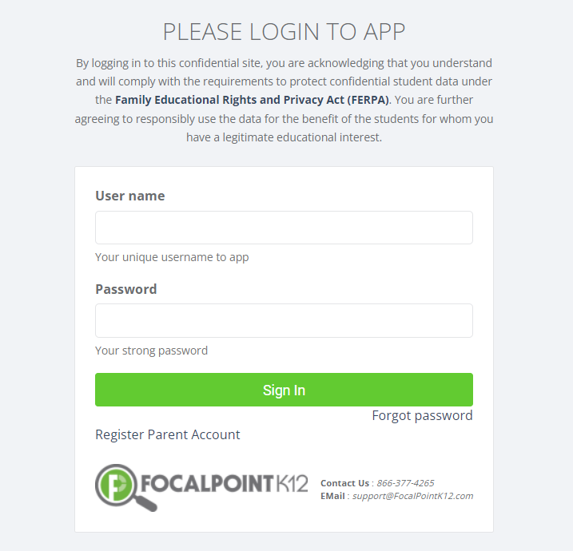
Logging in to LENS
1. Open the URL lms.backpack.education.
2. Select the FOCALPOINT icon.
Existing LENS users use the same information as last year. New LENS users will receive a system-generated welcome email.
3. Enter your LENS User name and Password.
(Click Forgot password if you need to reset your password.)

Slide 8

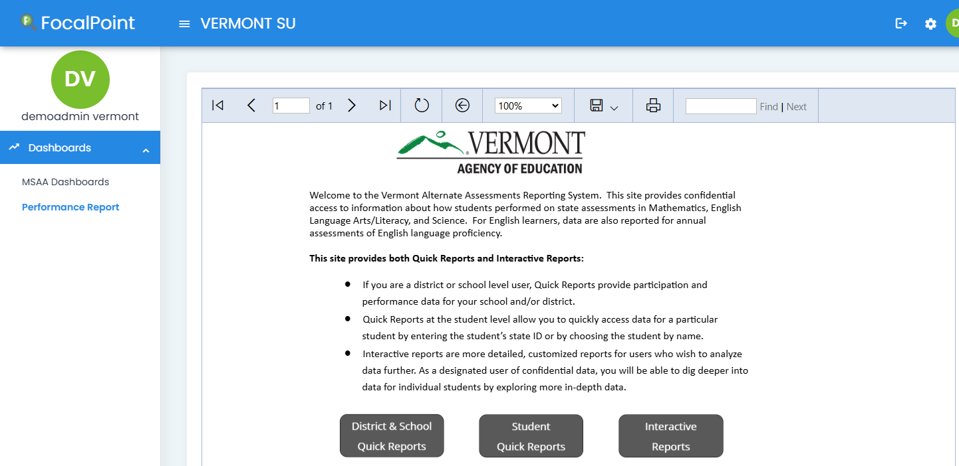
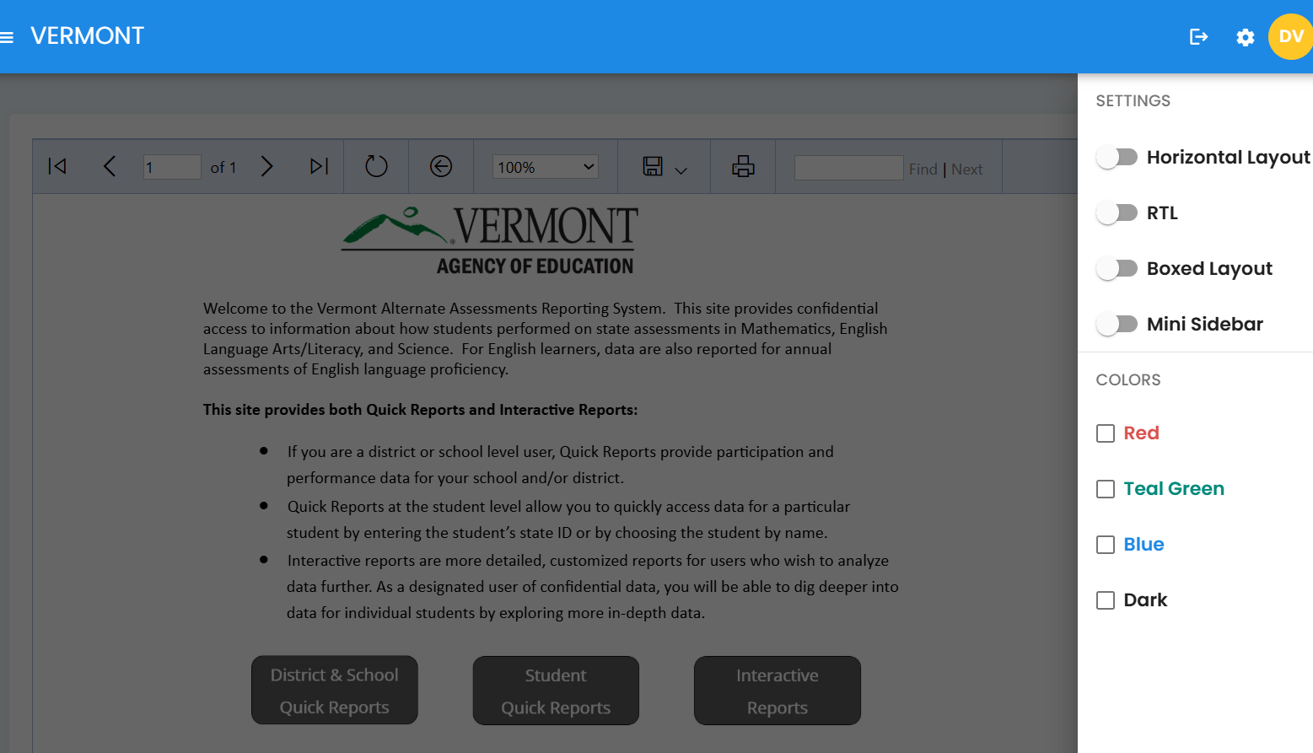
General Navigation
There is a 30-minute inactivity timeout.
Your password can be changed from your profile.
You can customize the layout, style, and color of your page view.
You must use the back arrow in the platform header when available
to return to the previous page. Do not use the browser back button.

Slide 9
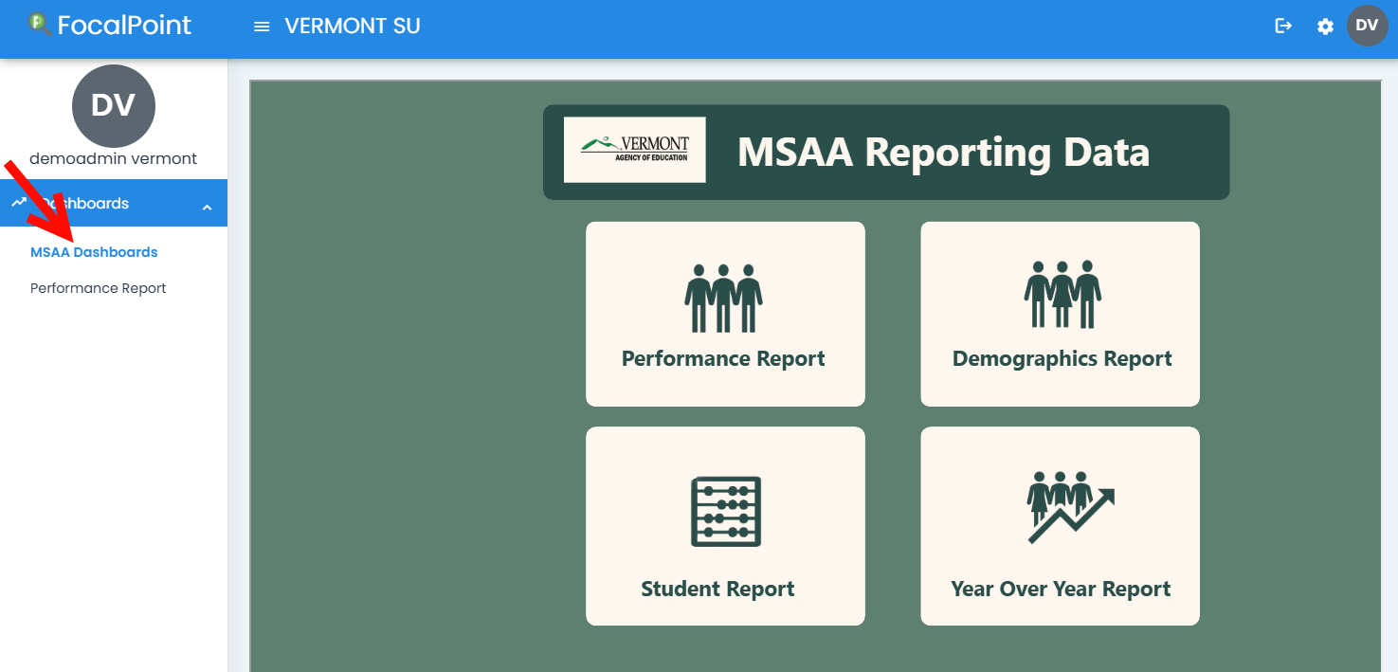
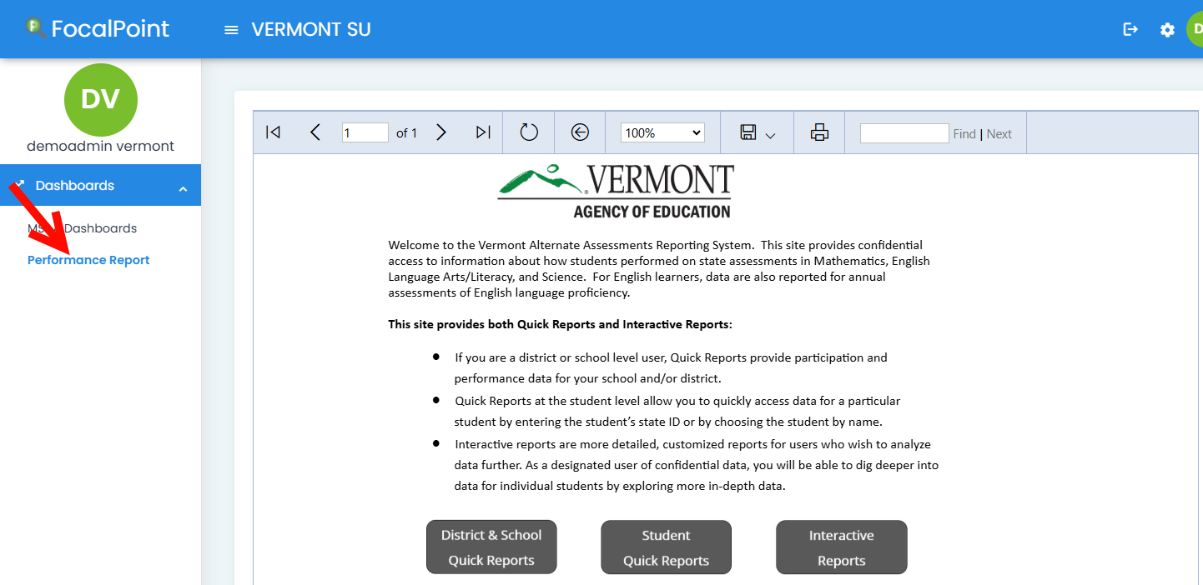
Report Dashboards
There are two types of report dashboards available in LENS:
MSAA Dashboards – Provides access to dynamic performance reports, demographic reports, student reports, and year over year reports. [NEW]
Performance Report – Provides access to district and school quick reports, student quick reports, and interactive reports.

Slide 10
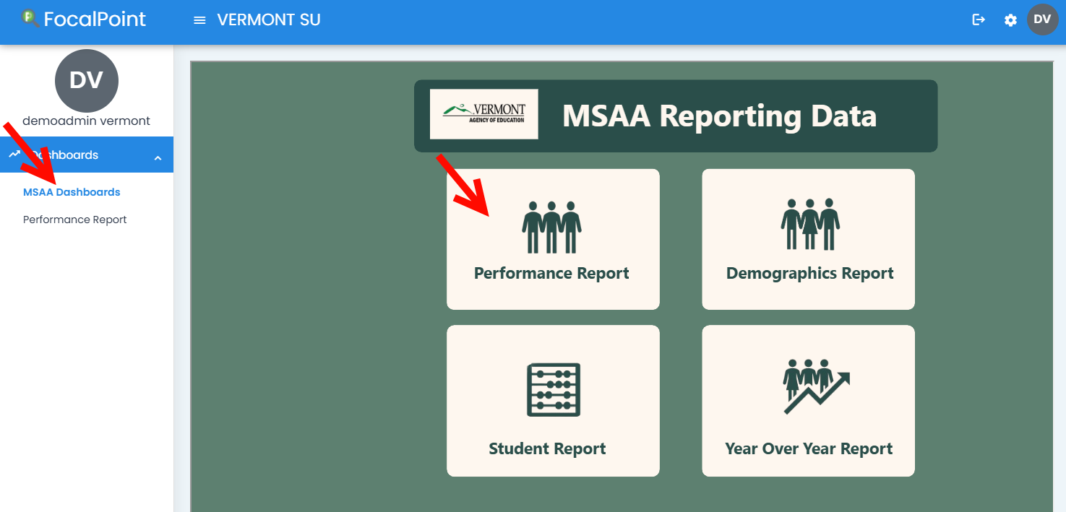
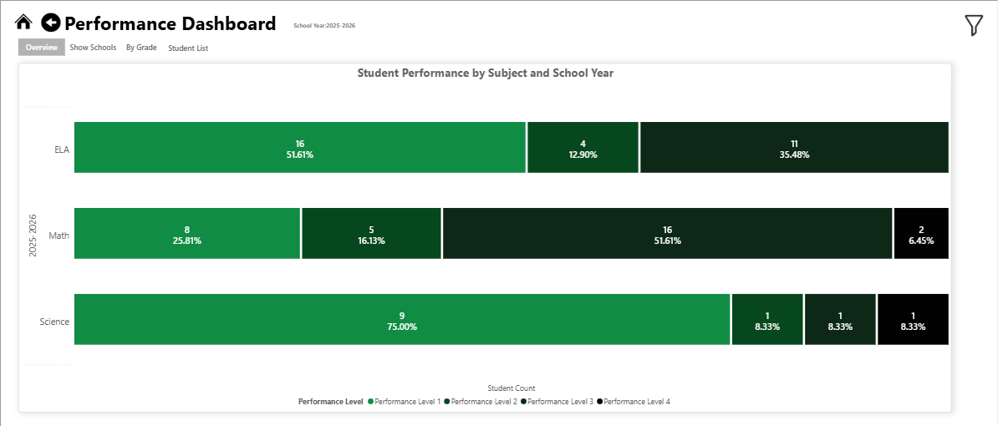
Performance Report (MSAA Dashboards)
The Performance Report is accessed from the new MSAA Dashboards.
This report provides student performance data by subject and school year, including a student performance list, with the option to filter results by school and school year, subject, and grade, and to further analyze the data by subscore and student group. The reports are also available for export.

Slide 11
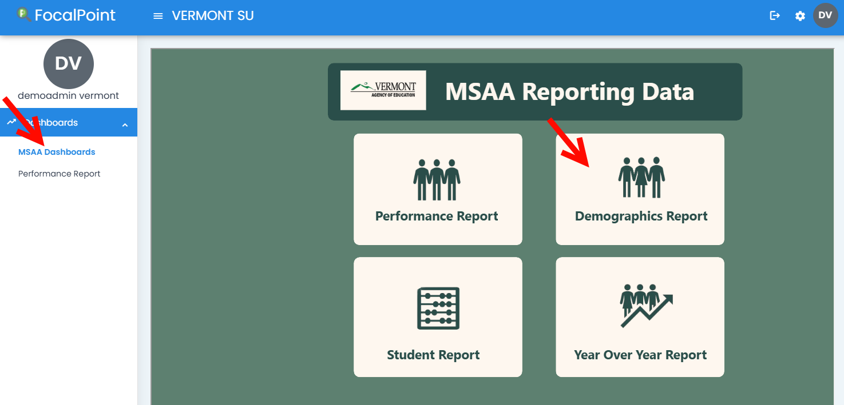
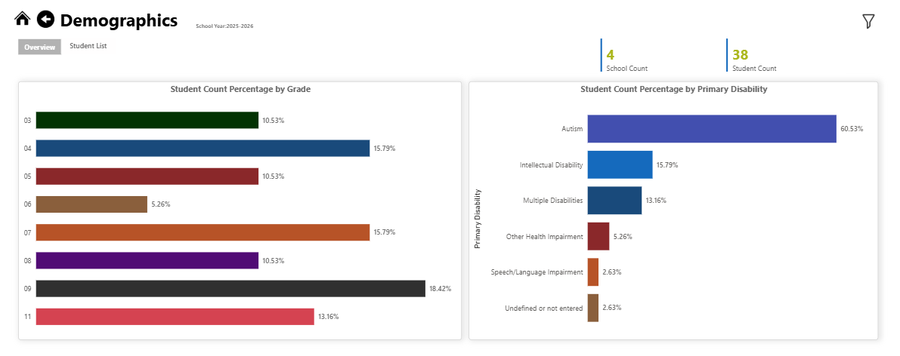
Demographics Report (MSAA Dashboards)
The Demographics Report is accessed from the new MSAA Dashboards.
This report provides student count percentage by grade and by disability status, with the option to filter results by school year, school, and subject. The reports are also available for export.

Slide 12
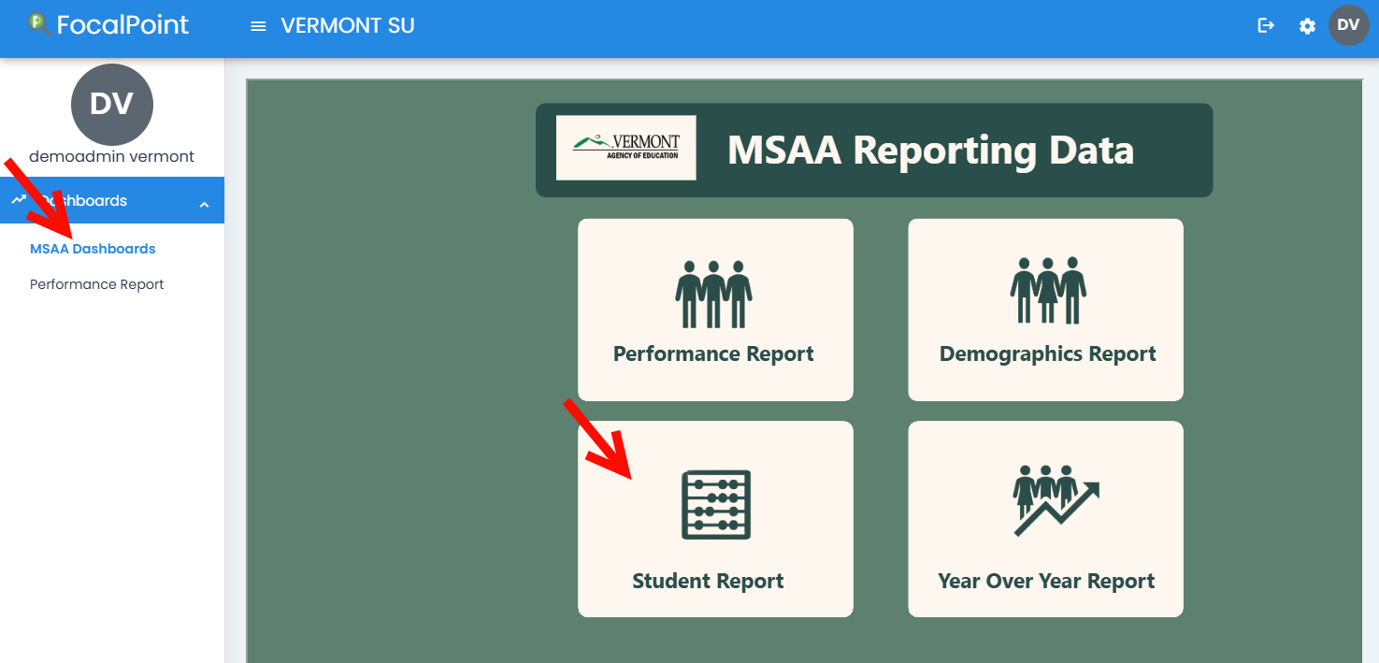
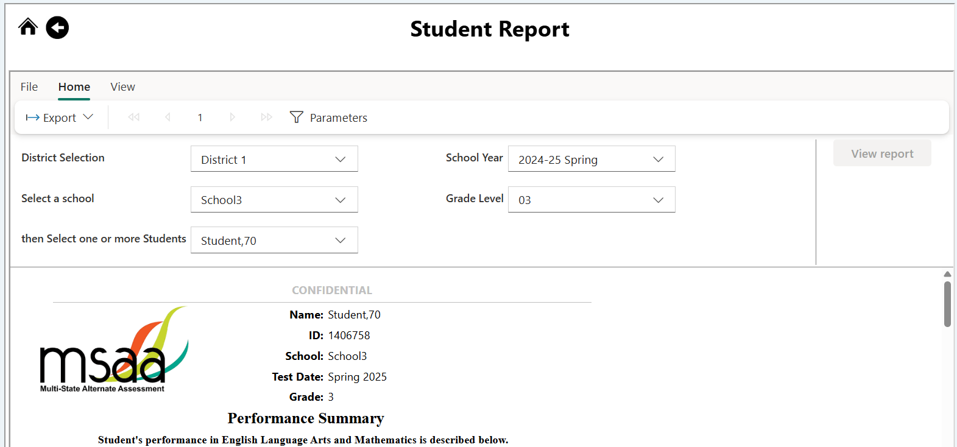
Student Report (MSAA Dashboards)
The Student Report is accessed from the new MSAA Dashboards.
This report provides access to individual student reports (ISRs). The reports are also available for export.

Slide 13
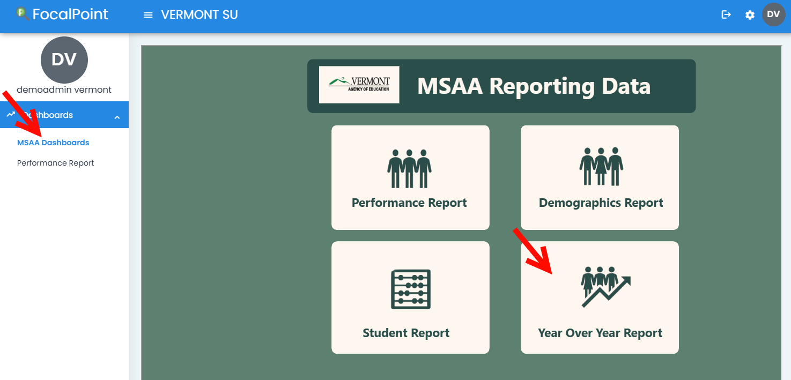
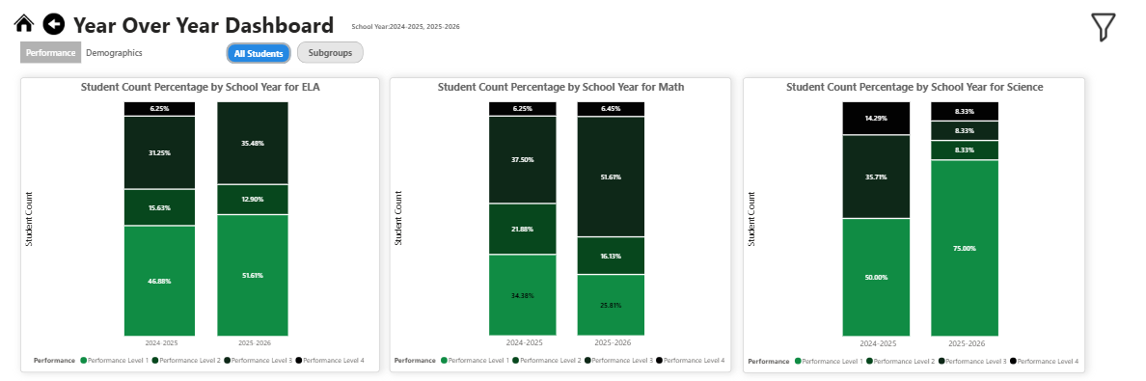
Year Over Year Report (MSAA Dashboards)
The Year Over Year Report is accessed from the new MSAA Dashboards.
This report provides longitudinal student performance data with student count percentages by school year and subject, including breakdowns by grade and primary disability, with the option to filter results by subgroup, school year, and school. The reports are also available for export.

Slide 14
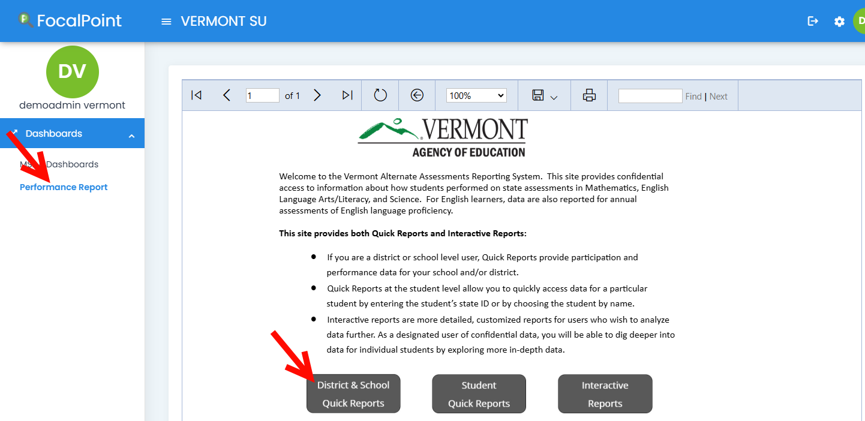
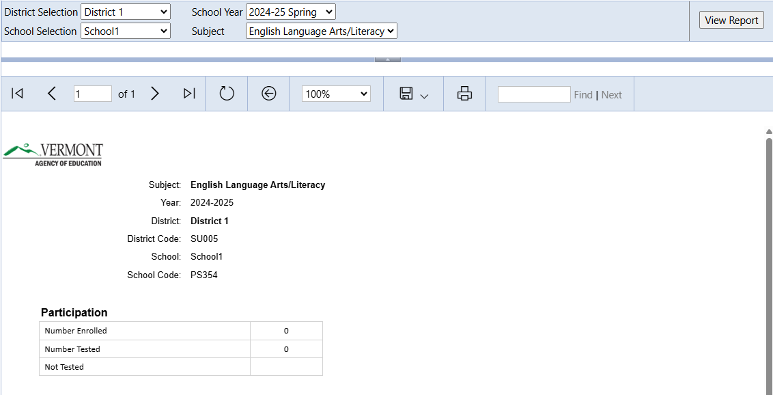
District and School Quick Reports
District and School Quick Reports are accessed from the existing Performance Report dashboard.
These quick reports provide participation and performance data at the school, district, and state levels, with the option to filter results by individual student roster lists. The reports are also available for export.

Slide 15

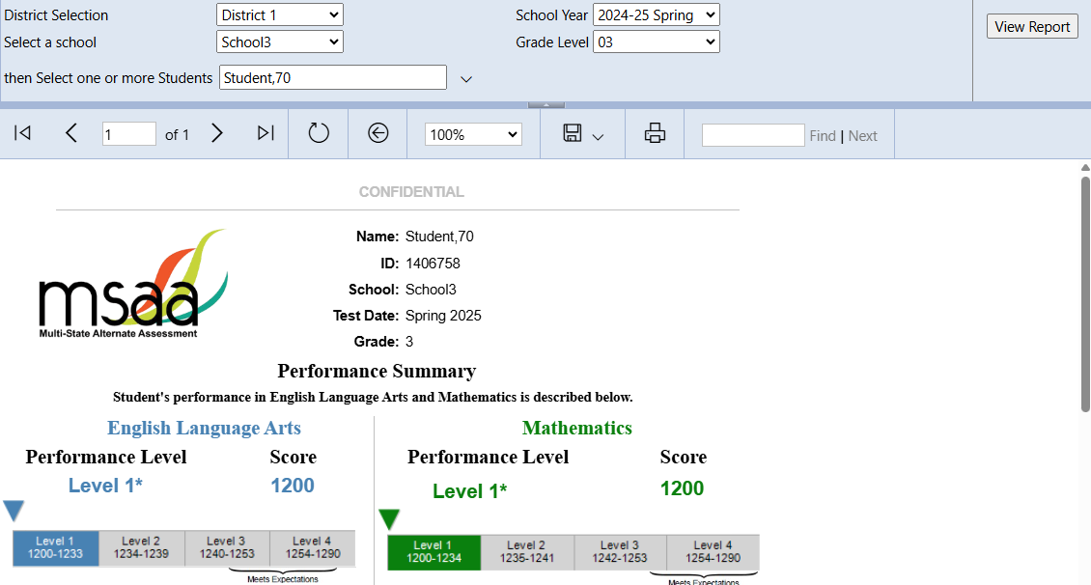
Student Quick Reports
Student Quick Reports are accessed from the existing Performance Report dashboard. These quick reports provide access to individual student reports (ISRs). The reports are also available for export.

Slide 16
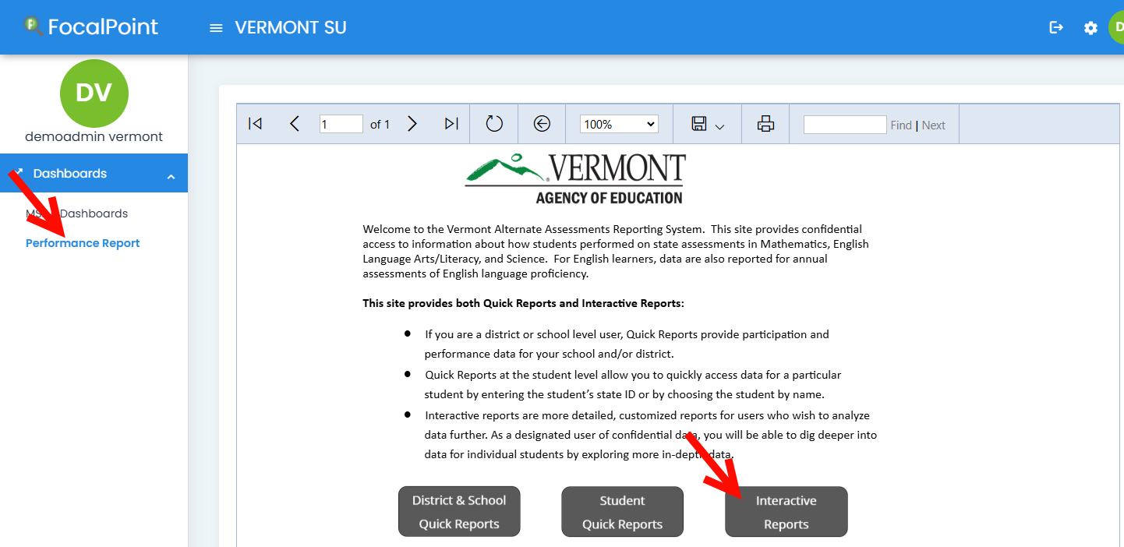
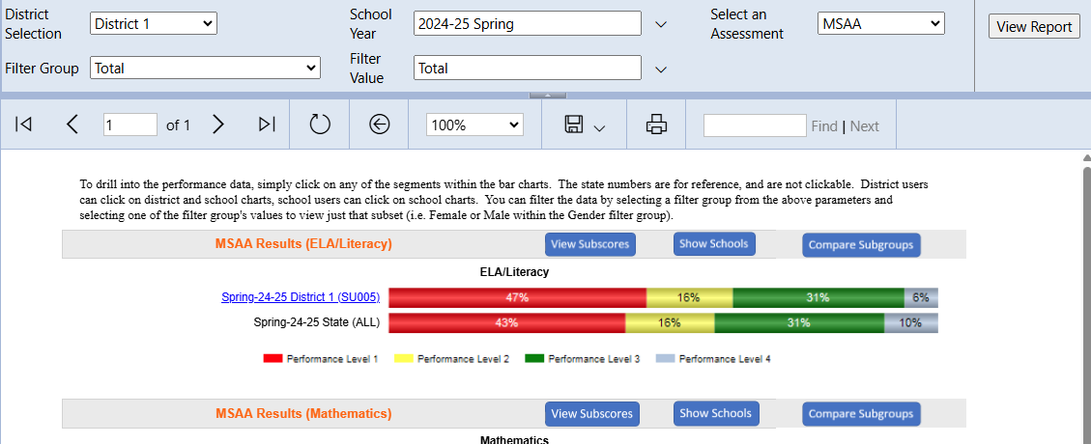
Interactive Reports
Interactive reports are accessed from the existing Performance Report dashboard.
These reports provide data that enable a more comprehensive analysis, including breakdowns by grade and subscore. They also enable comparisons of schools against the district and state, with the option to filter results by individual student roster lists. The reports are also available for export.

Slide 17
Live Demonstration

Slide 18

Support
Service Center
866.834.8879
MSAAServiceCenter@cognia.org
Help center
support.focalpointk12.com

Slide 19
Thank You!

